Slide 1

Life-Span Human Development, 10e
Chapter 12: Social Cognition and Moral Development
©2022 Cengage Learning. All Rights Reserved. May not be scanned, copied or duplicated, or posted to a publicly accessible website, in whole or in part.
Notes:
Add slide notes here

Slide 2
Icebreaker
The class will be broken up into pairs of students.
Each pair of students will discuss how they think morality develops across the lifespan.
Students will share their answers with the class for an open discussion.

Slide 3
Learning Objectives (1 of 5)
By the end of this chapter, you should be able to:
12.1 Define social cognition and explain the meaning and significance of having a theory of mind.
12.2 Summarize key steps in the development of a theory of mind and the contributions of nature and nurture to this development.
12.3 Describe developments in trait perception and perspective taking and explain how well social cognitive skills hold up in later life.
12.4 Define and illustrate the three main components of morality.

Slide 4
Learning Objectives (2 of 5)
By the end of this chapter, you should be able to:
12.5 Compare and contrast the main messages about moral development of psychoanalytic, cognitive-developmental, social learning, and evolutionary theorists.
12.6 Distinguish between Kohlberg’s preconventional, conventional, and postconventional levels of moral reasoning.
12.7 Summarize evidence that infants are capable of empathy and prosocial behavior.
12.8 Describe antisocial behavior in infancy and how it differs from that of older children.

Slide 5
Learning Objectives (3 of 5)
By the end of this chapter, you should be able to:
12.9 Explain how parents can help their infants develop a conscience.
12.10 Discuss key ways in which children are more morally sophisticated than Piaget and Kohl-berg believed.
12.11 Summarize an optimal approach to socializing morality in childhood.
12.12 Describe the significance of developing a moral identity and of changes in moral reasoning during adolescence.

Slide 6
Learning Objectives (4 of 5)
By the end of this chapter, you should be able to:
12.13 Compare early onset and late onset forms of antisocial behavior.
12.14 Compare how Kenneth Dodge and Gerald Patterson account for the behavior of aggressive youth.
12.15 Explain the roles of nature and nurture in aggression and what has been learned about pre-venting and treating it.
12.16 Summarize changes in moral reasoning over the adult years.

Slide 7
Learning Objectives (5 of 5)
By the end of this chapter, you should be able to:
12.17 Analyze the limitations of Kohlberg’s theory of moral development with reference to cultural differences in moral thinking and dual-process models of moral decision making.
12.18 Distinguish between religiosity and spirituality and discuss their development and relation-ships to adjustment.

Slide 8
12.1 Social Cognition

Slide 9
Social Cognition
Social cognition
Thinking about the perceptions, thoughts, emotions, motives, and behaviors of self, other people, groups, and even whole social systems
Ability to understand human psychology, describe other people, and adopt other people’s perspectives

Slide 10
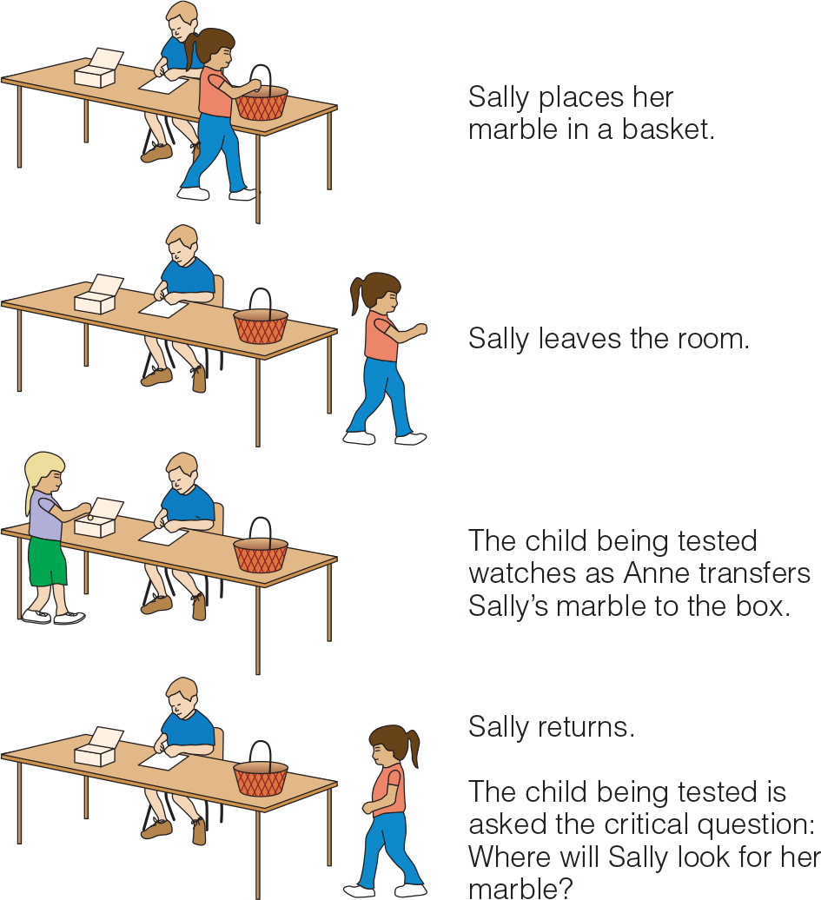
Developing a Theory of Mind (1 of 3)
A false belief task assesses the understanding that:
People can hold incorrect beliefs
These beliefs, even though incorrect, can influence their behavior
Theory of mind
Understanding that people have mental states such as desires, beliefs, and intentions and that these mental states guide their behavior

Slide 11
Developing a Theory of Mind (2 of 3)
85% of four-year-olds of average intelligence and older children with Down Syndrome passed the false belief task
80% of the children with autism failed
Children with autism may display social deficits because they lack a theory of mind
Have “mind blindness”

Slide 12
Developing a Theory of Mind (3 of 3)
Abilities considered important early steps in developing a theory of mind
Joint attention
Understanding intentions
Pretend play
Imitation
Emotional understanding
Implicit theory of mind
* Most of these skills are deficient in children with autism

Slide 13
Desire and Belief-Desire Psychologists
Wellman proposed children’s theory of mind develops in two phases
Desire psychology
Belief-desire psychology
Late elementary school
Children grasp that different minds construct different views of reality
Their interpretations of events are influenced by these views

Slide 14
Nature and Nurture (1 of 2)
Chimpanzees, gorillas, and other great apes share with humans some basic theory-of-mind skills
Developing a theory of mind requires a certain level of neurological and cognitive maturation
“Social brain”, a network of areas in the brain that specializes in thinking about the social world of self and others
Mirror neurons involved in theory of mind
Neurons that are activated both when we perform an action and when we observe someone else perform the same action

Slide 15
Milestones in the Development of Theory of Mind
Age | Achievements
Birth to 2 | Joint attention, understanding of intentions, pretend play, imitation, emotional understanding
Age 2 | Desire psychology
Age 4 | Belief–desire psychology
Age 5 and beyond | Understanding of second-order beliefs, sarcasm, different views of reality

Slide 16
Social Interaction
Children do not construct theory of mind on their own instead they construct them jointly with others during:
Language experience
Parent mental state talk
Interactions with siblings and peers
Cultural differences

Slide 17
Trait Perception
Young children perceive others in terms of their physical appearance, possessions, and activities
Age seven or eight
Children’s descriptions of people show that they think about others in terms of their enduring psychological traits
Adolescents see people as unique individuals with distinctive personality traits
They create more integrated personality profiles, analyzing how an individual’s inconsistent traits fit together to make sense as a whole personality

Slide 18
Perspective Taking
Another important aspect of social cognitive development
Outgrowing egocentrism and developing perspective-taking skills
Ability to adopt another person’s perspective and understand her thoughts and feelings
By age 8 to 10, children appreciate that two people can have different points of view
By age 12, they become capable of mentally juggling multiple perspectives

Slide 19
Social Cognition in Adulthood (1 of 2)
Social cognitive skills continue to improve after adolescence
Elderly people continue to display the sophisticated social cognitive skills
When elderly adults do show declines:
They are due to declines in fluid intelligence, executive control processes, information processing speed, and memory

Slide 20
Social Cognition in Adulthood (2 of 2)
Social cognitive skills hold up better than other nonsocial cognitive skills
Areas of the cortex that support social cognition and emotional understanding age more slowly
People use these abilities each day
They do not need to use mentally taxing cognitive processes

Slide 21
Knowledge Check 1
Leah understands the just because she likes toy trucks her friend may like something else, such as dolls. This understanding represents
a false belief task
theory of mind
mind blindness
joint attention

Slide 22
Knowledge Check 1: Answer
Leah understands the just because she likes toy trucks her friend may like something else, such as dolls. This understanding represents
Answer: B. Theory of mind
A theory of mind is the understanding that (a) people have mental states such as desires, beliefs, and intentions and that (b) these mental states guide (and help explain) their behavior.

Slide 23
12.2 Perspectives on Moral Development

Slide 24
Poll 1
Which of the following is not an aspect of morality?
Emotionality
Spirituality
Behavioral
cognitive

Slide 25
Perspectives on Moral Development
Three basic components of morality
Emotional component
Feelings regarding right or wrong actions that motivate moral thoughts
Cognitive component
How we think about right and wrong and make decisions about how to behave
Behavioral component
How we behave when we experience the temptation to cheat or are called upon to help a needy person

Slide 26
Moral Reasoning: Cognitive-Developmental Theory
Cognitive-developmental theorists study morality via development of moral reasoning
Thinking process is involved in deciding whether an act is right or wrong
Moral development is assumed to depend on social cognitive development
Moral reasoning is said to progress through universal stages

Slide 27
Kohlberg’s Stages of Moral Reasoning (1 of 3)
Moral growth progresses through three broad moral levels
Preconventional morality: rules are external to the self rather than internalized
Stage 1: Punishment-and-Obedience Orientation
The goodness or badness of an act depends on its consequences
Stage 2: Instrumental Hedonism
A person at the second stage of moral development conforms to rules to gain rewards or satisfy personal needs

Slide 28
Kohlberg’s Stages of Moral Reasoning (2 of 3)
Conventional morality: individual has internalized various moral values
Stage 3: “Good Boy” or “Good Girl” Morality
What is right is now what pleases, helps, or is approved by others. People are often judged by their intentions.
Stage 4: Authority and Social Order-Maintaining Morality
Now what is right is what conforms to the rules of legitimate authorities and is good for society as a whole.

Slide 29
Kohlberg’s Stages of Moral Reasoning (3 of 3)
Postconventional morality: individual defines what is right in terms of broad principles of justice.
Stage 5: Morality of Contract, Individual Rights, and Democratically Accepted Law
There is an understanding of the underlying purpose of laws, concern that rules should be arrived through a democratic consensus
Stage 6: Morality of Individual Principles of Conscience
Individual defines right and wrong on the basis of self-generated principles

Slide 30
Moral Emotion: Psychoanalytic Theory and Beyond (1 of 2)
Moral Reasoning: the thinking process involved in deciding whether an act is right or wrong
Empathy
Vicarious experiencing of another person’s feelings
Important for moral development
Can motivate prosocial behavior
Positive social acts
Keep us from engaging in antisocial behavior

Slide 31
Moral Emotion: Psychoanalytic Theory and Beyond (2 of 2)
Moral emotions motivate moral behavior
Early relationships with parents to moral development
Children must internalize moral standards to behave morally even when no authority figure is present
Prosocial behavior: positive social acts, that reflect concern for the welfare of others
Antisocial behavior: behavior that violates social norms, rules, laws, etc

Slide 32
Moral Behavior: Social Learning Theory (1 of 2)
Social learning theorists interested in behavioral component of morality
Moral behavior learned through observational learning and reinforcement and punishment principles
Moral behavior influenced by situational factors

Slide 33
Moral Behavior: Social Learning Theory (2 of 2)
Moral cognition is linked to moral action through self-regulatory mechanisms
Involve monitoring and evaluating our own actions
Moral disengagement
Allows us to avoid condemning ourselves when we engage in immoral behavior, even though we know the difference between right and wrong

Slide 34
Roots of Morality: Evolutionary Theory
Evolutionary theorists focus on:
How moral emotion, thought, and behavior may have helped humans adapt to their environments over the course of evolution
Our genetic self-interest to act altruistically toward kin
Pass on our genes

Slide 35
12.3 The Infant

Slide 36
Empathy, Prosocial Behavior, and Morality (1 of 3)
Newborns display a primitive form of empathy
Distressed by other infant’s cries
By age one to two
Become capable of truer form of empathy
Try to comfort individuals in distress, in ways that would comfort themselves
By age two to three
Ability to take the perspective of the friend

Slide 37
Empathy, Prosocial Behavior, and Morality (2 of 3)
Research has found prosocial acts by toddlers
Helping
Fourteen-month-old infants spontaneously help adults
Cooperation
Fourteen-month-old infants participate in cooperative games
Altruistic rather than selfish motivations
Before age two, show greater happiness when they give treats to appreciative puppet, than when they receive them

Slide 38
Empathy, Prosocial Behavior, and Morality (3 of 3)
A sense of fairness
* Fifteen-month-old infants recognize fairness and unfairness when they see it
Moral judgements
* Infants clearly distinguish between and have quite different feelings toward good guys and bad guys

Slide 39
Antisocial Behavior
Richard Tremblay proposes that humans:
Do not need to learn to be aggressive
Need to learn how not to be aggressive
Frequency of aggression normally rises from infancy to a peak around age four or five and then decreases

Slide 40
Early Moral Training (1 of 2)
Kochanska has studied development of conscience, which involves mastering two components:
Moral emotions
Associating negative emotions with violating rules and learning to empathize with people who are in distress
Self-control
Being able to inhibit one’s impulses when tempted to violate internalized rules
By age 18-24 months, toddlers show visible signs of emotional distress or guilt when breaking toys

Slide 41
Early Moral Training (2 of 2)
How can parents help children develop moral emotions, self-control, and a strong conscience?
By forming a secure parent-infant attachment
By establishing a mutually responsive orientation for caregiver and child
Close, emotionally positive, and cooperative relationship in which child and caregiver care about each other

Slide 42
Discussion
How can parents and other caregivers begin to foster prosocial behaviors during infancy?

Slide 43
12.4 The Child

Slide 44
Moral Understandings (1 of 3)
Piaget and Kohlberg believed that:
Young children were primarily focused on the consequences of acts
However, even three-year-olds can take both intentions and consequences into account
By age four:
Children’s moral thinking becomes more sophisticated
They have the basics of a theory of mind
Distinguish between different kinds of rules

Slide 45
Moral Understandings (2 of 3)
Children who pass theory-of-mind tasks are:
More forgiving when a wrong is committed accidentally
Better able to distinguish between lying and having one’s facts wrong
More attuned to other people’s feelings and welfare

Slide 46
Moral Understandings (3 of 3)
Children distinguish between different kinds of rules
Moral rules:
Standards that focus on the welfare and basic rights of individuals
Only moral rules as absolute, sacred, and unchangeable
Social-conventional rules:
Standards determined by social consensus that tell us what is appropriate in particular social settings

Slide 47
Upholding Norms (1 of 2)
Fairness
Infants seem to have a sense of fairness, expecting goods to be shared equally between 2 people
Five-year-olds often use an equality rule regardless of the context
Children ages nine through thirteen develop more elaborations on ideas of fairness and justice

Slide 48
Upholding Norms (2 of 2)
Self Control
Crucial for the development of a conscience
Only about 30% of four-year-olds are able to delay gratification
As adolescents those who delayed gratification as children were judged by their parents to be academically and socially competent, and scored higher on SAT exams
Effects on environment regarding delay of gratification and self control are evident, rooted in both temperament and culture

Slide 49
Moral Socialization (1 of 2)
Proactive parenting strategies
Tactics designed to prevent misbehavior, reducing the need for discipline
Approaches to discipline
Love withdrawal
Power assertion
Induction (best strategy to foster moral development)
More often positively associated with children’s moral maturity
Invokes empathy

Slide 50
Moral Socialization (2 of 2)
Kochanska’s research shows that children are likely to be easiest to socialize if they are:
By temperament fearful or inhibited
Likely to experience guilt when they do wrong
Avoid distress in the future
Capable of effortful control
Are able to inhibit their urges to engage in wrongdoing

Slide 51
Knowledge Check 2
Which disciplinary strategy is the best strategy to foster moral development in children?
Love withdrawal
Power assertion
Induction
Time-out

Slide 52
Knowledge Check 2: Answer
Which disciplinary strategy is the best strategy to foster moral development in children?
Answer: C. Induction.
Induction is explaining to a child why the behavior is wrong and should be changed by emphasizing how it affects other people.

Slide 53
12.5 The Adolescent

Slide 54
Moral Identity
Adolescents who develop a sense of moral identity tend to be:
More capable of advanced moral reasoning
Able to translate moral values into moral action
Development of moral identity:
Can be fostered by parents
Induction and occasional disappointment
Fostered via involvement in community service

Slide 55
Changes in Moral Reasoning (1 of 2)
10-year-olds
Preconventional reasoning
Teen years
Conventional reasoning dominant mode of moral thinking
Adulthood
Postconventional reasoning, if it emerges at all

Slide 56
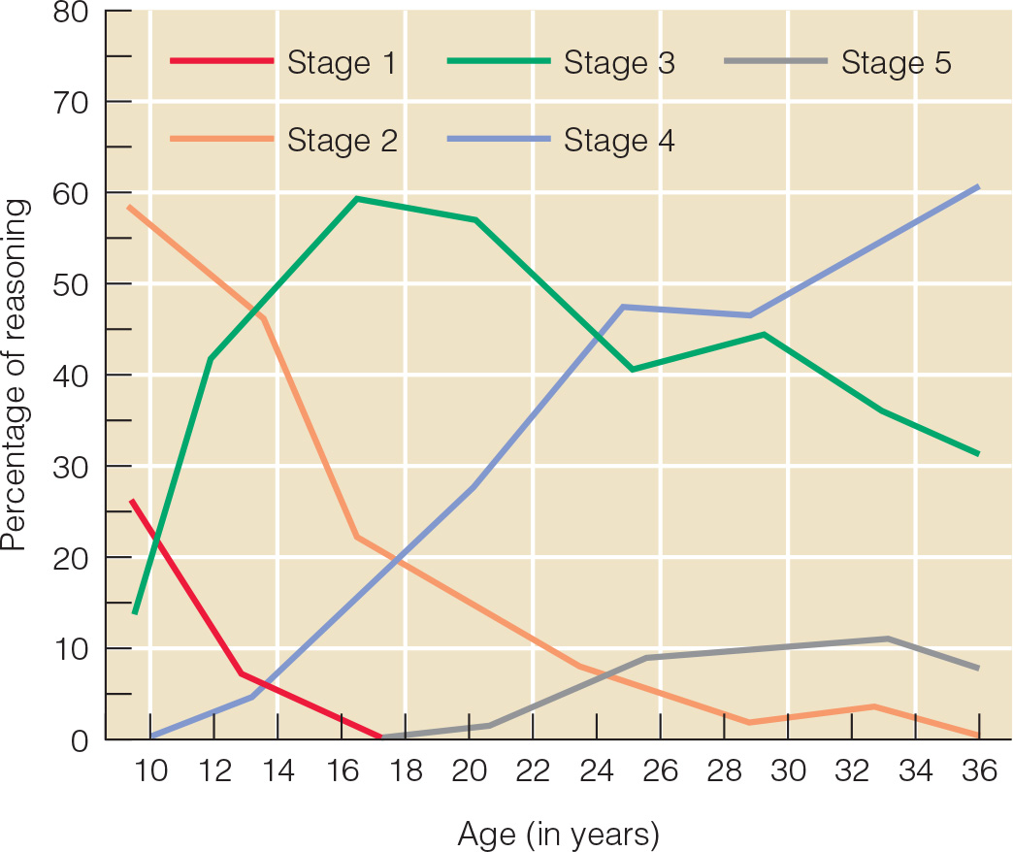
Changes in Moral Reasoning (2 of 2)
Notes:
Figure 13.2 Average percentage of moral reasoning at each of Lawrence Kohlberg’s stages for males from age 10 to age 36.

Slide 57
Antisocial Behavior (1 of 5)
Juvenile delinquency
Law breaking by a minor
Some diagnosed with conduct disorder
Persistent pattern of violating the rights of others or age-appropriate societal norms
Fighting
Bullying
Cruelty

Slide 58
Antisocial Behavior (2 of 5)
Two subgroups of antisocial youths
Early-onset, seriously disturbed group that is recognizable in childhood
Hurting others and/or animals
Persistently antisocial across lifespan
Later-onset, less seriously antisocial group that behaves more antisocially during adolescence
Outgrows behavior by early adulthood

Slide 59
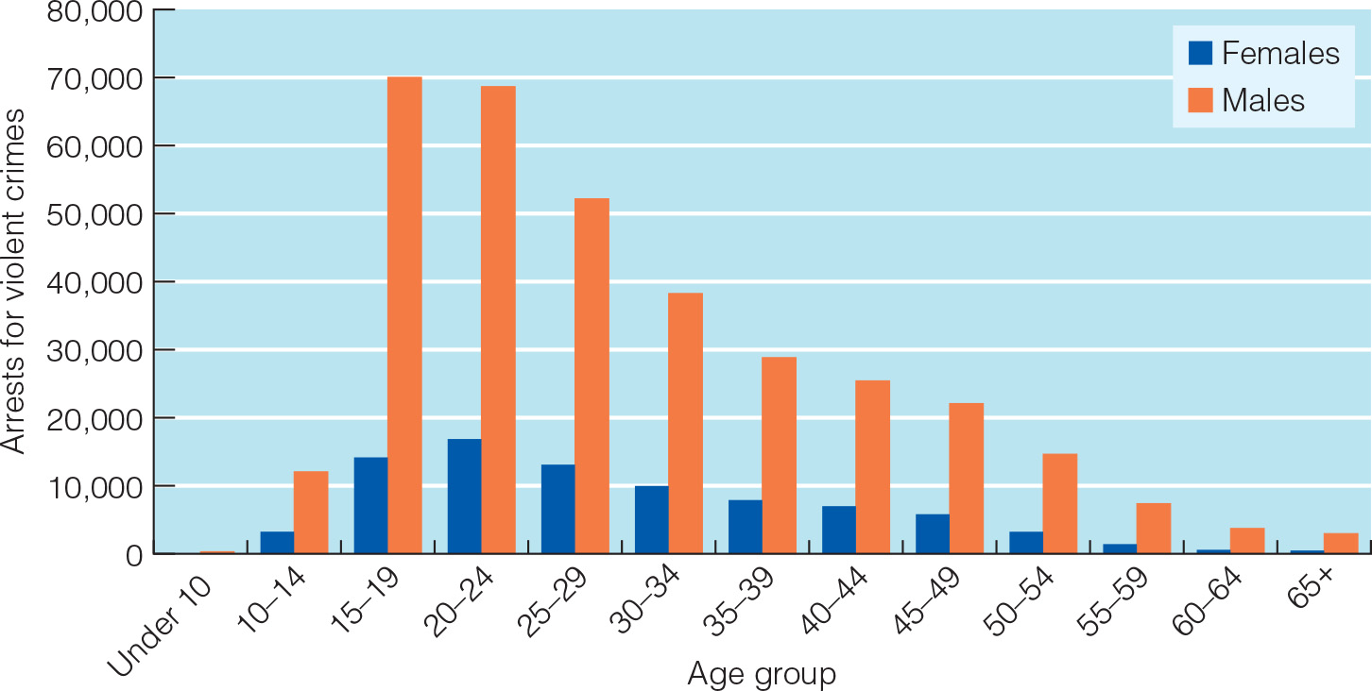
Violent Crime Among Males and Females
Notes:
Figure 13.3 Arrests for violent crimes by males and females of different ages in the United States, 2010.

Slide 60
Antisocial Behavior (3 of 5)
Dodge’s social information-processing model of aggressive behavior
Our reactions to frustration, anger, or provocation depend on the ways in which we process and interpret cues in situations
Aggressive youth develop a hostile attribution bias

Slide 61
Antisocial Behavior (4 of 5)
Patterson’s coercive family environments
Highly antisocial children and adolescents:
Often grow up in coercive cycle based family environments
Family members are locked in power struggles
Trying to control the others through negative, coercive tactics

Slide 62
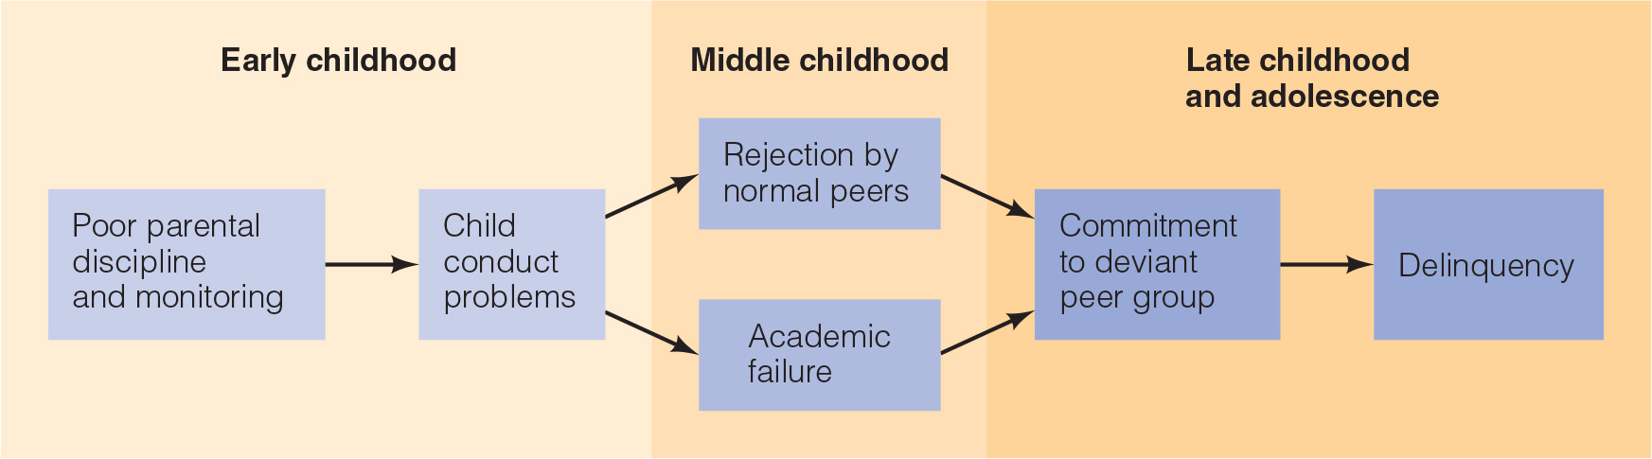
Antisocial Behavior (5 of 5)
Notes:
Figure 13.4 Gerald Patterson’s model of the development of antisocial behavior

Slide 63
Nature and Nurture (2 of 2)
Roles of genetic endowment in aggression
Some individuals are more genetically predisposed to develop aggressive, delinquent, and criminal behavior
Gene-environment correlation towards aggression and antisocial behavior
Epigenetic Effects
harsh parenting and other stressful early experiences play a role in aggressive behavior

Slide 64
Discussion
How could moral development during adolescence be connected with identity development?

Slide 65
12.6 The Adult

Slide 66
Changes in Moral Reasoning
Most studies find no major age differences in complexity of moral reasoning
Kohlberg’s theory
Children think about hypothetical moral dilemmas primarily in a preconventional manner
Adolescents adopt a conventional mode of moral reasoning
Minority of adults shift to a postconventional perspective

Slide 67
Culture and Morality
Results in cross-cultural studies
Postconventional moral reasoning emerges in Western democracies
People in collectivistic cultures:
Stage 3 conventional moral thinkers
Sophisticated concepts of justice that focus on the individual’s duty to the group

Slide 68
Three Different Ethics
Inform moral thinking around the world and that the balance of them differs from culture to culture
Cultural-developmental perspective on morality
Ethic of Autonomy: concern with individual rights and not harming or violating the rights of others
Ethic of Community: emphasis on duty, loyalty, and concern for the welfare of family members and larger social group
Ethic of Divinity: emphasis on divine law or authority, individual is to follow God’s laws and strive for spiritual purity

Slide 69
Moral Intuition and Emotion
Greene has proposed the dual-process model of morality
Both deliberate thought and intuition/emotion play distinct roles
Explain why we sometimes make judgments based on quick, emotion-based intuitions
Other times make judgments using more deliberative cognitive processes
Use different parts of the brain to make intuitive and deliberative moral decisions

Slide 70
Predicting Moral Action
Kohlberg’s stage theory
Underestimates children’s moral sophistication
Fails to recognize cultural differences in thinking about morality
Neglects intuition/emotion
Says too little about the many influences besides moral reasoning on moral behavior

Slide 71
Religion and Spirituality (1 of 2)
Religiousness
Sharing the beliefs and participating in the practices of an organized religion
Spirituality
Involves a quest for ultimate meaning and for a connection with something greater than oneself
Both are positively associated with health, mental health, and well-being

Slide 72
Religion and Spirituality (2 of 2)
Religiousness and spirituality may be especially beneficial in late adulthood
Linked to having a sense of meaning and purpose in life
Provides participation in a caring community
Important in certain racial and ethnic groups
Both African American and Caribbean Blacks age 55 and older report more religious participation

Slide 73
Self-Assessment
How does theory of mind develop?
What are the major theoretical perspectives related to moral development?
How does empathy, prosocial behaviors, and morality develop during infancy?
How do children develop moral understanding?
How is a moral identity developed during adolescence?
How does morality change in adulthood?

Slide 74
Summary (1 of 5)
Now that the lesson has ended, you should have learned how to:
Define social cognition and explain the meaning and significance of having a theory of mind.
Summarize key steps in the development of a theory of mind and the contributions of nature and nurture to this development.
Describe developments in trait perception and perspective taking and explain how well social cognitive skills hold up in later life.
Define and illustrate the three main components of morality.

Slide 75
Summary (2 of 5)
Now that the lesson has ended, you should have learned how to:
Compare and contrast the main messages about moral development of psychoanalytic, cognitive-developmental, social learning, and evolutionary theorists.
Distinguish between Kohlberg’s preconventional, conventional, and postconventional levels of moral reasoning.
Summarize evidence that infants are capable of empathy and prosocial behavior.
Describe antisocial behavior in infancy and how it differs from that of older children.

Slide 76
Summary (3 of 5)
Now that the lesson has ended, you should have learned how to:
Explain how parents can help their infants develop a conscience.
Discuss key ways in which children are more morally sophisticated than Piaget and Kohl-berg believed.
Summarize an optimal approach to socializing morality in childhood.
Describe the significance of developing a moral identity and of changes in moral reasoning during adolescence.

Slide 77
Summary (4 of 5)
Now that the lesson has ended, you should have learned how to:
Compare early onset and late onset forms of antisocial behavior.
Compare how Kenneth Dodge and Gerald Patterson account for the behavior of aggressive youth.
Explain the roles of nature and nurture in aggression and what has been learned about pre-venting and treating it.
Summarize changes in moral reasoning over the adult years.

Slide 78
Summary (5 of 5)
Now that the lesson has ended, you should have learned how to:
Analyze the limitations of Kohlberg’s theory of moral development with reference to cultural differences in moral thinking and dual-process models of moral decision making.
Distinguish between religiosity and spirituality and discuss their development and relation-ships to adjustment.

