Slide 1

Life-Span Human Development, 10e
Chapter 13: Emotions, Attachment, and Social Relationships
©2022 Cengage Learning. All Rights Reserved. May not be scanned, copied or duplicated, or posted to a publicly accessible website, in whole or in part.
Notes:
Add slide notes here

Slide 2
Icebreaker
The class will be broken up into pairs of students.
Each pair of students will discuss their relationship with the person to whom they believe they formed the closest, most secure attachment.
Students will share their answers with the class for an open discussion.

Slide 3
Learning Objectives (1 of 6)
By the end of this chapter, you should be able to:
13.1 Distinguish between primary and secondary or self-conscious emotions, giving examples and indicating when they emerge.
13.2 Discuss age-related changes in emotional competence, emotion regulation skills, and the learning of cultural display rules for emotion.
13.3 Using research on adolescent emotion regulation and socioemotional selectivity theory, explain why older adults typically have greater emotional well-being than adolescents.

Slide 4
Learning Objectives (2 of 6)
By the end of this chapter, you should be able to:
13.4 Outline the main argument of Bowlby and Ainsworth’s attachment theory, with emphasis on the role of nature and nurture in attachment and the mechanism through which early attachments have lasting effects on development.
13.5 Discuss two theorists who claim that peers are more important than parents in development.
13.6 Discuss how both the caregiver’s attachment and the infant’s attachment grow during the first year of life and the significance of neurobiological changes and synchronized routines in the attachment process.

Slide 5
Learning Objectives (3 of 6)
By the end of this chapter, you should be able to:
13.7 Distinguish among the four types of parent–infant attachments and explain how a parent’s behavior, an infant’s temperament, and the cultural context can influence which type of attachment develops.
13.8 Summarize the main lessons learned about attachment and later development from studies of infants in deprived institutions, infants separated from caregivers, infants attending day care, and infants with secure versus insecure attachments.
13.9 Characterize the ability of infants to participate in relationships with peers.

Slide 6
Learning Objectives (4 of 6)
By the end of this chapter, you should be able to:
13.10 Describe how parent–child attachments and peer relations change during childhood.
13.11 Explain how play becomes more social, more imaginative, and more rule-governed over the childhood years and how play contributes to development.
13.12 Describe what we learn from sociometric studies of peer acceptance about children who are popular, rejected, or neglected.
13.13 Explain the unique contributions of friendships to child development.

Slide 7
Learning Objectives (5 of 6)
By the end of this chapter, you should be able to:
13.14 Describe the significance of attachments to parents and friendships in adolescence.
13.15 Distinguish between cliques and crowds and describe their evolution and functions during adolescence.
13.16 Describe the development of adolescent romantic relationships and the typical effects of dating on adolescent development.
13.17 Explain how social networks change over the adult years and how socioemotional selectivity theory accounts for this change.

Slide 8
Learning Objectives (6 of 6)
By the end of this chapter, you should be able to:
13.18 Characterize romantic relationships in terms of the primary bases for partner choice, the triangular theory of love, and adult attachment styles.
13.19 Describe the positive effects on adult development of a secure adult attachment style and of having at least one close friend or confidant—and the negative effects of social isolation and loneliness.

Slide 9
13.1 Emotional Development

Slide 10
Poll 1
Which statement do you agree with?
The development of emotions progresses through the life span.
Emotion regulation remains consistent through the life span.
Emotional expression is universal.
How we feel emotions changes as we move through the life span.

Slide 11
First Emotions and Emotion Regulation (1 of 3)
Izard and colleagues—basic emotions
Biologically based
Develop early in life
Play critical roles in motivating and organizing behavior
Primary emotions
Distinct basic emotions that emerge within the first 6 months of life
Birth: Babies show contentment and distress
Six months: Contentment becomes joy, interest becomes surprise, and distress becomes disgust, sadness, anger, and fear.

Slide 12
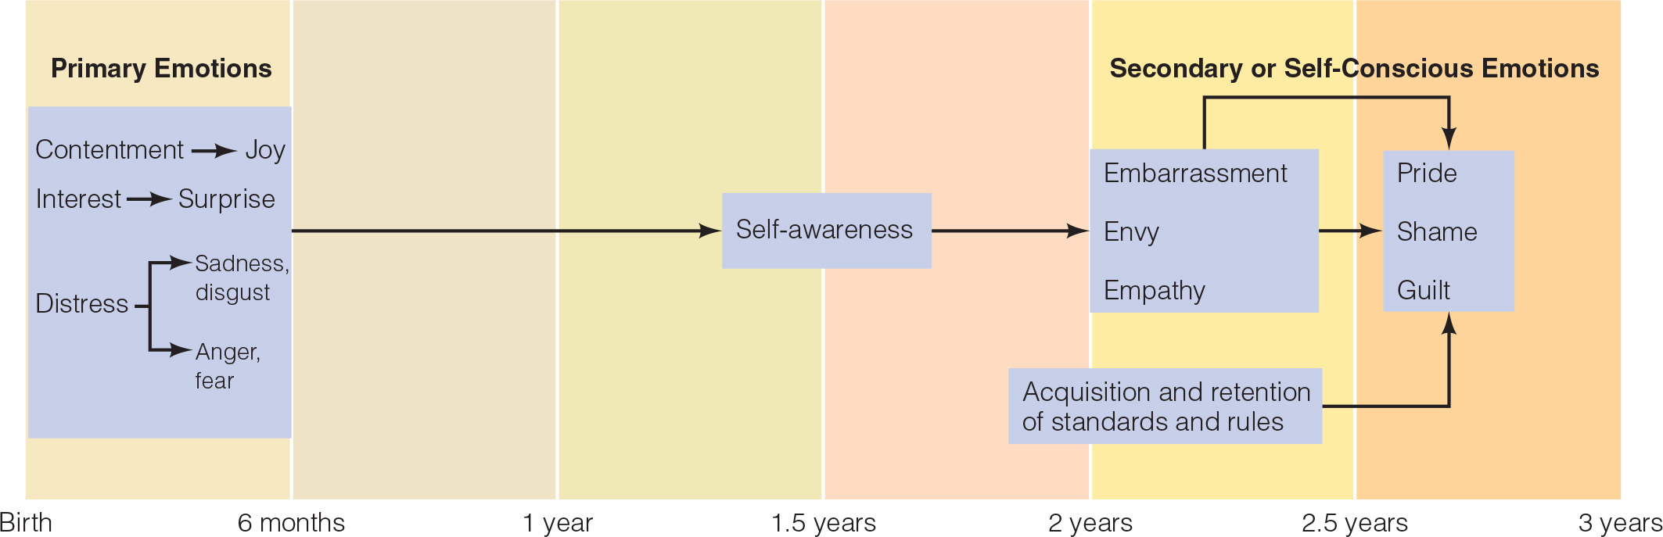
First Emotions and Emotion Regulation (2 of 3)
After 18 months:
Self-conscious emotions emerge
Require self-awareness
Embarrassment
Pride
Shame
Guilt

Slide 13
First Emotions and Emotion Regulation (3 of 3)
Infants begin to use social referencing:
Around 9 months of age
Monitor companions’ emotional reactions to stimuli
Use this information to decide how to feel and behave
Infants develop strategies for emotion regulation:
By the end of the first year, infants can move away from upsetting events.
By 18–24 months, toddlers will try to control whatever is upsetting them.

Slide 14
Emotional Socialization in Childhood
As children get older, they:
Develop emotional competence
Patterns of emotional expression, greater understanding of emotion, and better emotion regulation skills
Learn about display rules for emotion
Cultural rules specifying what emotions should and should not be expressed under what circumstances

Slide 15
Adolescents’ Emotional Lives
Why do adolescents experience mildly negative moods more often than children?
Experience more negative life events
May not be as able as adults to regulate negative emotions
May choose to savour negative or mixed emotions at times

Slide 16
Emotions and Aging (1 of 3)
Do older adults experience more negative emotions than younger adults?
Research findings
Older adults did not experience more negative emotions.
Emotions were not any less important.
They experienced emotions with similar intensity as younger adults.
Older adults seem to live more positive emotional lives.

Slide 17
Emotions and Aging (2 of 3)
Carstensen and colleagues
Overall emotional well-being increases with age.
Older adults also experienced:
Longer-lasting positive emotions
Fleeting negative emotions
Fewer emotional ups and downs per day

Slide 18
Emotions and Aging (3 of 3)
Socioemotional selectivity theory
Perception that one has little time left to live
Prompts more emphasis on the goal of fulfilling current emotional needs
Positivity effect
Tendency for older adults to place more priority on positive information

Slide 19
13.2 Perspectives on Relationships

Slide 20
Attachment Theory (1 of 3)
Attachment theory
Based primarily on ethology
Asked how attachment might have helped our ancestors adapt to their environment
Attachment
A strong affectional tie that binds a person to an intimate companion

Slide 21
Attachment Theory (2 of 3)
Babies’ behaviors ensure adults will love them and meet their needs
Sucking
Smiling
Cooing
Crying
Adults hormonally prepared for caregiving
Oxytocin

Slide 22
Attachment Theory (3 of 3)
Infants construct expectations about relationships via internal working models
Cognitive representations of themselves and other people
Guide processing of social information and behavior in relationships
Securely attached infants will develop secure internal working models that they are loveable.
Insecurely attached infants develop models that they are difficult to love

Slide 23
Peers: The Second World of Childhood
Peer: a social equal
Learn that relationships are reciprocal
Force them to hone their perspective-taking skills
Contribute to their social cognitive and moral development
Chumships
Close childhood relationships teach children how to participate in emotionally intimate relationships

Slide 24
Knowledge Check 1
Bowlby’s attachment theory is based primarily on
the theory of evolution
Psychiatry
psychoanalysis
ethology

Slide 25
Knowledge Check 1: Answer
Bowlby’s attachment theory is based primarily on
Answer: D. ethology
Attachment theory was developed by John Bowlby and later elaborated on by his colleague Mary Ainsworth. The theory was based primarily on ethology, the study of the behavior of various species in their natural environments and the evolution of that behavior.

Slide 26
13.3 The Infant

Slide 27
An Attachment Forms (1 of 4)
The caregiver’s attachment to the infant
Bonding at birth is neither necessary nor sufficient for a strong parent–infant attachment to form.
Over the weeks and months, caregivers and infants develop synchronized routines.

Slide 28
An Attachment Forms (2 of 4)
Four phases in forming attachments
Undiscriminating social responsiveness (birth to 2 or 3 months)
Discriminating social responsiveness (2 or 3 months to 6 or 7 months)
True attachment (6 or 7 months to about 3 years)
Goal-corrected partnership (3 years and older)

Slide 29
An Attachment Forms (3 of 4)
Attachment-related fears
Separation anxiety
Baby becomes wary or fretful when separated from parent.
Peaks between 14 and 18 months
Stranger anxiety
Wary or fretful reaction to the approach of an unfamiliar person
Peaks around 1 year of age

Slide 30
An Attachment Forms (4 of 4)
Explanatory behavior
Attachment figure serves as a
Secure base for exploration
Safe haven

Slide 31
Quality of Attachment (1 of 2)
Ainsworth and her associates created the Strange Situation, a now-famous procedure for measuring the quality of an attachment
Secure attachment
Resistant attachment
Avoidant attachment
Disorganized–disoriented attachment

Slide 32
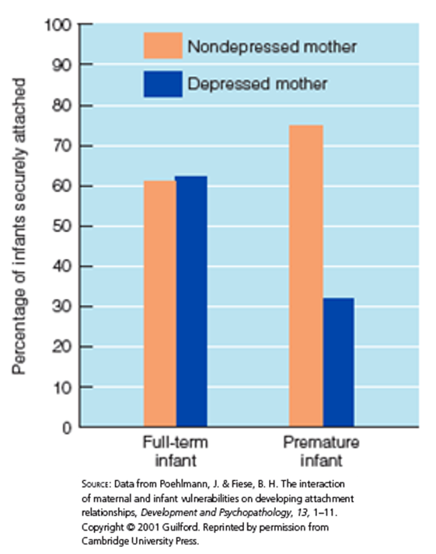
Quality of Attachment (2 of 2)
Caregiver’s contributions
Contact comfort promotes human attachments.
Parents who are sensitive and responsive to baby’s needs and emotional signals promote secure attachment.
Infant’s contributions
Relationships between infant temperament and quality of attachment are often weak.

Slide 33
The Caregiver’s Caregiving
According to Freud, infants become attached to the individual who provides them with oral pleasure, and the attachment bond will be most secure if a mother is relaxed and generous in her feeding practices.
Contact comfort, the pleasurable tactile sensations provided by a soft and cuddly “parent,” is a more powerful contributor to attachment in monkeys than feeding.

Slide 34
The Infant’s Temperament
An infant’s temperament can also influence the quality of an attachment
Infant temperament and quality of attachment are typically quite weak.
An infant’s genetic makeup
Many infants are securely attached to one parent but insecurely attached to the other.
Caregivers who are sensitive and responsive and adjust to their baby’s temperamental quirks are able to establish secure relationships.

Slide 35
Cultural and Social Context (1 of 2)
Biological mother in attachment theory
Alloparenting distributes care among multiple caregivers, such as aunts and uncles, grandparents, siblings, cousins, and neighbor women.
Individualistic cultures want their babies to take interest in objects, interact face-to-face with their parents, and explore independently.
Collectivist cultures keep their babies in physical contact all day and train them to stay close and do as they are told.

Slide 36
Cultural and Social Context (2 of 2)
The cultural context in which caregiver and baby interact also colors their relationship
In Germany, an individualistic culture, parents strongly encourage independence and discourage clingy behavior.
In Japan infants are rarely separated from their mothers early in life and are encouraged to be dependent on their mothers.

Slide 37
Implications of Early Attachment
From Freud, secure parent–child relationship is critical in human development
Studies of socially deprived infants
Studies of infants who experience separations from their caregivers
Studies comparing the later development of securely and insecurely attached infants

Slide 38
Deprived Institutions (1 of 2)
What happens if an infant never has an opportunity to form an attachment?
Infants who spent their first several months or more in deprived orphanages
Poor growth
Medical problems
Delays and differences in physical, cognitive, and social-emotional development

Slide 39
Deprived Institutions (2 of 2)
After being adopted
90% had clearly become attached to their adoptive parents
Many saw their parents as both comforting and threatening

Slide 40
Separations
Infants go through a grieving process
Protest and search frantically for their loved one
Then become sad and listless once they give up
Sometimes then ignore or avoid their caregiver if she returns, only gradually warming up to her again

Slide 41
Day Care
Infants who experienced routine care by someone other than their mothers were not much different than infants cared for by their mothers.
Quality of parenting was a much stronger influence on these infants’ attachments and later development than whether they had day care experience.

Slide 42
Later Development of Securely and Insecurely Attached Infants
Three main qualities distinguish children who were securely attached infants from children who were insecurely attached
Intellectual competence. Children who were securely attached as infants are described by teachers as more curious, self-directed, and eager to learn.
Social competence. Children who had been securely attached as infants are more able to initiate play activities, are more sensitive to the needs and feelings of other children, and more popular and socially competent.
Emotion regulation. Secure attachment in infancy is also linked to good emotion regulation and coping skills.

Slide 43
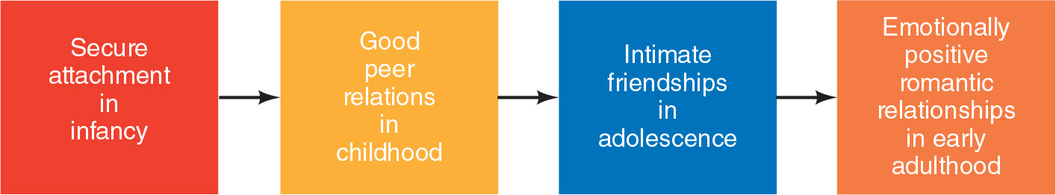
Relationship Quality

Slide 44
First Peer Relations
Infants show interest in other babies.
At age one year of age:
Show capacities for sharing, cooperation, and empathy
At 18 months:
Infants are able to engage in simple forms of reciprocal, complementary play with peers

Slide 45
Knowledge Check 2
Jamal is in the first grade. On his most recent report card, his teacher describes him as “curious and eager to learn.” It is likely that Jamal has which type of attachment to his primary caregiver?
Resistant
Secure
Avoidant
Disorganized−disoriented

Slide 46
Knowledge Check 2: Answer
Jamal is in the first grade. On his most recent report card, his teacher describes him as “curious and eager to learn.” It is likely that Jamal has which type of attachment to his primary caregiver?
Answer: B. Secure
Children who were securely attached as infants are described by teachers as more curious, self-directed, and eager to learn than insecurely attached children.

Slide 47
13.4 The Child

Slide 48
Poll 2
Which do you think was the most important for your development during childhood?
Parents
Peer acceptance
Free play
Close friends

Slide 49
Parent–Child Attachments
At age 3
A child grows more independent of the parent
Wants separations to be predictable and controllable
Children
Continue to seek attention and approval from their parents
Look more to peers for social and emotional support

Slide 50
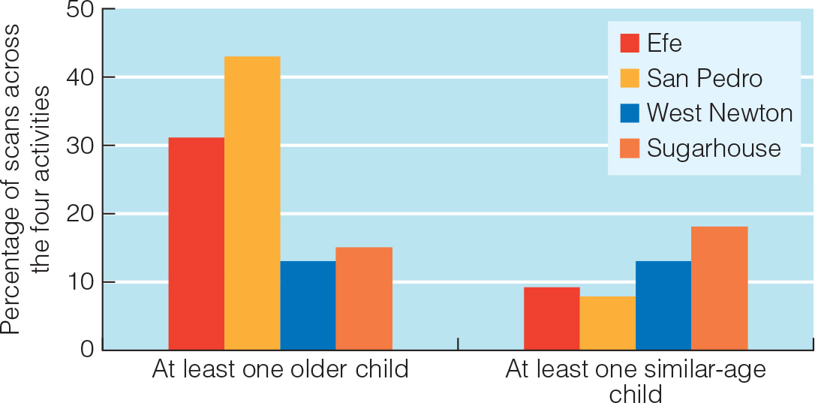
Peer Networks
10% of social interactions in toddlerhood are with peers
30% of those in middle childhood are with peers
Cross-cultural research
U.S. children spend more time with same-age children
May miss out on opportunities to learn from older and wiser children

Slide 51
Play (1 of 4)
Children spend much time playing
Locomotor play
Object play
Social play
Pretend play
Two changes in play between infancy and age 5
Becomes more social and more imaginative

Slide 52
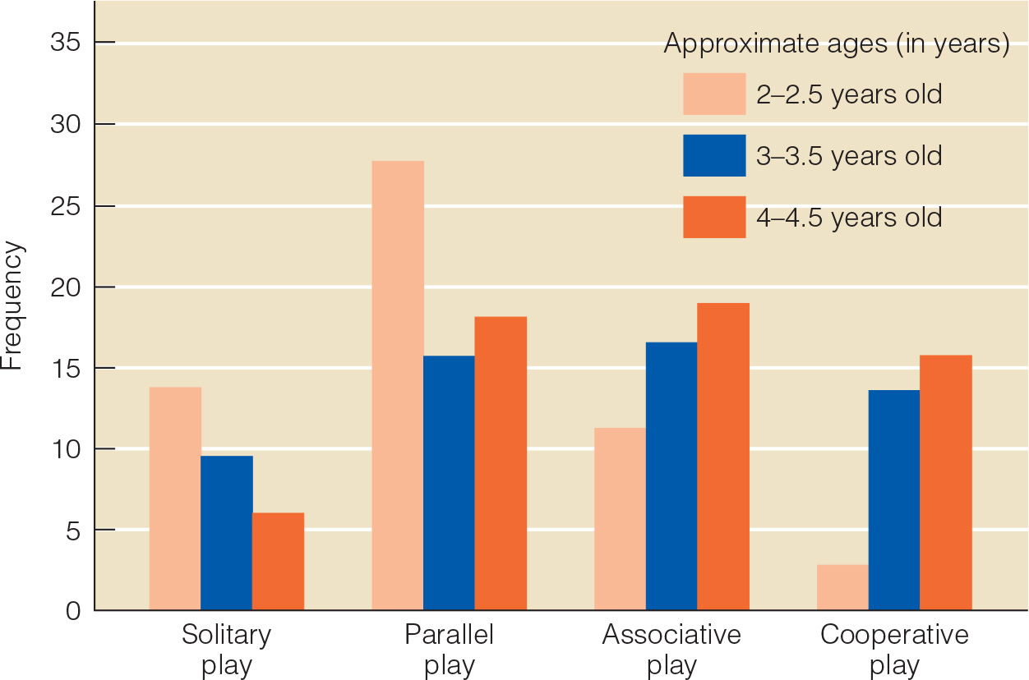
Play (2 of 4)
Parten’s six categories of preschool play—from least to most social
Unoccupied play
Solitary play
Onlooker play
Parallel play
Associative play
Cooperative play

Slide 53
Play (3 of 4)
At age 1
First pretend play
Play in which one actor, object, or action symbolizes or stands for another
At ages 2 to 5
Pretend play blossoms
Social pretend play
At school age
Playing organized games with rules

Slide 54
Play (4 of 4)
Allows children to develop many skills
Associated with the development of motor, cognitive, language, social, and emotional skills
May contribute to healthy emotional development

Slide 55
Peer Acceptance (1 of 3)
Researchers study peer-group acceptance through sociometric techniques
Accepted (or popular). Well liked by most and rarely disliked
Rejected. Rarely liked and often disliked
Neglected. Neither liked nor disliked; these children seem to be invisible to their classmates.
Controversial. Liked by many but also disliked by many
Average. In the middle on both the liked and disliked scales

Slide 56
Peer Acceptance (2 of 3)
Why are some children more popular than others?
Physically attractive children are more liked
Children who are relatively intelligent are usually more popular
Social competence predicts popularity

Slide 57
Peer Acceptance (3 of 3)
“Rejected” children
Often highly aggressive
Some are socially isolated, submissive children
Neglected
Good social skills
Nonaggressive; tend to be shy and unassertive
Controversial children
Good social skills, leadership qualities, and aggressive

Slide 58
Friendships (1 of 2)
Study of 7- to 8-year-olds
39% of children rejected by peers had at least one mutual or reciprocated friendship
31% of popular children lacked such a friendship
Having at least one friend increases the odds that a child will be happy and socially competent.

Slide 59
13.5 The Adolescent

Slide 60
Parent−Adolescent Attachments
Adolescents
Need the security and encouragement to explore
Provided by supportive parents
Adolescents with secure parent−child attachments
Stronger sense of identity
Higher self-esteem
Greater social competence
Better emotional adjustment
Fewer behavioral problems

Slide 61
Friendships (2 of 2)
Qualitatively change
Based on
Enjoyment of common activities
Mutual loyalty
Intimacy and self-disclosure

Slide 62
Changing Social Networks (1 of 2)
Dexter Dunphy: How peer-group structures change during adolescence
Late childhood: same-sex groups
Boy and girl cliques begin to interact
By age 11 or 12: Popular boys and girls form mixed-sex cliques
Crowds then form
Late high school: Crowds lessen as couples form

Slide 63
Changing Social Networks (2 of 2)
Sociometric popularity and perceived popularity
Sociometric popularity or peer acceptance in the sense of being liked by many peers
Perceived popularity or being viewed as someone who has status, power, and visibility in the peer group

Slide 64
Cliques and Crowds
Dexter Dunphy’s five steps are still helpful today in understanding how peer relations lay the foundation for romantic attachments.
In late childhood, boys and girls typically become members of same-sex cliques and have little to do with the other sex.
Boy cliques and girl cliques then begin to interact.
In early adolescence, the most popular boys and girls lead the way and form a heterosexual clique.
The crowd completes its evolution during the high school years.
More and more couples form and the crowd disintegrates in late high school.

Slide 65
Dating (1 of 2)
Percentage of adolescents reporting they have dates
8th grade: 29%
10th grade: 45%
12th grade: 51%

Slide 66
Dating (2 of 2)
Adolescent romantic relationships evolve through four phases
Initiation
Status
Affection
Bonding
Dating has more positive than negative effects on development.

Slide 67
Discussion
What were the peer groups when you were in high school? Were there cliques and crowds? Where was your place in the social sphere during this time?

Slide 68
13.6 The Adult

Slide 69
Social Networks
Each of us has a social convoy
Social network and support system that accompanies us during our life’s journey
Trend toward smaller social networks with age
Older adults narrow their social networks to close family and friends

Slide 70
Romantic Relationships and Love (1 of 3)
Greatest influence on mate selection
Homogamy (similarity)
People may also look for complementarity
Partners who are different from them but who have strengths that compensate for their own weaknesses

Slide 71
Romantic Relationships and Love (2 of 3)
Sternberg’s triangular theory of love
Passion
Intimacy
Commitment
Consummate love
High levels of passion, intimacy, and commitment
Companionate love
High intimacy and commitment but not much passion

Slide 72
Romantic Relationships and Love (3 of 3)
Erikson’s issue of intimacy versus isolation by finding a romantic partner
How do we choose our partners
What does love involve
How do the internal working models of self and others that we form starting in infancy affect our romantic attachments

Slide 73
Partner Choice
Universally men prefer attractive, younger mates and women prefer older men with financial resources
Kindness, intelligence, and health

Slide 74
Love
Robert Sternberg’s triangular theory of love
Passion involves sexual attraction, romantic feelings, and a sense of excitement.
Intimacy involves feelings of warmth, caring, closeness, trust, and respect.
It is about emotional togetherness, attachment, and communication.
Commitment involves first deciding that one loves the other person and then committing to a long-term relationship.

Slide 75
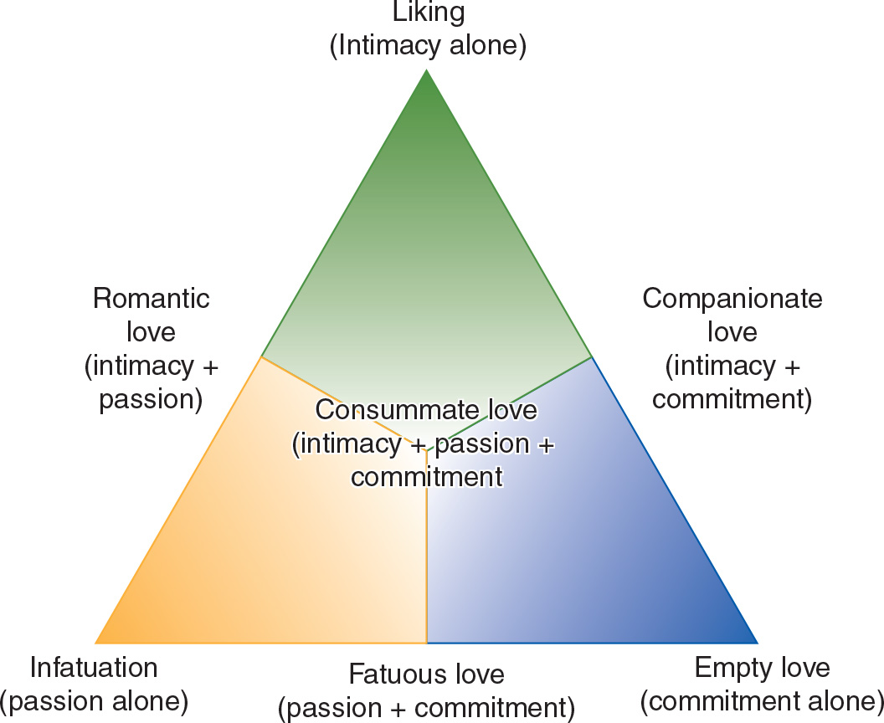
Sternberg’s Triarchic Theory of Love
Notes:
Figure 14.7 The three components of love in Sternberg’s triarchic theory of love

Slide 76
Adult Attachment Styles (1 of 2)
Adults’ styles of attachment are related to:
Quality of their romantic relationships
Well-being, physical and mental health in later life
Quality of the parent−child relationship that an adult experienced earlier in life predicts adult attachment style and romantic relationship quality

Slide 77
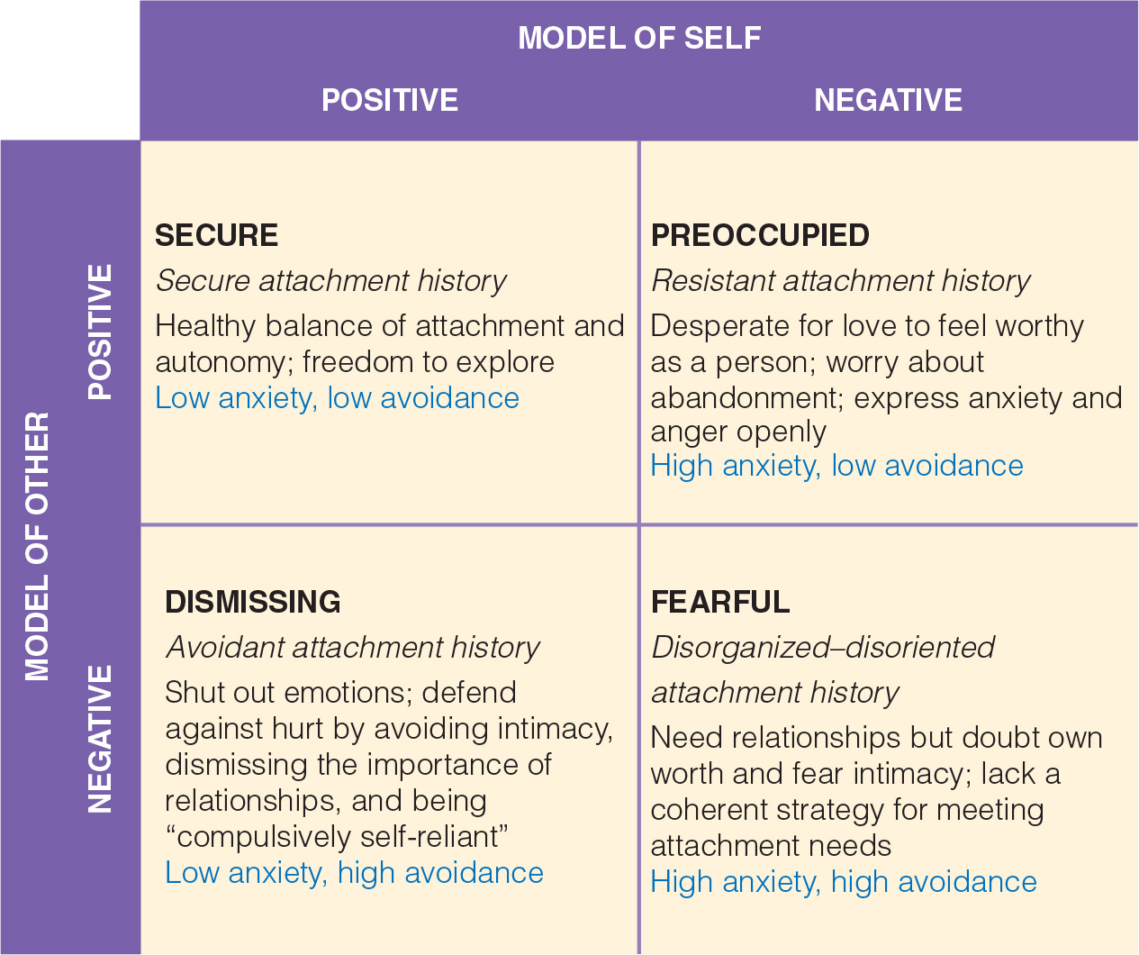
Adult Attachment Styles (2 of 2)
Notes:
Figure 14.8 Adult attachment styles based on internal working models of self and other people

Slide 78
Adult Relationships and Adult Development
Size of adult’s social network is not as important as whether it includes a confidant
Spouse, relative, or friend to whom the individual feels especially attached
Men are particularly dependent on their spouses
Benefits of having a confidant
Life satisfaction, physical health, cognitive functioning, and longevity

Slide 79
Self-Assessment
How are we socialized to express emotions?
How is the parent−child attachment related to the development of emotions?
How do parent and peer relationships change through the life span?
Why is play important during childhood?
How are adult attachment styles related to romantic relationships?

Slide 80
Summary (1 of 6)
Now that the lesson has ended, you should have learned how to:
Distinguish between primary and secondary or self-conscious emotions, giving examples and indicating when they emerge.
Discuss age-related changes in emotional competence, emotion regulation skills, and the learning of cultural display rules for emotion.
Using research on adolescent emotion regulation and socioemotional selectivity theory, explain why older adults typically have greater emotional well-being than adolescents.

Slide 81
Summary (2 of 6)
Now that the lesson has ended, you should have learned how to:
Outline the main argument of Bowlby and Ainsworth’s attachment theory, with emphasis on the role of nature and nurture in attachment and the mechanism through which early attachments have lasting effects on development.
Discuss two theorists who claim that peers are more important than parents in development.
Discuss how both the caregiver’s attachment and the infant’s attachment grow during the first year of life and the significance of neurobiological changes and synchronized routines in the attachment process.

Slide 82
Summary (3 of 6)
Now that the lesson has ended, you should have learned how to:
Distinguish among the four types of parent−infant attachments and explain how a parent’s behavior, an infant’s temperament, and the cultural context can influence which type of attachment develops.
Summarize the main lessons learned about attachment and later development from studies of infants in deprived institutions, infants separated from caregivers, infants attending day care, and infants with secure versus insecure attachments.
Characterize the ability of infants to participate in relationships with peers.

Slide 83
Summary (4 of 6)
Now that the lesson has ended, you should have learned how to:
Describe how parent–child attachments and peer relations change during childhood.
Explain how play becomes more social, more imaginative, and more rule-governed over the childhood years and how play contributes to development.
Describe what we learn from sociometric studies of peer acceptance about children who are popular, rejected, or neglected.
Explain the unique contributions of friendships to child development.

Slide 84
Summary (5 of 6)
Now that the lesson has ended, you should have learned how to:
Describe the significance of attachments to parents and friendships in adolescence.
Distinguish between cliques and crowds and describe their evolution and functions during adolescence.
Describe the development of adolescent romantic relationships and the typical effects of dating on adolescent development.
Explain how social networks change over the adult years and how socioemotional selectivity theory accounts for this change.

Slide 85
Summary (6 of 6)
Now that the lesson has ended, you should have learned how to:
Characterize romantic relationships in terms of the primary bases for partner choice, the triangular theory of love, and adult attachment styles.
Describe the positive effects on adult development of a secure adult attachment style and of having at least one close friend or confidant—and the negative effects of social isolation and loneliness.

