Slide 1
Chapter 15
Investments
Wild and Shaw
Fundamental Accounting Principles
2025 Release

Slide 2
Chapter 15 Learning Objectives
CONCEPTUAL
C1 Distinguish between debt and equity securities and between short-term and long-term investments.
C2 Describe how to report equity securities with controlling influence.
ANALYTICAL
A1 Compute and analyze the components of return on total assets.
PROCEDURAL
P1 Account for debt securities as trading.
P2 Account for debt securities as held-to-maturity.
P3 Account for debt securities as available-for-sale.
P4 Account for equity securities with insignificant influence.
P5 Account for equity securities with significant influence.

Slide 3
Learning Objective C1
Distinguish between debt and equity securities and between short-term and long-term investments.

Slide 4
Basics of Investments
Motivation for Investments
Companies invest extra cash into investments to earn more income.
Some entities are set up to earn income from investments.
Companies make investments for strategic reasons.
Notes:
Companies make investments for at least three reasons.
First, companies invest their extra cash into investments to earn more income.
Second, some entities, such as mutual funds and pension funds, are set up to produce income from investments.
Third, companies make investments for strategic reasons such as investments in competitors, suppliers, and customers.

Slide 5
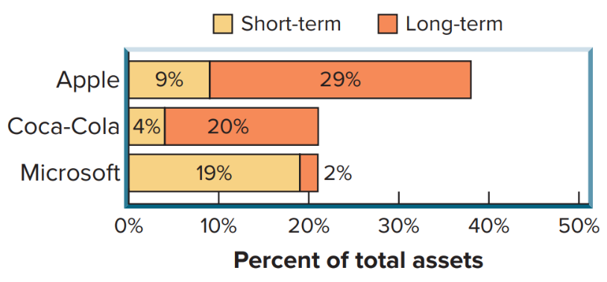
Investments of Selected Companies
Short-Term (ST) and Long-Term (LT) Investments as a Percent of Total Assets
Exhibit 15.1
Access the text alternative for slide images.
Notes:
This chart shows the relative proportion of short-term and long-term investments for three different companies. Notice the difference between the investments as a percent of total assets between Microsoft and Coca-Cola. Also notice the different emphasis on short-term versus long-term investments for Microsoft and Coca-Cola.

Slide 6
Short-Term Investments
Short-term investments are ones that:
management intends to convert to cash within one year or the operating cycle whichever is longer and
are readily convertible to cash
Usually mature between 3 and 12 months.
Notes:
Short-term investments, or marketable securities, are investments that (1) management intends to convert to cash within one year, or the operating cycle, whichever is longer, and (2) are readily convertible to cash. Short-term investments are current assets. These investments usually mature between 3 and 12 months. Cash equivalents are not short-term investments because they usually mature within 3 months.

Slide 7
Long-Term Investments
Long-term investments are:
Not readily convertible to cash or.
Not intended to be converted to cash in the short term.
Reported in the noncurrent section of the balance sheet, often in its own category.
Notes:
Long-term investments in securities are investments that are not readily convertible to cash or are not intended to be converted into cash in the short term. Long-term investments also include funds designated for a special purpose, such as investments in land or other assets not used in operations. Long-term investments are noncurrent assets.

Slide 8
Debt Securities versus Equity Securities
Debt Securities
Reflect a creditor relation
Examples: Investments in notes, bonds, and CD’s
Issued by governments, companies, or individuals
Equity Securities
Reflect an owner relation
Examples: Investments in shares of stock
Issued by companies
Notes:
Investments in securities can include both debt and equity securities.
Debt securities reflect a creditor relation such as investments in notes, bonds, and certificates of deposit; they are issued by governments, companies, and individuals.
Equity securities reflect an owner relation such as investments in shares of stock issued by companies.

Slide 9
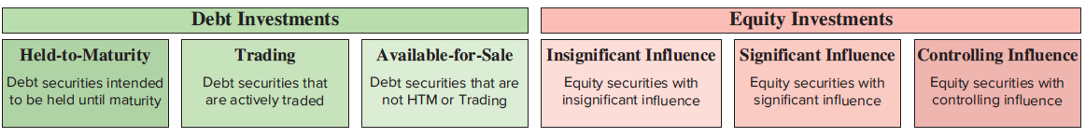
Classification and Reporting
Accounting for Investments depends on three factors:
Security type: debt or equity
Intent to hold the security short or long term
Percentage ownership in another company’s equity securities
Exhibit 15.2
Access the text alternative for slide images.
Notes:
Accounting for investments in securities depends on three factors: (1) security type, either debt or equity, (2) the company’s intent to hold the security either short term or long term, and (3) the investor’s percentage of ownership in the other company’s (investee’s) equity securities. This slide identifies six classes of securities using these three factors.
1. Held-to-maturity securities represent investment in debt securities of another company. In the balance sheet, held-to-maturity investments are shown at amortized cost.
2. Trading securities include both debt securities that are actively traded and are reported in the balance sheet at fair value.
3. Available-for-sale securities are those that cannot be classified as held-to-maturity or trading. Like trading securities, available-for-sale securities are shown in the balance sheet at fair value rather than historical cost.
4. Equity investments with insignificant influence are accounted for at fair value.
5. Equity investments with significant influence are accounted for using the equity method.
6. Equity investments with controlling influence mean that the company holds more than 50 percent of the investment company’s voting stock. These types of investments are accounted for under consolidation rules.

Slide 10
Debt Investments: Acquisition
Debt investments are recorded at cost.
On July 1, 2026, Ling Co. paid $30,000 to buy Dell’s 7%, 2-year bonds payable with a $30,000 par value.
The bonds pay interest semiannually on December 31 and June 30.
Journal entry on July 1, 2027; account name and amount debited on first line; account name and amount credited on next line; description of transaction on last line.
July 1, 2027 | Debt Investments | 30,000
 | Cash |  | 30,000
 | Purchased bonds as debt investments.
Notes:
Debt investments are recorded at cost when purchased.
Assume that Ling Co. paid $30,000 on July 1, 2027, to buy Dell’s 7%, two-year bonds payable with a $30,000 par value. The bonds pay interest semiannually on December 31 and June 30. The entry to record this purchase is shown.

Slide 11
Debt Investments: Recording Interest and Reporting
Interest revenue is recorded when earned.
$30,000 par value × 7% × 6∕12 = $1,050 interest earned from July 1 to December 31.
Journal entry on December 31, 2027; account name and amount debited on first line; account name and amount credited on next line; description of transaction on last line.
Dec. 31, 2027 | Cash | 1,050
 | Interest Revenue |  | 1,050
 | Record interest earned ($30,000 × 7% × 6∕12).
The following content is arranged like a table. Table has single column.
Exhibit 15.3
On the income statement for year 2027:
Interest revenue $1,050
On the balance sheet at December 31, 2027:
Debt investments $30,000
Notes:
Interest revenue for debt investments is recorded when earned. On December 31, 2027, at the end of its accounting period, Ling Co. records cash receipt of interest as described above.
The $1,050 interest earned from July 1 to December 31 is computed as “Principal × Annual rate × Fraction of year” (shown above), which also equals 6/12 of the semiannual cash receipt of interest. Ling Co.’s financial statements at December 31, 2027, report the interest revenue and the investment as shown. The financial statement impact is also shown on this slide for the year 2027.

Slide 12
Debt Investments: Maturity
When the bonds mature, Ling Co. will receive the amount of the par value in cash.
Journal entry on July 1, 2029; account name and amount debited on first line; account name and amount credited on next line; description of transaction on last line.
July 1, 2029 | Cash | 30,000
 | Debt Investments |  | 30,000
 | Received cash from matured bonds.
Notes:
When the bonds mature, the proceeds (not including the interest entry) are recorded as shown.
The cost of a debt security can be either higher or lower than its maturity value. When the investment is long term, the difference between cost and maturity value is amortized over the remaining life of the security. We assume for simplicity that the cost of a long-term debt security equals its maturity value for all investments.

Slide 13
Learning Objective P1
Account for debt securities as trading.

Slide 14
Debt Investments – Trading
Debt investments
Actively managed for profit
Always current assets
Portfolio reported at fair value
Requires a “fair value adjustment” from cost of portfolio (group of securities)
Unrealized gain (or loss) from change in fair value reported in the income statement
Notes:
Trading securities are debt investments that the company intends to actively buy and sell for profit. Trading securities are always current assets. The portfolio of trading securities is reported at its fair value; this requires a “fair value adjustment” from the cost of the portfolio. A portfolio is a group of securities. Any unrealized gain (or loss) from a change in the fair value of the portfolio of trading securities is reported on the income statement. It is unrealized because it is not yet confirmed by actual sales of securities.

Slide 15

Debt Investments: Trading Recording and Reporting Fair Value
TechCom’s portfolio of trading securities had a total cost of $11,500, and a fair value of $13,000, on December 31, 2027, the first year the securities were held.
The $1,500 difference between the cost of $11,500 and the fair value of $13,000 is an unrealized gain.
Journal entry on December 31, 2027; account name and amount debited on first line; account name and amount credited on next line; description of transaction on last line.
Dec. 31, 2027 | Fair Value Adjustment—Trading | 1,500
 | Unrealized Gain—Income |  | 1,500
 | Record unrealized gain in trading securities.
The following content is arranged like a table. Table has three columns. In the table, the following cells are blank: Row 1 and 5: columns 2, 3. Rows 2 and 3: column 3. Rows 4 and 6: column 2.
Current Assets
Debt investments—Trading (at cost) | $11,500
Fair value adjustment—Trading | 1,500
Debt investments—Trading (at fair value) |  | $13,000
or simply Debt investments—Trading (at fair value; cost is $11,500) |  | $13,000
Notes:
TechCom’s portfolio of trading securities had a total cost of $11,500 and a fair value of $13,000 on December 31, 2027, the first year it held trading securities. The difference between the $11,500 cost and the $13,000 fair value reflects a $1,500 gain. It is an unrealized gain because it is not yet confirmed by actual sales. The fair value adjustment for trading securities is recorded with an adjusting entry at the end of each period to equal the difference between the portfolio’s cost and its fair value. TechCom records this gain as shown.
The unrealized gain is reported in the Other Revenues and Gains (or Expenses and Losses) section on the income statement. Unrealized Gain – Income (or Unrealized Loss – Income) is a temporary account that is closed to Income Summary at the end of each period. Fair Value Adjustment – Trading is a permanent account, which adjusts the reported value of the trading securities portfolio from its prior period fair value to the current period fair value. The total cost of the trading securities portfolio is maintained in one account, and the fair value adjustment is recorded in a separate account. TechCom’s investment in trading securities is reported in current assets.

Slide 16
Debt Investments – Trading Selling Trading Securities
Assume TechCom sells trading securities that had cost $100 for $120 cash, on January 9, 2028.
The realized gain is reported in the Other Revenues and Gains on the Income Statement.
A loss is reported in Other Expenses and Losses.
Journal entry on January 9, 2028; account name and amount debited on first line; account names and amounts credited on next two lines; description of transaction on last line.
Jan. 9, 2028 | Cash | 120
 | Debt Investments—Trading |  | 100
 | Gain on Sale of Debt Investments |  | 20
 | Sold trading securities costing $100 for $120 cash.
Notes:
When individual trading securities are sold, the difference between the net proceeds (sale price less fees) and the cost of the individual trading securities that are sold is recognized as a gain or a loss. Any prior period fair value adjustment to the portfolio is not used to compute the gain or loss from sale of individual trading securities. This is because the balance in the Fair Value Adjustment account is for the entire portfolio, not individual securities. For example, if TechCom sold some of its trading securities that had cost $100 for $120 cash on January 9, 2028, it would record the entry shown. This is a realized $20 gain - realized by an actual sale.
A gain is reported in the Other Revenues and Gains section on the income statement, whereas a loss is shown in Other Expenses and Losses. When the period-end fair value adjustment for the portfolio of trading securities is computed, it excludes the cost and fair value of any securities sold.

Slide 17
Learning Objective P2
Account for debt securities as held-to-maturity.

Slide 18
Debt Investments: Held-to-Maturity
Debt securities company intends to hold to maturity
Reported as:
a) Current assets if maturity dates are within one year or the operating cycle, whichever is longer
b) Noncurrent investments if their maturity dates are longer
Recorded at cost when purchased; interest revenue is recorded when earned
Portfolio of HTM securities reported at amortized cost
No fair value adjustment to the portfolio
Notes:
Held-to-maturity (HTM) securities are debt securities a company intends and is able to hold until maturity. They are reported in current assets if their maturity dates are within one year or the operating cycle, whichever is longer. HTM securities are reported in long-term assets when the maturity dates extend beyond one year or the operating cycle, whichever is longer. All HTM securities are recorded at cost when purchased, and interest revenue is recorded when earned.
The portfolio of HTM securities is usually reported at (amortized) cost, which is explained in advanced courses. There is no fair value adjustment to the portfolio of HTM securities—neither to the short-term nor long-term portfolios.

Slide 19
Learning Objective P3
Account for debt securities as available-for-sale.

Slide 20
Debt Investments: Available-for-Sale
Debt investments not classified as trading or held-to-maturity. Classified as:
a) Short-term investments if intent to sell within one year or the operating cycle, whichever is longer.
b) Long-term investments if securities do not meet short-term criteria.
Valued at fair value.
Cost adjusted for changes in fair value where unrealized gain (or loss) reported as part of other comprehensive income (OC I) in statement of comprehensive income.
At period-end, OC I closed to accumulated other comprehensive income, reported in equity section of the balance sheet.
Notes:
Available-for-Sale (AFS) securities are debt investments not classified as trading or held-to-maturity securities. If the intent is to sell AFS securities within the longer of one year or operating cycle, they are classified as short-term investments. Otherwise, they are classified as long-term investments.
Companies adjust the cost of the portfolio of AFS securities to reflect changes in fair value. This is done with a fair value adjustment to its total portfolio cost. However, any unrealized gain or loss for the portfolio of AFS securities is reported as part of other comprehensive income in the statement of comprehensive income (OCI). At period-end, OCI is closed to accumulated other comprehensive income, which is reported in the equity section of the balance sheet.

Slide 21
Available-for-Sale: Recording Fair Value
Mitsu Co. had no prior investments.
In the current period, it acquired two available-for-sale securities as shown below.
At December 31, 2027 the year-end adjusting entry to record fair value is shown.
The following content is arranged like a table. A table has 3 entries and the account names are listed in column 1. The column header of column 1 is blank.
Exhibit 15.4
 | Cost | Fair Value | Unrealized Gain (Loss)
Apple bonds | $30,000 | $29,050 | $ (950)
Index notes | 43,000 | 45,500 | 2,500
Total | $73,000 | $74,550 | $1,550
Journal entry on December 31, 2027; account name and amount debited on first line; account name and amount credited on next line; description of transaction on last line.
Dec. 31, 2027 | Fair Value Adjustment—Available-for-Sale | 1,550
 | Unrealized Gain—Equity |  | 1,550
 | Record adjustment to fair value of AFS securities.
Notes:
Mitsu Co. had no prior period investments in available-for-sale securities other than those purchased in the current period. This slide shows both the cost and fair value of the portfolio of these investments on December 31, 2027, the end of its reporting period.
The year-end adjusting entry to record the fair value of the portfolio of investments is also shown.

Slide 22
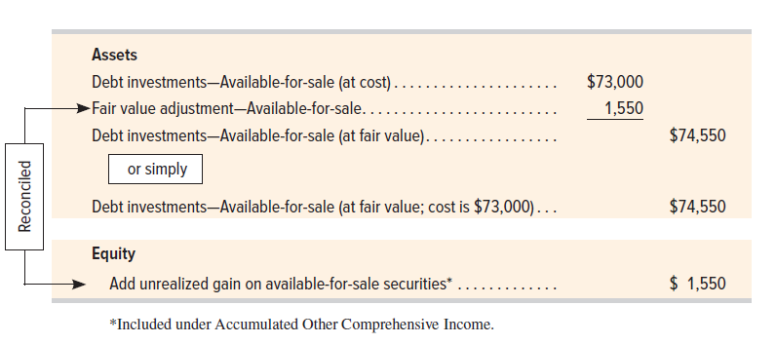
Available-for-Sale: Reporting Fair Value
Exhibit 15.5
Access the text alternative for slide images.
Notes:
This slide shows the December 31, 2027, balance sheet presentation—it assumes these investments are long term, but they can also be short term. It is also common to combine the cost of investments with the balance in the Fair Value Adjustment account and report the net as a single amount.

Slide 23
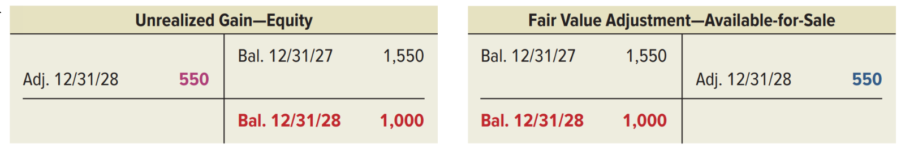
Available-for-Sale: Reporting for Next Year
Let’s extend our example and assume that at December 31, 2028, Mitsu’s portfolio of long-term AFS securities has an $81,000 cost and an $82,000 fair value.
Journal entry on December 31, 2028; account name and amount debited on first line (highlighted in red); account name and amount credited on next line (highlighted in blue); description of transaction on last line.
Dec. 31, 2028 | Unrealized Gain—Equity | 550
 | Fair Value Adjustment—Available-for-Sale |  | 550
 | Record adjustment to fair value of AFS securities.
T-account. Table looks like an uppercase T, with a line dividing the table in half between debits and credits. Date of transaction listed with the dollar amount. End balance also has a horizontal line separating it from the entries. First column is transaction reference for debits in that row, last column is transaction reference for credits in that row.
Unrealized Gain—Equity account, December 31, 2028, debited $550 adjustment, December 31, 2027, credit balance $1,550. December 31, 2028 credit balance $1,000.
T-account. Table looks like an uppercase T, with a line dividing the table in half between debits and credits. Date of transaction listed with the dollar amount. End balance also has a horizontal line separating it from the entries. First column is transaction reference for debits in that row, last column is transaction reference for credits in that row.
Fair Value Adjustment—Available-for-Sale account, December 31, 2027, debit balance $1,550. December 31, 2028, credit $550 adjustment. December 31, 2028 debit balance $1,000.
Notes:
Let’s extend this illustration and assume that at the end of its next calendar year (December 31, 2028), Mitsu’s portfolio of debt AFS securities has an $81,000 cost and an $82,000 fair value. It records the year-end adjustment to fair value as shown.
This year-end adjustment can also be determined using our 3-step adjusting process.
Step 1: Determine what unadjusted balance equals: Fair Value Adj—AFS = $1,550 Dr.
Step 2: Determine what adjusted balance should equal: Fair Value Adj—AFS = $1,000 Dr. Explanation: $82,000 fair value > $81,000 cost, thus the Fair Value Adj—Trading requires a $1,000 debit so securities are at fair value.
Step 3: Record the $550 adjusting entry to get from Step 1 to Step 2.
Explanation: This implies a $550 credit to Fair Value Adj—AFS (and reduction of Unrealized Gain).

Slide 24
Learning Objective P4
Account for equity securities with insignificant influence.

Slide 25
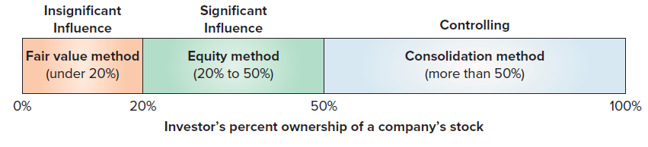
Accounting for Equity Investments Based on Ownership Percentage
Exhibit 15.6
Access the text alternative for slide images.
Notes:
When an investor has insignificant influence over another company, presumably when it owns less than 20% of the voting stock, the stock investment is reported at fair value. Stock investments are classified as short- or long-term based on managers’ intent and the stock’s marketability. Any cash dividends are recorded as dividend revenue.

Slide 26
Equity Investments Insignificant: Recording Acquisition
Equity investments are recorded at cost when acquired, including any commissions or brokerage fees paid.
ITI purchased 100 shares of Lynx for $7,000.
Journal entry with date; account name and amount debited on first line; account name and amount credited on next line; description of transaction on last line.
Oct. 10 | Stock Investments | 7,000
 | Cash |  | 7,000
 | Purchased 100 shares of Lynx.
Notes:
Equity investments are recorded at cost when acquired, including any commissions and brokerage fees paid. The journal entry to record the purchase is as shown.

Slide 27
Equity Investments Insignificant: Recording Dividends
On 11/1, ITI receives $10 in dividends.
Cash is debited and Dividend Revenue is credited.
Journal entry with date; account name and amount debited on first line; account name and amount credited on next line; description of transaction on last line.
Nov. 1 | Cash | 10
 | Dividend Revenue |  | 10
 | Record dividend received on stock investments.
Notes:
ITI receives $10 in dividends on November 1 from its stock investment, it records the journal entry shown.

Slide 28
Equity Investments Insignificant: Recording Fair Value
ITI’s portfolio of stock investments with insignificant influence, has a cost of $7,000.
Fair value is $9,000 on 12/31/27.
First year securities held.
Unrealized gain = $9,000 − 7,000 = $2,000.
Journal entry with date; account name and amount debited on first line; account name and amount credited on next line; description of transaction on last line.
Dec. 31 | Fair Value Adjustment—Stock | 2,000
 | Unrealized Gain—Income |  | 2,000
 | Record unrealized gain in stock investments.
Notes:
Assume ITI’s portfolio of stock investments has a total cost of $7,000 and a fair value of $9,000 on December 31, 2027, the first year it held these securities.
The difference between the $7,000 cost and the $9,000 fair value is a $2,000 unrealized gain.
The fair value adjustment is recorded at the end of each period to equal the difference between the portfolio’s cost and its fair value. ITI records this gain as shown.
Adjustment follows three-step adjusting process:
Step 1: Determine what unadjusted balance equals: Fair Value Adj.—Stock = $0.
Step 2: Determine what adjusted balance should equal: Fair Value Adj.—Stock = $2,000 Dr.
Explanation: $9,000 fair value $7,000 cost; thus Fair Value Adj.—Stock requires a $2,000 debit to be at fair value.
Step 3: Record the $2,000 adjusting entry to get from step 1 to step 2.
Explanation: This means a $2,000 debit to Fair Value Adj.—Stock; and a $2,000 credit to Unrealized Gain – Income.

Slide 29
Stock Investments: Insignificant Reporting Fair Value
Unrealized gain, a temporary account, is reported in Other Revenues and Gains (or Expenses and Losses) on the Income Statement.
Fair Value Adjustment − Stock, is a permanent asset which reports adjustments in portfolio.
Total cost kept in one account and fair value adjustment kept in separate account. Reported in assets as shown below:
The following content is arranged like a table. Table has three columns. In the table, the following cells are blank: Rows 1 and 5: columns 2, 3. Rows 2 and 3: column 3. Rows 4 and 5: column 2.
Assets
Stock investments (at cost) | $7,000
Fair value adjustment—Stock | 2,000
Stock investments (at fair value) |  | $9,000
or simply Stock investments (at fair value; cost is $7,000) |  | $9,000
Notes:
The unrealized gain (or loss) is reported in the Other Revenues and Gains (or Expenses and Losses) section on the income statement. Unrealized Gain (or Loss)—Income is a temporary account that is closed to Income Summary at the end of each period. Fair Value Adjustment—Stock is a permanent asset account that adjusts the reported value of the stock investments portfolio from its prior-period fair value to the current-period fair value. The total cost of the portfolio is kept in one account, and the fair value adjustment is kept in a separate account. ITI’s stock investment is reported in its assets as shown.

Slide 30
Stock Investments Insignificant: Selling Stock Investments
When sold, difference between net proceeds and cost recorded as gain or loss.
Prior-period fair value adjustments not used to compute gain or loss from sale of individual stocks.
3/9/28: ITI sold individual stock with cost of $500 for $800.
Gain: $800 net proceeds − $500 cost = $300.
Journal entry with date; account name and amount debited on first line; account names and amounts credited on next two lines; description of transaction on last line.
Mar. 9 | Cash | 800
 | Stock Investments |  | 500
 | Gain on Sale of Stock Investments |  | 300
 | Sold stock investments costing $500 for $800 cash.
Notes:
When individual stock investments are sold, the difference between the net proceeds (sale price minus fees) and the cost of the individual stocks that are sold is recorded as a gain or a loss. Any prior-period fair value adjustment to the portfolio is not used to compute the gain or loss from the sale of individual stocks.
The balance in the Fair Value Adjustment account is for the entire portfolio, not individual stocks.
Assume that on 3/9/28, ITI sold some of its stock investments that had cost $500 for $800 cash. The journal entry to record the sale is shown here. A gain is reported in the Other Revenues and Gains section on the income statement and a loss is reported in Other Expenses and Losses.

Slide 31
Learning Objective P5
Account for equity securities with significant influence.

Slide 32
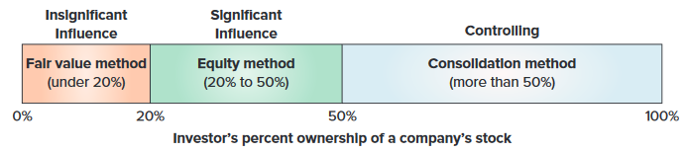
Equity Investments: Significant Influence, 20% to– 50%
Investor Percentage Ownership of Investee Shares Outstanding
Exhibit 15.6
Access the text alternative for slide images.
Notes:
A long-term investment classified as equity securities with significant influence implies that the investor can exert significant influence over the investee. An investor that owns 20% or more (but not more than 50%) of a company’s voting stock has significant influence over the investee. The equity method of accounting and reporting is used for long-term investments in equity securities with significant influence.

Slide 33
Equity Investments Significant Influence: Recording Acquisition
On January 1, 2027, Micron Co. records the purchase of 3,000 shares (30%) of Star Co. common stock at a total cost of $70,000 cash.
Journal entry with date; account name and amount debited on first line; account name and amount credited on next line; description of transaction on last line.
Jan. 1 | Early Method Investments | 70,000
 | Cash |  | 70,000
 | Record purchase of 3,000 Star shares.
Notes:
Long-term investments in equity securities with significant influence are recorded at cost when acquired. To illustrate, Micron Co. records the purchase of 3,000 shares (30%) of Star Co. common stock at a total cost of $70,000 on January 1, 2027, as shown.

Slide 34
Equity Investments Significant Influence: Recording Share of Earnings
On December 31, 2027, Star reports net income of $20,000 for 2026.
Micron records $6,000 share of earnings: $20,000 × 30% = $6,000.
Debit increases Micron’s equity in Star.
Credit increases Earnings from Equity Method Investments which is a temporary account closed to Income Summary and reported on income statement.
Journal entry with date; account name and amount debited on first line; account name and amount credited on next line; description of transaction on last line.
Dec. 31 | Early Method Investments | 6,000
 | Earnings from Equity Method Investments |  | 6,000
 | Record 30% equity in investee’s $20,000 earnings.
Notes:
When the investee reports its earnings, the investor records its share of those earnings in its investment account. Assume that Star reports net income of $20,000 for 2027. Micron records its 30% share of those earnings. The debit increases Micron’s equity in Star. The credit is 30% of Star’s net income. Earnings from Equity Method Investments is a temporary account (closed to Income Summary at each period-end) and is reported on the investor’s (Micron’s) income statement. If the investee incurs a net loss instead of a net income, the investor records its share of the loss and reduces (credits) its investments account.

Slide 35
Equity Investments Significant Influence: Recording Share of Dividends
Cash dividends received by investor accounted for as conversion of one asset for another.
Dividends reduce Equity Method Investments.
1/9/28: Star pays $10,000 in cash dividends.
Equity Method Investments credited (decreased) for $10,000 × 30% = $3,000.
Journal entry on January 9; account name and amount debited on first line; account name and amount credited on next line; description of transaction on last line.
Jan. 9 | Cash | 3,000
 | Equity Method Investments |  | 3,000
 | Record 30% share of $10,000 dividend paid by Star.
Notes:
The receipt of cash are viewed as a conversion of one asset to another; that is, dividends reduce the balance of the investment account. To illustrate, Star declares and pays a total of $10,000 in cash dividends on its common stock. Micron records its 30% share of these dividends received on January 9, 2028, as shown.

Slide 36
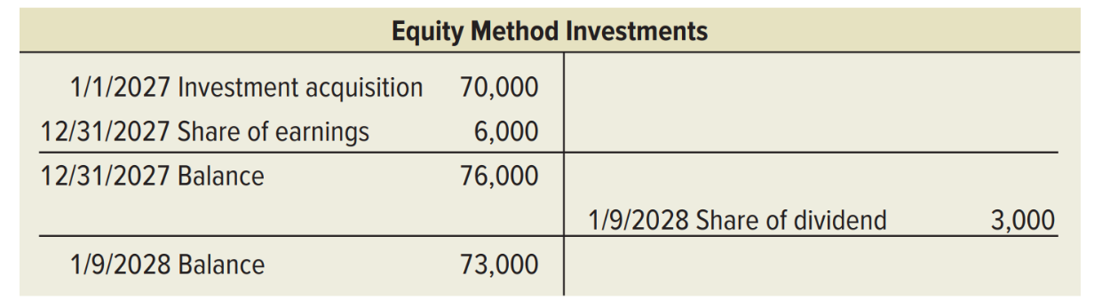
Equity Investments Significant Influence: Reporting Investments
Book value of investment will equal cost plus share of earnings minus share of dividends.
1/9/28: Micron will report as shown:
T-account. Table looks like an uppercase T, with a line dividing the table in half between debits and credits. Date of transaction listed with the dollar amount. End balance also has a horizontal line separating it from the entries. First column is transaction reference for debits in that row, last column is transaction reference for credits in that row.
Equity Method Investments account, January 1, 2027, debited Investment acquisition $70,000, December 31, 2027, debited Share of earnings $6,000, December 31, 2027, debit balance $76,000. January 9, 2028 credited Share of dividend $3,000. January 9, 2028 debit balance $73,000.
Exhibit 15.7
Notes:
The book value of an investment under the equity method equals the cost of the investment plus the investor’s share of net income or loss, minus its share of dividends. The Equity Method Investments account is not adjusted to fair value. Once Micron records these transactions, its Equity Method Investments account appears as shown.

Slide 37
Equity Investments Significant Influence: Selling Investments
When sold, will report gain or loss equal to sale proceeds minus book value of investment.
1/10/28: sold Star stock for $80,000.
Gain: $80,000 proceeds minus $73,000 book value = $7,000 gain.
Journal entry with date; account name and amount debited on first line; account names and amounts credited on next two lines; description of transaction on last line.
Jan. 10 | Cash | 80,000
 | Equity Method Investments |  | 73,000
 | Gain on Sale of Stock Investments |  | 7,000
 | Sold 3,000 shares of stock for $80,000.
Notes:
When equity method investments are sold, the gain or loss is computed by comparing proceeds from the sale with the book value of the investments on the sale date. If Micron sells all of its Star stock for $80,000 on January 10, 2028, it records the entry shown.

Slide 38
Learning Objective C2
Describe how to report equity securities with controlling influence.

Slide 39
Equity Investments, Controlling Influence, More than 50%
Investor ownership exceeds 50% of investee.
Consolidation Method is used for long-term investments.
Consolidated financial statements show the financial statements of all entities under parent’s control.
Controlling investor: parent.
Investee: subsidiary.
Notes:
A long-term investment classified as equity securities with controlling influence means that the investor has a controlling influence over the investee. An investor who owns more than 50% of a company’s voting stock has control over the investee. This investor can dominate all other shareholders in electing the corporation’s board of directors and has control over the investee’s management.
The consolidation method is used to account for long-term investments in equity securities with controlling influence. The investor reports consolidated financial statements when owning such securities. The controlling investor is called the parent, and the investee is called the subsidiary.

Slide 40
Accounting Summary for Debt and Equity Investments in Securities
Exhibit 15.8
The following content is arranged like a table. A table has 9 entries and the account names are listed in column 1. Rows 1 and 6 of column 2 is blank.
Classification | Investments Account Reported at
Short-Term Investment in Securities
Debt Investments—Held-to-Maturity | Cost (without any discount or premium amortization)
Debt Investments—Trading | Fair value (with fair value adjustment to income)
Debt Investments—Available-for-Sale | Fair value (with fair value adjustment to equity)
Stock Investments—insignificant influence | Fair value (with fair value adjustment to income)
Long-Term Investment in Securities
Debt Investments—Held-to-Maturity | Cost (with any discount or premium amortized)
Debt Investments—Available-for-Sale | Fair value (with fair value adjustment to equity)
Stock Investments—insignificant influence | Fair value (with fair value adjustment to income)
Equity Method Investments—significant influence | Equity method (no fair value adjustment)
Consolidated Investments—controlling influence | Consolidation method (no fair value adjustment)
Notes:
This slide summarizes the standard accounting for investments in securities. Recall that many investment securities are classified as either short-term or long-term depending on management’s intent and ability to convert them in the future. Understanding the accounting for these investments enables us to draw better conclusions from financial statements in making business decisions.

Slide 41
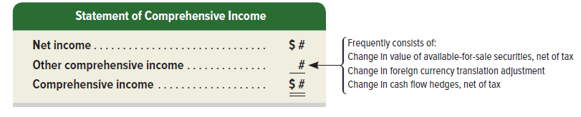
Other Comprehensive Income
Comprehensive Income: all changes in equity during a period except those from owners’ investments and dividends.
Add other comprehensive income (O C I) to, or subtract it from, net income.
O C I includes unrealized gains and losses on available-for-sale securities, foreign currency translation adjustments, and other adjustments.
Access the text alternative for slide images.
Notes:
Comprehensive income is all changes in equity during a period except those from owners’ investments and dividends. Specifically, comprehensive income is computed by adding other comprehensive income to or subtracting it from net income:
Other comprehensive income includes unrealized gains and losses on available-for-sale securities, foreign currency translation adjustments, and other adjustments. (Accumulated other comprehensive income is the cumulative impact of other comprehensive income.)
Comprehensive income is reported in financial statements in one of two ways:
1. On a separate statement of comprehensive income that follows the income statement.
2. On the lower section of the income statement (as a single continuous statement of income and comprehensive income).

Slide 42
Reporting Other Comprehensive Income
Reported:
On a separate statement of comprehensive income that follows the income statement or
On the lower section of the income statement (as a single continuous statement of income and comprehensive income.
Option 1 is the most common.
Accumulated Other Comprehensive Income (AO C I): cumulative impact of other comprehensive income for all prior periods.
AO C I = beginning period balance + OC I income (loss) = ending period AO C I.
Notes:
Other comprehensive income is reported in one to two ways:
On a separate statement of comprehensive income that follows the income statement or
On the lower section of the income statement (as a single continuous statement of income and comprehensive income.
Option 1 is the most common.
Accumulated Other Comprehensive Income (A O C I): cumulative impact of other comprehensive income for all prior periods.
A O C I = beginning period balance + O C I income (loss) = ending period A O C I.

Slide 43
Learning Objective A1
Compute and analyze the components of return on total assets.

Slide 44



Components of Return on Total Assets
Exhibit 15.9
Notes:
A company’s return on total assets (or simply return on assets) is important in assessing financial performance. The return on total assets can be separated into two components, profit margin and total asset turnover, for additional analyses. This slide shows how these two components determine return on total assets.
Profit margin reflects the percent of net income in each dollar of net sales. Total asset turnover reflects a company’s ability to produce net sales from total assets. All companies desire a high return on total assets. By considering these two components, we can often discover strengths and weaknesses not revealed by return on total assets alone. This improves our ability to assess future performance and company strategy.

Slide 45
Return on Total Assets
Exhibit 15.10
Return on total assets for Costco and Walmart
The following content is arranged like a table. Table divided into 5 columns. The column headers are marked from left to right as: Costco Return on Total Assets, Costco Profit Margin, Costco Total Asset Turnover, and Walmart Return on Total Assets. Table has 3 entries and the account names are listed in column 1. The entries in column 2 are highlighted in red.
Year | Costco Return on Total Assets = | Costco Profit Margin × | Costco Total Asset Turnover | Walmart Return on Total Assets
Current Year | 9.4% = | 2.6% × | 3.6 | 6.3%
1 Year Ago | 9.6% = | 2.6% × | 3.7 | 4.8%
2 Years Ago | 8.8% = | 2.6% × | 3.4 | 5.5%
All companies desire a high return on total assets. To improve the return, the company must meet any decline in profit margin or total asset turnover with an increase in the other. Companies consider these components in planning strategies.
Notes:
To illustrate, consider return on total assets and its components for Costco.
Costco’s return on total assets improved over the three-year period. This increase is driven by both an increase in profit margin and total asset turnover. Costco increased its return on total assets during a time when other retailers like Walmart have struggled. To continue this trend, Costco’s management must increase net income while keeping total asset turnover steady or at least at a level where it does not decrease return on total assets.

Slide 46
End of Main Content

Slide 47
Accessibility Content: Text Alternatives for Images

Slide 48
Investments of Selected Companies - Text Alternative
Return to parent-slide containing images.
The vertical axis has the categories: Apple, Coca-Cola, and Microsoft. The horizontal axis represents percent of total assets and ranges from 0 percent through 50 percent in increments of 10 percent. The data mentioned in the bar graph is as follows: Apple: short term, 0 to 9 percent; long term 9 percent to 38 percent. Coca-Cola: short term, 0 to 1 percent; long term 1 percent to 21 percent. Microsoft: short term, 0 to 19 percent; long term 19 percent to 21 percent.
Return to parent-slide containing images.

Slide 49
Classification and Reporting - Text Alternative
Return to parent-slide containing images.
Under debt investments:
Held-to-maturity: Debt securities intended to be held until maturity.
Trading: Debt securities that are actively traded.
Available-for-sale: Debt securities that are not H T M or Trading.
Under equity investments:
Insignificant influence: Equity securities with insignificant influence.
Significant influence: Equity securities with significant influence.
Controlling influence: Equity securities with controlling influence.
Return to parent-slide containing images.

Slide 50
Available-for-Sale: Reporting Fair Value - Text Alternative
Return to parent-slide containing images.
Assets: Long-term investments—Available-for-sale (at cost) of $73,000 plus Fair value adjustment—Available-for-sale of $1,550 equals Long-term investments—Available-for-sale (at fair value) at $74,550.
Or simply
Long-term investments—Available-for-sale (at fair value; cost is $73,000) at $74,550.
Fair value adjustment—Available-for-sale of $1,550 under assets is reconciled under Equity through a balance sheet entry of Add unrealized gain on available-for-sale securities at $1,550. This entry is often included under the caption Accumulated Other Comprehensive Income.
Return to parent-slide containing images.

Slide 51
Accounting for Equity Investments Based on Ownership Percentage - Text Alternative
Return to parent-slide containing images.
Investor’s percent ownership of a company’s stock:
Fair value method: under 20%, considered an insignificant influence.
Equity method: 20% to 50%, considered a significant influence.
Consolidation method: more than 50%, considered a controlling influence.
Return to parent-slide containing images.

Slide 52
Equity Investments: Significant Influence, 20% – 50% - Text Alternative
Return to parent-slide containing images.
Investor’s percent ownership of a company’s stock:
Fair value method: under 20%, considered an insignificant influence.
Equity method: 20% to 50%, considered a significant influence.
Consolidation method: more than 50%, considered a controlling influence.
Return to parent-slide containing images.

Slide 53
Other Comprehensive Income - Text Alternative
Return to parent-slide containing images.
Heading: Statement of Comprehensive Income.
Net income plus other comprehensive income equals comprehensive income
Other comprehensive income frequently consists of change in value of available-for-sale investment, net of tax; change in foreign currency translation adjustment; change in cash flow hedges, net of tax.
Return to parent-slide containing images.

