Slide 1
Chapter 16
Reporting the Statement of Cash Flows
Wild and Shaw
Fundamental Accounting Principles
2025 Release

Slide 2
Chapter 16 Learning Objectives
CONCEPTUAL
C1 Distinguish between operating, investing, and financing activities, and describe how noncash investing and financing activities are disclosed.
ANALYTICAL
A1 Analyze the statement of cash flows and apply the cash flow on total assets ratio.
PROCEDURAL
P1 Prepare a statement of cash flows.
P2 Compute cash flows from operating activities using the indirect method.
P3 Determine cash flows from both investing and financing activities.
P4 Appendix 16A—Illustrate use of a spreadsheet to prepare a statement of cash flows.
P5 Appendix 16B—Compute cash flows from operating activities using the direct method.

Slide 3
Learning Objective C1
Distinguish between operating, investing, and financing activities, and describe how noncash investing and financing activities are disclosed.

Slide 4
Purpose of the Statement of Cash Flows
How does a company receive its cash?
What explains the change in cash balance?
Why do income and cash flows differ?
Where does a company spend its cash?
Notes:
The statement of cash flows reports cash receipts (inflows) and cash payments (outflows) during a period. Cash flows are separated into operating, investing, and financing activities. The details of sources and uses of cash make this statement useful to users.
Information in this statement helps answer questions such as these:
What explains the change in the cash balance?
Where does a company spend its cash?
How does a company receive its cash?
Why do income and cash flows differ?

Slide 5
Importance of Cash Flows
Cash flows help:
users decide if a company has cash to pay its debts,
users evaluate company’s ability to pursue opportunities,
managers plan day-to-day operations,
managers make long-term investment decisions.
Notes:
Information about cash flows can influence decision makers in important ways. Information about cash flows helps users decide whether a company has enough cash to pay its debts as they mature. It helps users evaluate a company’s ability to pursue opportunities. Managers use cash flow information to plan day-to-day operations and make long-term investment decisions.

Slide 6
Measurement of Cash Flows
Cash flows includes both cash and cash equivalents
Cash equivalents must meet two criteria:
be readily convertible into cash and
be sufficiently close to maturity so that market value is unaffected by interest rate changes.
Notes:
Cash flows include both cash and cash equivalents. The statement of cash flows explains the difference between the beginning and ending balances of cash and cash equivalents. We continue to use the phrases cash flows and the statement of cash flows, but remember that both phrases refer to cash and cash equivalents.
A cash equivalent must satisfy two criteria: (1) be readily convertible to a known amount of cash and (2) be sufficiently close to its maturity so its market value is unaffected by interest rate changes.

Slide 7
Classification of Cash Flows
The Statement of Cash Flows includes the following three sections:
Operating Activities
Investing Activities
Financing Activities
Notes:
Since cash and cash equivalents are combined, the statement of cash flows does not report transactions between cash and cash equivalents, such as cash paid to purchase cash equivalents and cash received from selling cash equivalents. However, all other cash receipts and cash payments are classified and reported on the statement in one of three categories—operating, investing, or financing activities. Individual cash receipts and payments for each of these three categories are labeled to identify their originating transactions or events. A net cash inflow (source) occurs when the receipts in a category exceed the payments. A net cash outflow (use) occurs when the payments in a category exceed the receipts.

Slide 8
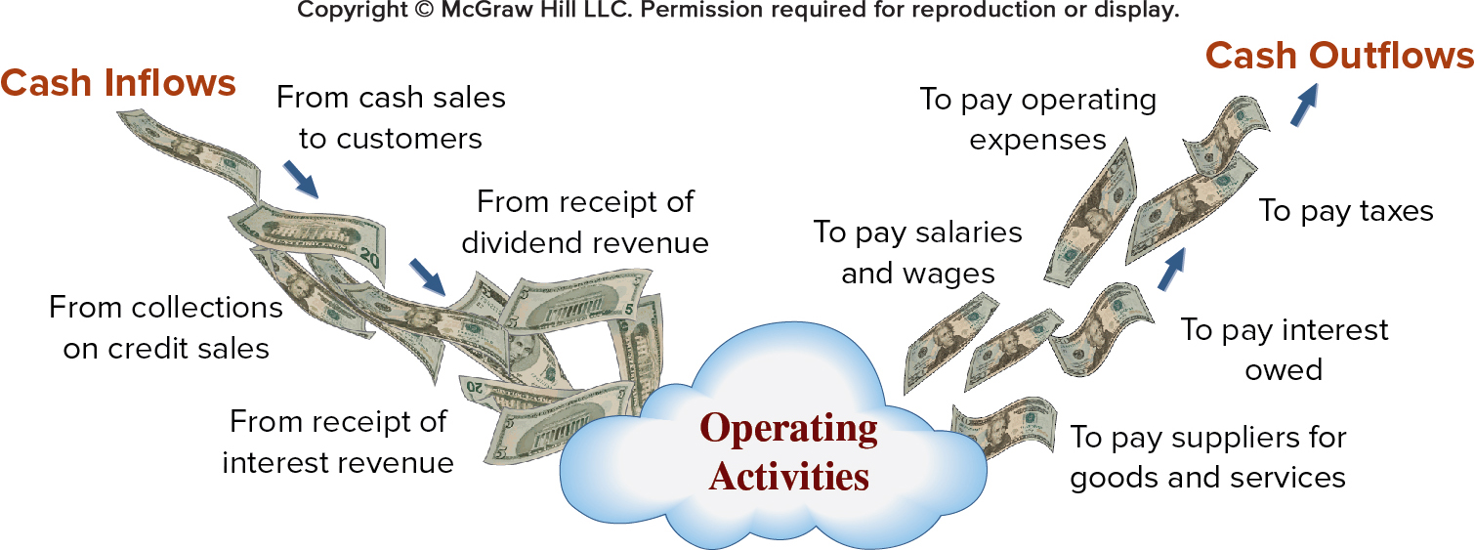
Operating Activities
Exhibit 16.1
Access the text alternative for slide images.
Notes:
Operating activities include transactions and events that affect net income. Examples are the production and purchase of inventory, the sale of goods and services to customers, and the expenditures to operate the business. Not all items in income, such as unusual gains and losses, are operating activities (we discuss these exceptions later). This slide lists the more common cash inflows and outflows from operating activities.

Slide 9
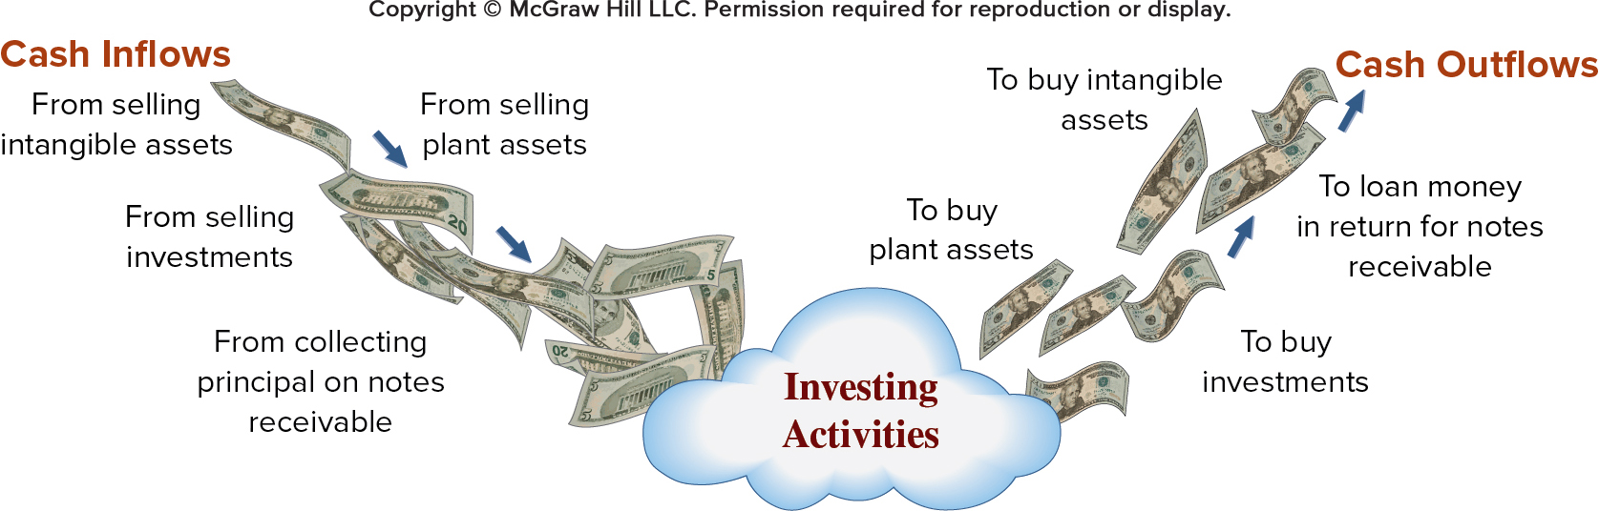
Investing Activities
Exhibit 16.2
Access the text alternative for slide images.
Notes:
Investing activities include transactions and events that come from the purchase and sale of long-term assets. They also include (1) the purchase and sale of short-term investments in other entities, and (2) lending and collecting money for notes receivable. This slide lists examples of cash flows from investing activities. Cash from collecting the principal on notes is an investing activity. However, collecting interest on notes is an operating activity. If a note results from sales to customers, it is as operating activity.

Slide 10
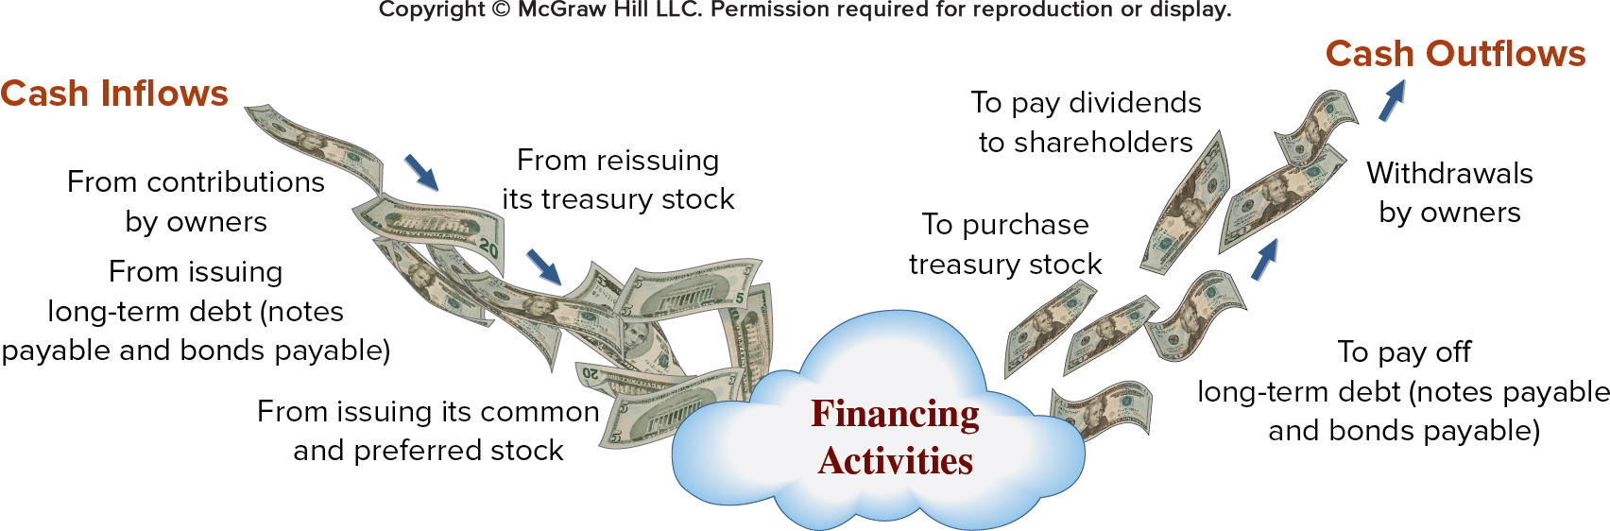
Financing Activities
Exhibit 16.3
Access the text alternative for slide images.
Notes:
Financing activities include transactions and events that affect long-term liabilities and equity. Examples are (1) receiving cash from issuing debt and repaying debt and (2) receiving cash from or distributing cash to owners. Borrowing and repaying principal on both short- and long-term debt are financing activities. Payments of interest are operating activities.

Slide 11
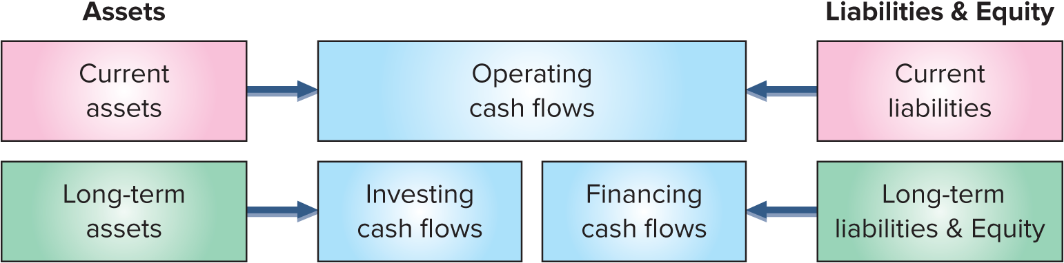
Link between Classification of Cash Flows and the Balance Sheet
Operating, investing, and financing activities are loosely linked to the balance sheet.
Operating activities are affected by changes in current assets and current liabilities.
Investing activities are affected by changes in long-term assets.
Financing activities are affected by changes in long-term liabilities and equity.
Exhibit 16.4
Access the text alternative for slide images.
Notes:
Operating, investing, and financing activities are loosely linked to different parts of the balance sheet. Operating activities are affected by changes in current assets and current liabilities (and the income statement). Investing activities are affected by changes in long-term assets. Financing activities are affected by changes in long-term liabilities and equity. These links are shown in Exhibit 16.4.
Exceptions to these links include (1) current assets unrelated to operations—such as short-term notes receivable from noncustomers and from investment securities, which are investing activities, and (2) current liabilities unrelated to operations—such as short-term notes payable and dividends payable, which are financing activities.

Slide 12
Noncash Investing and Financing
Examples of Noncash Investing and Financing Activities:
Exhibit 16.5
Retirement of debt by issuing equity stock.
Conversion of preferred stock to common stock.
Lease of assets in a long-term lease transaction.
Purchase of long-term assets by issuing a note or bond.
Exchange of noncash assets for other noncash assets.
Purchase of noncash assets by issuing equity or debt
Notes:
Some investing and financing activities do not affect cash flows. One example is the purchase of long-term assets by issuing a long-term note or bond payable (loan). This transaction involves both investing and financing activities but does not impact current-period cash. Such transactions are reported at the bottom of the statement of cash flows or in a note to the statement because of their importance and the full-disclosure principle. This slide lists transactions commonly disclosed as noncash investing and financing activities.

Slide 13
Learning Objective P1
Prepare a statement of cash flows.

Slide 14
Format of the Statement of Cash Flows
Exhibit 16.6
COMPANY NAME
Statement of Cash Flows
For period Ended date
The following content is arranged like a table. Table titled, company name, statement of cash flows for the period ended date, lists 3 accounts related to different cash flow activities. The last 3 rows list net increase and cash balances. Blank spaces are provided for values of each of these accounts. The last rows shows a line of text.
Cash flows from operating activities
[Compute operating cash flows using indirect or direct method]
Net cash provided (used) by operating activities | $ #
Cash flows from investing activities
[List of individual inflows and outflows]
Net cash provided (used) by investing activities | #
Cash flows from financing activities
[List of individual inflows and outflows]
Net cash provided (used) by financing activities | #
Net increase (decrease) in cash | $ #
Cash (and equivalents) balance at prior period-end | #
Cash (and equivalents) balance at current period-end | $ #
Separate schedule or note disclosure of any noncash investing and financing transactions is required.
Notes:
A statement of cash flows reports cash flows from three activities: operating, investing, and financing. The statement shows the net increase or decrease from those activities and ties it into the cash balance. Any non-cash investing and financing transactions are disclosed in a note or separate schedule.

Slide 15
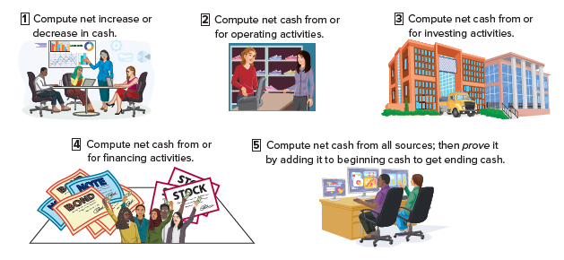
Preparing the Statement of Cash Flows
Exhibit 16.7
Access the text alternative for slide images.
Notes:
Preparing a statement of cash flows involves five steps:
Compute the net increase or decrease in cash;
Compute net cash from or used by operating activities;
Compute net cash from or used by investing activities;
Compute net cash from or used by financing activities;
Compute the net cash flow from all sources, and then prove it by adding it to the beginning cash balance to get ending cash balance.
We will follow these steps in the preparation of our example statement of cash flows.

Slide 16
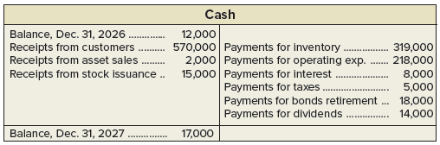
Analyzing the Cash Account
The Cash account is a natural place to look for information about cash flows from operating, investing, and financing activities.
T-account. Table looks like an uppercase T, with a line dividing the table in half between debits and credits. Date of transaction listed with the dollar amount. End balance also has a horizontal line separating it from the entries. First column is transaction reference for debits in that row, last column is transaction reference for credits in that row.
Cash accounts, Balance, Dec. 31, 2026, debited $12,000, Receipts from customers, debited $570,000, Payments for inventory, credited $319,000, Receipts from asset sales, debited $2,000, Payments for operating exp., credited $218,000, Receipts from stock issuance, debited $15,000, Payments for interest, credited $8,000, Payments for taxes, credited $5,000, Payments for bonds retirement, credited $18,000, Payments for dividends, credited $14,000, debit balance, December 31, 2027, $17,000.
Exhibit 16.8
Notes:
Computing the net increase or net decrease in cash is a simple but crucial computation. It equals the current period’s cash balance minus the prior period’s cash balance. This is the bottom-line figure for the statement of cash flows and is a check on accuracy.
A company’s cash receipts and cash payments are recorded in the Cash account. The Cash account is one place to look for information about cash flows from operating, investing, and financing activities. To illustrate, see the summarized Cash T-account of Genesis, Inc., in this slide. The Cash account increased $5,000, from $12,000 to $17,000. Individual cash transactions are summarized in this Cash account according to the major types of cash receipts and cash payments. For instance, only the total of cash receipts from all customers is listed. Individual cash transactions underlying these totals can number in the thousands. Accounting software is available to provide summarized cash accounts.
The statement of cash flows summarizes and classifies the transactions that led to the $5,000 increase in the Cash account. Preparing a statement of cash flows requires determining whether an individual cash inflow or outflow is an operating, investing, or financing activity, and then listing each by activity.

Slide 17
Analyzing Noncash Accounts
A second approach to preparing the statement of cash flows is analyzing noncash accounts.
Exhibit 16.9
Notes:
A second approach to preparing the statement of cash flows is analyzing noncash accounts and draws on double-entry accounting.
In sum, all cash transactions eventually affect noncash balance sheet accounts. Thus, we can determine cash inflows and outflows by analyzing changes in noncash balance sheet accounts.
This slide uses the accounting equation to show the relation between the Cash account and the noncash balance sheet accounts.

Slide 18
Information to Prepare the Statement
Information to prepare the statement of cash flows comes from three sources:
Comparative Balance Sheets
Current Income Statement
Additional Information
Notes:
Information to prepare the statement of cash flows comes from three sources:
comparative balance sheets,
the current income statement, and
additional information.
Comparative balance sheets are used to compute changes in noncash accounts from the beginning to the end of the period. The current income statement is used to help compute cash flows from operating activities. Additional information often includes details that help explain cash flows and non-cash activities.

Slide 19
Learning Objective P2
Compute cash flows from operating activities using the indirect method.

Slide 20


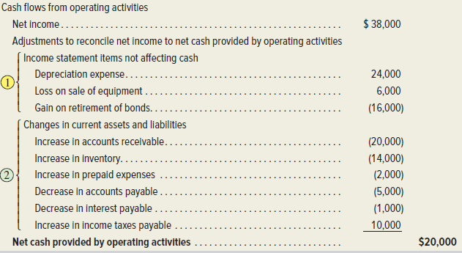

Cash Flows from Operating
Indirect and Direct Methods of Reporting
Cash flows from operating activities
Cash received from customers $570,000
Cash paid for inventory (319,000)
Cash paid for operating expenses (218,000)
Cash paid for interest (8,000)
Cash paid for taxes (5,000)
Net cash provided by operating activities $20,000
Direct Method
Indirect Method
The net cash amount provided by operating activities is identical under both the direct and indirect methods.
Access the text alternative for slide images.
Notes:
Cash flows provided (used) by operating activities are reported using the direct method or the indirect method. These two different methods apply only to the operating activities section.
The direct method separately lists operating cash receipts (such as cash received from customers) and operating cash payments (such as cash paid for inventory). The cash payments are then subtracted from cash receipts.
The indirect method reports net income and then adjusts it for items that do not affect cash. It does not report individual items of cash inflows and cash outflows from operating activities.
The net cash amount provided by operating activities is identical under both the direct and indirect methods. This equality always exists. The difference is with the computation and presentation of this amount. Nearly all companies report operating cash flows using the indirect method.

Slide 21
Cash Flows: Indirect Method Illustration
GENESIS
Income Statement
For Year Ended December 31, 2027
GENESIS
Balance Sheets
Exhibit 16.10
At December 31 | 2027 | 2026 | Change
Assets
Current assets
Cash | $ 17,000 | $ 12,000 | $ 5,000 Increase
Accounts receivable | 60,000 | 40,000 | 20,000 Increase
Inventory | 84,000 | 70,000 | 14,000 Increase
Prepaid expenses | 6,000 | 4,000 | 2,000 Increase
Total current assets | 167,000 | 126,000
Long-term assets
Equipment | 190,000 | 210,000 | 20,000 Decrease
Accumulated depreciation | (60,000) | (48,000) | 12,000 Increase
Land | 60,000 | 0 | 60,000 Increase
Total assets | $357,000 | $288,000
Liabilities
Current liabilities
Accounts payable | $ 35,000 | $ 40,000 | $ 5,000 Decrease
Interest payable | 3,000 | 4,000 | 1,000 Decrease
Income taxes payable | 22,000 | 12,000 | 10,000 Increase
Total current liabilities | 60,000 | 56,000
Long-term notes payable | 90,000 | 30,000 | 60,000 Increase
Long-term bonds payable | 0 | 34,000 | 34,000 Decrease
Total liabilities | 150,000 | 120,000
Equity
Common stock, $5 par | 95,000 | 80,000 | 15,000 Increase
Retained earnings | 112,000 | 88,000 | 24,000 Increase
Total equity | 207,000 | 168,000
Total liabilities and equity | $357,000 | $288,000
Sales |  | $590,000
Cost of goods sold | $300,000
Operating expenses (excluding depreciation) | 216,000
Depreciation expense | 24,000
Interest expense | 7,000 | (547,000)
 |  | 43,000
Other gains (losses)
Loss on sale of equipment | (6,000)
Gain on retirement of bonds | 16,000 | 10,000
Income before taxes |  | 53,000
Income taxes expense |  | (15,000)
Net income |  | $38,000
The following content is arranged like a table. Table, titled Genesis balance sheet, lists 14 accounts in 3 categories: assets, liabilities, and equity. The 7 accounts in assets are further categorized into 2: current assets and long-term assets. The values for total amount is displayed at the end of each category and sub category. These total accounts don’t have values in column 4 for change.
The following content is arranged like a table. Table titled, Genesis Income Statement for year ended December 31, 2027, lists the values of 10 accounts listed in column 1. The accounts for sales, income before taxes, income taxes expense, net income, and row 6 have their values in column 3. The rest of the accounts have values only in column 2. The accounts, interest expense and gain on retirement of notes have values in both columns 2 and 3.
Additional information for 2027
a. The accounts payable balances result from inventory purchases.
b. Purchased $60,000 in land by issuing $60,000 of long-term notes payable.
c. Sold equipment with a book value of $8,000 (original cost of $20,000 and accumulated depreciation of $12,000) for $2,000 cash, yielding a $6,000 loss.
d. Received $15,000 cash from issuing 3,000 shares of common stock.
e. Paid $18,000 cash to retire bonds with a $34,000 book value, yielding a $16,000 gain.
f. Declared and paid cash dividends of $14,000.
The following content is arranged like a table. Table lists 6 additional information for 2027.
Notes:
To illustrate, we prepare the operating activities section of the statement of cash flows for Genesis. This slide shows the December 31, 2026 and 2027, balance sheets of Genesis along with its 2027 income statement. We use this information to prepare a statement of cash flows that explains the $5,000 increase in cash for 2027 as reflected in its balance sheets. This $5,000 is computed as Cash of $17,000 at the end of 2027 minus Cash of $12,000 at the end of 2026.
Additional information for 2027:
a. The accounts payable balances result from inventory purchases.
b. Purchased $60,000 in land by issuing $60,000 of long-term notes payable.
c. Sold equipment with a book value of $8,000 (original cost of $20,000 and accumulated depreciation of $12,000) for $2,000 cash, yielding a $6,000 loss.
d. Received $15,000 cash from issuing 3,000 shares of common stock.
e. Paid $18,000 cash to retire bonds with a $34,000 book value, yielding a $16,000 gain.
f. Declared and paid cash dividends of $14,000.

Slide 22
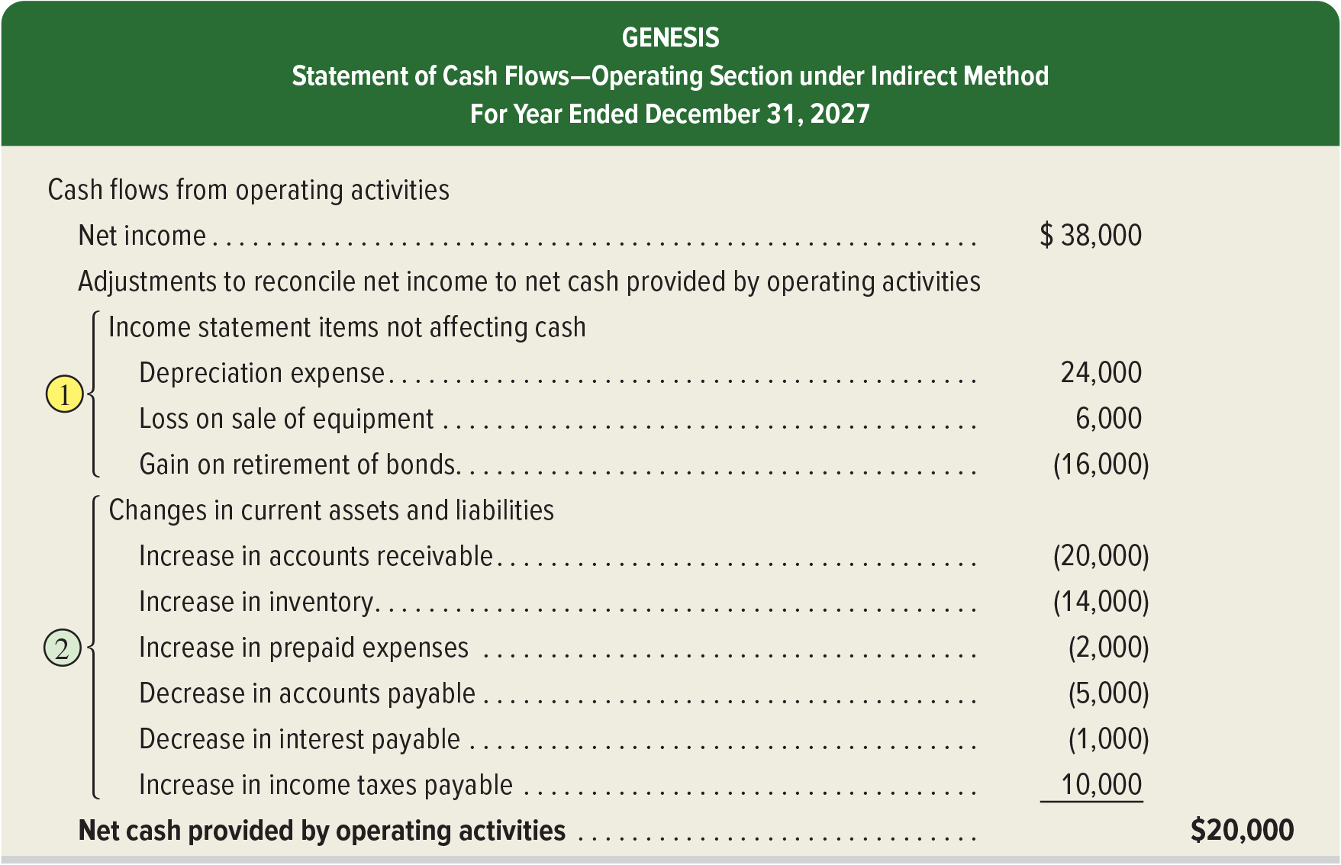
Applying the Indirect Method
Exhibit 16.11
Access the text alternative for slide images.
Notes:
The indirect method starts with the accrual based net income and makes two types of adjustments to arrive at cash flows from operating activities. Adjustments to the accrual based net income include (1) adjustments for changes current assets and current liabilities and (2) adjustments to income statement items that do not impact cash.

Slide 23
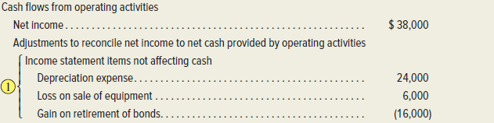
Adjustments for Income Statement Items Not Affecting Cash
Expenses and losses with no cash outflows are added back to net income.
Revenues and gains with no cash inflows are subtracted from net income.
Access the text alternative for slide images.
Notes:
Adjustments for Income Statement Items Not Affecting Cash:
The income statement usually includes some expenses and losses that are subtracted when computing net income that are not cash outflows. Examples are depreciation, amortization, depletion, bad debts expense, loss from an asset sale, and loss from retirement of notes payable. When there are expenses and losses that do not reflect cash outflows, the indirect method for reporting operating cash flows requires the following adjustment:
Expenses and losses with no cash outflows are added back to net income.
Recall that items such as depreciation, amortization, and depletion did not reduce cash, and adding them back cancels their deductions when computing net income. To see the logic for losses, consider that items such as a sale of equipment or a notes or bonds retirement, are usually recorded by recognizing the cash, removing the asset or note accounts, and recording any loss or gain. The cash received or paid is part of either investing or financing cash flows. No operating cash flow effect occurs, and adding it back to net income, cancels the deduction.
Similarly, when net income includes revenues that are not cash inflows, the indirect method for reporting operating cash flows requires the following adjustment:
Revenues and gains with no cash inflows are subtracted from net income.
Depreciation: Depreciation expense is Genesis’s only operating item that has no effect on cash flows. We must add back the $24,000 depreciation expense to net income when computing cash provided by operating activities. Adding it back cancels the expense.
Loss on sale of equipment. Genesis reported a $6,000 loss on sale of equipment as part of net income. This loss is a proper deduction in computing income, but it is not part of operating activities. Instead, a sale of equipment is part of investing activities. Thus, the $6,000 nonoperating loss is added back to net income because it is not a cash outflow.
Gain on retirement of bonds. A $16,000 gain on retirement of bonds is properly included in net income, but it is not part of operating activities. This means the $16,000 gain must be subtracted from net income to obtain net cash provided by operating activities because it was not a cash inflow.

Slide 24

Adjustments for Changes in Current Assets and Current Liabilities 1
Change in Account Balance During Year
The following content is arranged like a table. Table divided into 3 columns. The column headers are marked from left to right as: increase, and decrease. Column header for column 1 is blank.
 | Increase | Decrease
Current Assets | Subtract from net income | Add to net income
Current Liabilities | Add to net income | Subtract from net income
Use this table when adjusting Net Income to Operating Cash Flows.
Notes:
This chart explains how to treat a change in a noncash current asset or current liability in the operating section of the statement of cash flows.
Adjustments for changes in current assets: if accounts receivable, a current asset, decreased during the year, this decrease would be added to net income. A decrease in accounts receivable means that customer cash payments on account exceeded customer charges on account during the period. This excess of cash payments over charges is used to adjust the accrual-based revenues reported on the income statement to report the total cash received from customers during the period. If accounts receivable increased during the year, this increase would be subtracted from net income. An increase in accounts receivable means that customer charges on account exceeded customer cash payments on account during the period. This excess of charges over cash payments is used to adjust the accrual-based revenues reported on the income statement to report the total cash received from customers during the period.
Adjustments for changes in current liabilities: if salaries payable, a current liability, decreased during the year, this decrease would be subtracted from net income. A decrease in salaries payable means that the company paid off more in salaries than it charged to expense during the period. This excess of cash payments over charges is used to adjust the accrual-based expense reported on the income statement to report the total cash paid for salaries during the period. If salaries payable increased during the year, this increase would be added to net income. An increase in salaries payable means the company charged more to expense than it paid off during the period. This excess of charges over cash payments is used to adjust the accrual-based expense reported on the income statement to report the total cash paid for salaries during the period.

Slide 25
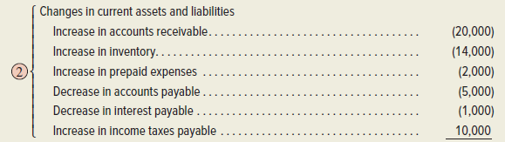
Adjustments for Changes in Current Assets and Current Liabilities 2
Decreases in current assets are added to net income.
Increases in current assets are subtracted from net income.
Increases in current liabilities are added to net income.
Decreases in current liabilities are subtracted from net income.
Access the text alternative for slide images.
Notes:
This slide shows the results of the indirect method of reporting operating cash flows, which adjusts net income for two types of adjustments.
Adjustments for Changes in Current Assets and Current Liabilities:
1. Adjustments for changes in current assets.
Decreases in current assets require the following adjustment: Decreases in current assets are added to net income.
Increases in current assets require the following adjustment: Increases in current assets are subtracted from net income.
2. Adjustments for changes in current liabilities.
Increases in current liabilities require the following adjustment to net income when computing operating cash flows: Increases in current liabilities are added to net income.
Accounts Receivable: The $20,000 increase in the current asset of accounts receivable is subtracted from net income. This means that Genesis collects less cash than is reported in sales.
Inventory: The $14,000 increase in inventory is subtracted from income. Cash paid is $14,000 more than COGS which is why we subtract it from income in computing cash flow.
Prepaid Expenses: The $2,000 increase in prepaid expenses is subtracted from income because cash paid is $2,000 more than expenses recorded.
Accounts Payable: The $5,000 decrease in accounts payable is subtracted from income because cash paid is $5,000 more than the purchases recorded.
Interest Payable: The $1,000 decrease in interest payable is subtracted from income because the cash paid is $1,000 more than the interest recorded.
Income Taxes Payable: The $10,000 increase in income taxes payable is added to income because cash paid is less than the taxes recorded.

Slide 26


Summary of Adjustments for Indirect Method: Part 2
Common adjustments to net income when computing net cash provided or used by operating activities under the indirect method:
The following content is arranged like a table. Table has single column.
Exhibit 16.12
Net Income (or Loss)
1 Adjustments for operating items not providing or using cash
+ Noncash expenses and losses
Examples: Expenses for depreciation, depletion, and amortization; losses from disposal of long-term assets and from retirement of debt
− Noncash revenues and gains
Examples: Gains from disposal of long-term assets and from retirement of debt
2 Adjustments for changes in current assets and current liabilities
+ Decrease in noncash current operating assets
− Increase in noncash current operating assets
+ Increase in current operating liabilities
− Decrease in current operating liabilities
Net cash provided (used) by operating activities
Notes:
This slide summarizes the adjustments to net income when computing net cash provided or used by operating activities under the indirect method.

Slide 27
Learning Objective P3
Determine cash flows from both investing and financing activities.

Slide 28
Cash Flows from Investing: Three-Step Analysis
A three-step process to determine cash provided or used by investing activities:
Identify changes in investing-related accounts
Determine the cash effects using T‑accounts and reconstructed entries
Report the cash flow effects
Notes:
The second major step in preparing the statement of cash flows is to compute and report cash flows from investing activities. We normally do this by identifying changes in (1) all long-term asset accounts and (2) any current accounts for notes receivable and investments in securities. Reporting of investing activities is identical under the direct method and indirect method.
To determine cash provided or used by investing activities: (1) identify changes in investing-related accounts, (2) determine the cash effects using T-accounts and reconstructed entries, and (3) report the cash flow effects.

Slide 29
Cash Flows from Investing: First Step
Exhibit 16.10
GENESIS
Income Statement
For Year Ended December 31, 2027
GENESIS
Balance Sheets
At December 31 | 2027 | 2026 | Change
Assets
Current assets
Cash | $ 17,000 | $ 12,000 | $ 5,000 Increase
Accounts receivable | 60,000 | 40,000 | 20,000 Increase
Inventory | 84,000 | 70,000 | 14,000 Increase
Prepaid expenses | 6,000 | 4,000 | 2,000 Increase
Total current assets | 167,000 | 126,000
Long-term assets
Equipment | 190,000 | 210,000 | 20,000 Decrease
Accumulated depreciation | (60,000) | (48,000) | 12,000 Increase
Land | 60,000 | 0 | 60,000 Increase
Total assets | $357,000 | $288,000
Liabilities
Current liabilities
Accounts payable | $ 35,000 | $ 40,000 | $ 5,000 Decrease
Interest payable | 3,000 | 4,000 | 1,000 Decrease
Income taxes payable | 22,000 | 12,000 | 10,000 Increase
Total current liabilities | 60,000 | 56,000
Long-term notes payable | 90,000 | 30,000 | 60,000 Increase
Long-term bonds payable | 0 | 34,000 | 34,000 Decrease
Total liabilities | 150,000 | 120,000
Equity
Common stock, $5 par | 95,000 | 80,000 | 15,000 Increase
Retained earnings | 112,000 | 88,000 | 24,000 Increase
Total equity | 207,000 | 168,000
Total liabilities and equity | $357,000 | $288,000
This analysis reveals a $20,000 decrease in equipment from $210,000 to $190,000 and a $12,000 increase in accumulated depreciation from $48,000 to $60,000.
The following content is arranged like a table. Table titled, Genesis Income Statement for year ended December 31, 2027, lists the values of 10 accounts listed in column 1. The accounts for sales, income before taxes, income taxes expense, net income, and row 6 have their values in column 3. The rest of the accounts have values only in column 2. The accounts, interest expense and gain on retirement of notes have values in both columns 2 and 3.
The following content is arranged like a table. Table, titled Genesis balance sheet, lists 14 accounts in 3 categories: assets, liabilities, and equity. The 7 accounts in assets are further categorized into 2: current assets and long-term assets. The values for total amount is displayed at the end of each category and sub category. These total accounts don’t have values in column 4 for change.
Sales |  | $590,000
Cost of goods sold | $300,000
Operating expenses (excluding depreciation) | 216,000
Depreciation expense | 24,000
Interest expense | 7,000 | (547,000)
 |  | 43,000
Other gains (losses)
Loss on sale of equipment | (6,000)
Gain on retirement of bonds | 16,000 | 10,000
Income before taxes |  | 53,000
Income taxes expense |  | (15,000)
Net income |  | $ 38,000
The following content is arranged like a table. A table lists 6 additional information for 2027.
Additional information for 2027
a. The accounts payable balances result from inventory purchases.
b. Purchased $60,000 in land by issuing $60,000 of long-term notes payable.
c. Sold equipment with a book value of $8,000 (original cost of $20,000 and accumulated depreciation of $12,000) for $2,000 cash, yielding a $6,000 loss.
d. Received $15,000 cash from issuing 3,000 shares of common stock.
e. Paid $18,000 cash to retire bonds with a $34,000 book value, yielding a $16,000 gain.
f. Declared and paid cash dividends of $14,000.
Notes:
Information about the Genesis transactions provided earlier reveals that the company both purchased and sold equipment during the period. Both transactions are investing activities and are analyzed for their cash flow effects in this section.
Equipment Transactions: The first step in analyzing the Equipment account and its related Accumulated Depreciation account is to identify any changes in these accounts. This analysis shows a $20,000 decrease in plant assets from $210,000 to $190,000 and a $12,000 increase in accumulated depreciation from $48,000 to $60,000.

Slide 30
Cash Flows from Investing: Second Step
Item c reports that Genesis sold equipment costing $20,000 (with $12,000 of accumulated depreciation) for $2,000 cash, resulting in a $6,000 loss.
Reconstruction | Cash | 2,000
 | Accumulated Depreciation | 12,000
 | Loss on Sale of Equipment | 6,000
 | Equipment |  | 20,000
The following content is arranged like a table. Reconstruction journal entry shows account names and amounts debited on the first 3 lines; indented account name and amount on the last line.
We also reconstruct the entry for Depreciation Expense using information from the income statement.
The following content is arranged like a table. Reconstruction journal entry shows account name and amount debited on the first line; indented account name and amount on the next line.
Reconstruction | Depreciation Expense | 24,000
 | Accumulated Depreciation |  | 24,000
Notes:
The second step is to explain these changes. Item “c” of the additional information discussed earlier affects equipment. Recall that the Equipment account is impacted by both purchases and sales; its Accumulated Depreciation account is normally increased by depreciation and decreased by the removal of accumulated depreciation in asset sales. To explain changes in these accounts, and to identify their cash flow effects, we prepare reconstructed entries from prior transactions (they are not the actual entries made by the preparer).
To illustrate, item c reports that Genesis sold equipment costing $20,000 for $2,000 cash. The reconstructed entry for analysis of item c is shown.

Slide 31
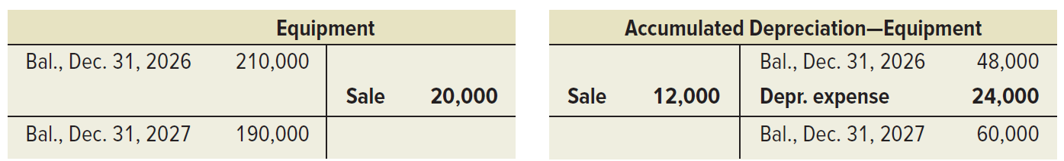
Cash Flows from Investing: Third Step
Reconstructed T-accounts show changes in long-term assets.
T-account. Table looks like an uppercase T, with a line dividing the table in half between debits and credits. Date of transaction listed with the dollar amount. End balance also has a horizontal line separating it from the entries. First column is transaction reference for debits in that row, last column is transaction reference for credits in that row.
Equipment accounts, Balance, Dec. 31, 2026, debited $210,000, Sale, credited $20,000, Balance, Dec. 31, 2027, debited $190,000.
T-account. Table looks like an uppercase T, with a line dividing the table in half between debits and credits. Date of transaction listed with the dollar amount. End balance also has a horizontal line separating it from the entries. First column is transaction reference for debits in that row, last column is transaction reference for credits in that row.
Accumulated depreciation-equipment accounts, Balance, Dec. 31, 2026, credited $48,000, Sale, debited $12,000, Depreciation expense, credited $24,000, balance, December 31, 2027, credited $60,000.
The identified cash flows are reported in the investing section:
The following content is arranged like a table. A table shows an account and an amount for cash flows from investing activities.
Cash flows from investing activities
Cash received from sale of equipment | $2,000
The $60,000 purchase in item b, was paid for by issuing a long-term notes payable. This means it is reported in a note or in a separate schedule to the statement as a noncash investing and financing activity.
The following content is arranged like a table. A table shows an account and an amount for noncash investing and financing activity.
Noncash investing and financing activity
Purchased land with issuance of notes | $60,000
Notes:
In the third step, the $2,000 cash received from the sale of equipment identifies cash flows as reported in the investing section of the statement.
We also reconstruct the entry for Depreciation Expense from the income statement. Depreciation expense results in no cash flow effect.
The $60,000 purchase in item b, was paid by issuing a long-term notes payable. This means it is not reported as a cash flow, but is instead reported in a note or in a separate schedule to the statement as a noncash investing and financing activity.

Slide 32
Cash Flows from Financing: Three-Step Analysis
A three-step process to determine cash provided or used by financing activities:
Identify changes in financing-related accounts
Determine the cash effects using T-accounts and reconstructed entries
Report the cash flow effects
Notes:
To compute cash flows from financing activities, we analyze changes in all noncurrent liability accounts (including the current portion of any notes and bonds) and equity accounts.
These accounts include long-term debt, notes payable, bonds payable, common stock, and retained earnings. Reporting of financing activities is identical under the direct method and indirect method.
Three-Step Process of Analysis
We again use a three-stage process to determine cash provided or used by financing activities: (1) identify changes in financing-related accounts, (2) determine the cash effects using T-accounts and reconstructed analysis, and (3) report their cash flow effects.

Slide 33
Cash Flows from Financing: First Step
Exhibit 16.10
Liabilities
Current liabilities
Accounts payable | $ 35,000 | $ 40,000 | $ 5,000 Decrease
Interest payable | 3,000 | 4,000 | 1,000 Decrease
Income taxes payable | 22,000 | 12,000 | 10,000 Increase
Total current liabilities | 60,000 | 56,000
Long-term notes payable | 90,000 | 30,000 | 60,000 Increase
Long-term bonds payable | 0 | 34,000 | 34,000 Decrease
Total liabilities | 150,000 | 120,000
This analysis reveals: a decrease in bonds payable from $34,000 to $0.
The following content is arranged like a table. Table divided into 4 columns and 9 rows.
Notes:
Information about Genesis provided earlier reveals two transactions involving noncurrent liabilities. Genesis retired bonds and issued notes in noncurrent liabilities.
Bonds Payable Transactions:
First step: review the comparative balance sheets shown which reveals a decrease in bonds payable from $34,000 to $0.

Slide 34
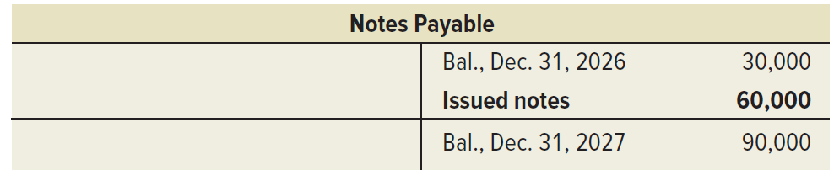
Cash Flows from Financing: Second Step
Step two explains the change in item e. Bonds with a carrying value of $34,000 are retired for $18,000 cash, resulting in a $16,000 gain.
The following content is arranged like a table. Reconstruction journal entry shows account name and amount debited on the first line; indented account names and amounts on the next 2 lines.
Reconstruction | Bonds Payable | 34,000
 | Gain on bond retirement |  | 16,000
 | Cash |  | 18,000
Cash Flows from Financing: Third Step
Step three reports cash paid for the bond’s retirement in the financing activities section.
T-account. Table looks like an uppercase T, with a line dividing the table in half between debits and credits. Date of transaction listed with the dollar amount. End balance also has a horizontal line separating it from the entries. First column is transaction reference for debits in that row, last column is transaction reference for credits in that row.
Notes payable accounts, Balance, Dec. 31, 2026, credited $30,000, issued notes, credited $60,000, credit balance, December 31, 2027, $90,000.
The following content is arranged like a table. A table shows an account and an amount for cash flows from financing activities.
Cash flows from financing activities
Cash paid to retire bonds $(18,000)
Notes:
The second step explains this change. Item e of the additional information reports that bonds with a carrying value of $34,000 are retired for $18,000 cash, resulting in a $16,000 gain. The reconstructed entry for analysis of item is shown here.
This entry reveals an $18,000 cash outflow for retirement of notes and a $16,000 gain from comparing the bonds payable carrying value to the cash received. This gain does not reflect any cash inflow or outflow.
The third step reports the cash paid for the bond retirement in the financing activities section.

Slide 35
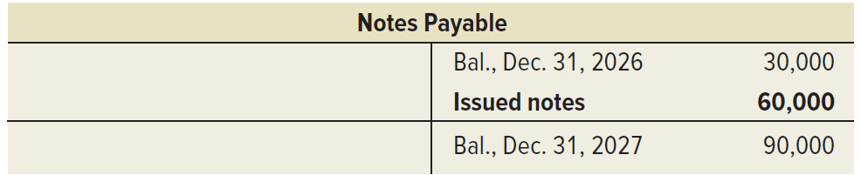
Notes Payable Transactions: Steps 1–3
Step 1: Review of comparative balance sheets shows an increase in notes payable from $30,000 to $90,000.
Step 2: Explain the change in item e. Genesis purchased land costing $60,000 by issuing notes payable of $60,000.
Step 3: The $60,000 increase in notes payable is reported as a noncash investing and financing transaction.
The following content is arranged like a table. Table has 4 columns and three rows.
Long-term notes payable | 90,000 | 30,000 | 60,000 Increase
Long-term bonds payable | 0 | 34,000 | 34,000 Decrease
Total liabilities | 150,000 | 120,000
The following content is arranged like a table. Table shows an account and an amount for noncash investing and financing activities.
T-account. Table looks like an uppercase T, with a line dividing the table in half between debits and credits. Date of transaction listed with the dollar amount. End balance also has a horizontal line separating it from the entries. First column is transaction reference for debits in that row, last column is transaction reference for credits in that row.
Notes payable accounts, Balance, Dec. 31, 2026, credited $30,000, issued notes, credited $60,000, credit balance, December 31, 2027, $90,000.
Noncash investing and financing activities
Purchased land with issuance of notes | $60,000
Notes:
First step: review the comparative balance sheets which shows an increase in notes payable from $30,000 to $90,000.
Second step: explain the change in item e. Genesis purchased land costing $60,000 by issuing $60,000 in notes payable. This issuance of notes entirely explains the change in the Notes Payable account.
Third step: This $60,000 increase in notes payable is reported as a noncash investing and financing transaction.

Slide 36
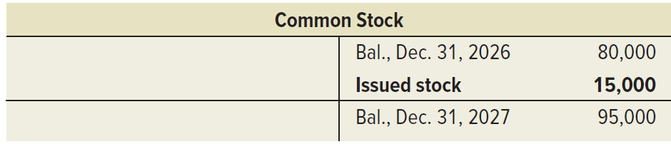
Cash Flows from Financing: Common Stock Transactions
Step one review the comparative balance sheets which show an increase in common stock from $80,000 to $95,000.
Step two explains change of item d which reports 3,000 shares of common stock are issued at par for $5 per share.
Step three reports cash received from stock issuance in financing activities section.
The following content is arranged like a table. Reconstruction journal entry shows account name and amount debited on the first line; indented account names and amounts on the next line.
Reconstruction | Cash | 15,000
 | Common Stock |  | 15,000
T-account. Table looks like an uppercase T, with a line dividing the table in half between debits and credits. Date of transaction listed with the dollar amount. End balance also has a horizontal line separating it from the entries. First column is transaction reference for debits in that row, last column is transaction reference for credits in that row.
Common stock accounts, Balance, Dec. 31, 2026, credited $80,000, issued stock, credited $15,000, credit balance, December 31, 2027, $95,000.
The following content is arranged like a table. Table shows an account and an amount for cash flows from financing activities.
Cash flows from financing activities
Cash received from issuing stock | $15,000
Notes:
The Genesis information reveals two transactions involving equity accounts. The first is the issuance of common stock for cash.
The first step in analyzing common stock is to review the comparative balance sheets shown in Exhibit 16.10, which reveal an increase in common stock from $80,000 to $95,000.
The second step explains this change using the T-account. Item d of the additional information provided earlier reports that 3,000 shares of common stock are issued at par for $5 per share. The reconstructed entry for analysis of item d is shown. This entry reveals a $15,000 cash inflow from stock issuance.
Step three reports cash received from stock issuance in the financing activities section.

Slide 37
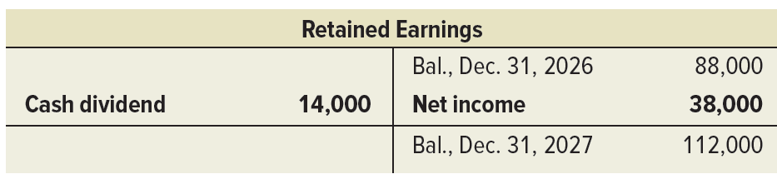
Cash Flows from Financing: Retained Earnings Transactions
Step one in analyzing Retained Earnings reviews comparative balance sheets. Show an increase in retained earnings from $88,000 to $112,000.
Step two explains change of item f which reports cash dividends of $14,000 are paid.
Step three reports cash paid for dividends in the financing activities section.
The following content is arranged like a table. Reconstruction journal entry shows account name and amount debited on the first line; indented account names and amounts on the next line.
Reconstruction | Retained Earnings | 14,000
 | Cash |  | 14,000
T-account. Table looks like an uppercase T, with a line dividing the table in half between debits and credits. Date of transaction listed with the dollar amount. End balance also has a horizontal line separating it from the entries. First column is transaction reference for debits in that row, last column is transaction reference for credits in that row.
Retained earnings accounts, Balance, Dec. 31, 2026, credited $88,000, cash dividend debited $14,000, net income, credited $38,000, credit balance, December 31, 2027, $112,000.
The following content is arranged like a table. Table shows an account and an amount for cash flows from financing activities.
Cash flows from financing activities
Cash paid for dividends | $(14,000)
Notes:
The Genesis information reveals two transactions involving equity accounts. The second is the declaration and payment of cash dividends.
The first step in analyzing the Retained Earnings account is to review the comparative balance sheets shown earlier. This reveals an increase in retained earnings from $88,000 to $112,000.
The second step explains this change. Item f of the additional information provided earlier reports that cash dividends of $14,000 are paid. The reconstructed entry is shown.
In step three, the cash paid for dividends is reported in the financing activities section.
We now have identified and explained all of Genesis’ cash inflows and cash outflows and one noncash investing and financing transaction.

Slide 38
Proving Cash Balances
GENESIS
Statement of Cash Flows (Indirect Method)
For Year Ended December 31, 2027
Exhibit 16.13
Cash flows from operating activities
Net income | $ 38,000
Adjustments to reconcile net income to net cash provided by operating activities
Income statement items not affecting cash
Depreciation expense | 24,000
Loss on sale of equipment | 6,000
Gain on retirement of bonds | (16,000)
Changes in current assets and liabilities
Increase in accounts receivable | (20,000)
Increase in inventory | (14,000)
Increase in prepaid expenses | (2,000)
Decrease in accounts payable | (5,000)
Decrease in interest payable | (1,000)
Increase in income taxes payable | 10,000
Net cash provided by operating activities |  | $ 20,000
Cash flows from investing activities
Cash received from sale of equipment | 2,000
Net cash provided by investing activities |  | 2,000
Cash flows from financing activities
Cash received from issuing stock | 15,000
Cash paid to retire bonds | (18,000)
Cash paid for dividends | (14,000)
Net cash used in financing activities |  | (17,000)
Net increase in cash |  | $ 5,000
Cash balance at prior year-end |  | 12,000
Cash balance at current year-end |  | $ 17,000
Noncash investing and financing activities
Purchased land with issuance of notes |  | $ 60,000
The following content is arranged like a table. Table titled, Genesis, statement of cash flows (indirect method) for year ended December 31, 2027. The table has 3 columns with Columns 2 and 3 being amount columns, and Column 2 is an intermediary calculation column with subtotal carried to Column 3.
Notes:
The final step in preparing the statement is to report the beginning and ending cash balances and prove that the net change in cash is explained by operating, investing, and financing cash flows. This step is shown here for Genesis.

Slide 39
Learning Objective A1
Analyze the statement of cash flows and apply the cash flow on total assets ratio.

Slide 40
Analyzing Cash Sources and Uses
Managers review cash flows for business decisions.
Creditors evaluate a company’s ability to generate enough cash to pay debt.
Investors assess cash flows before buying and selling stock.
$ thousands | BMX | ATV | Trex
Cash provided (used) by operating activities | $90,000 | $40,000 | $(24,000)
Cash provided (used) by investing activities
Proceeds from sale of plant assets |  |  | 26,000
Purchase of plant assets | (48,000) | (25,000)
Cash provided (used) by financing activities
Proceeds from issuance of debt |  |  | 13,000
Repayment of debt | (27,000) | ͏ | ͏
Net increase (decrease) in cash | $15,000 | $15,000 | $15,000
Exhibit 16.14
The following content is arranged like a table. Table summarizes account values of BMX, ATV, and Trex in columns 2, 3, and 4. The accounts are listed in column 1. The first and last data rows have entries in all data cells. The 2 subheading rows have no entries in the 3 amount columns. The 2 proceed rows have no data in Columns 2 and 3. The Purchase line has no data in Column 4. And the Repayment row has no data in Columns 3 or 4.
Notes:
Managers review cash flows for business decisions. Creditors evaluate a company’s ability to generate enough cash to pay debt. Investors assess cash flows before buying and selling stock.
To effectively answer these questions, it is important to separately analyze investing, financing, and operating activities. To illustrate, consider data from three different companies in Exhibit 16.14. These companies operate in the same industry and have been in business for several years. Each company generates an identical $15,000 net increase in cash, but its sources and uses of cash flows are very different. BMX’s operating activities provide net cash flows of $90,000, allowing it to purchase plant assets of $48,000 and repay $27,000 of its debt. ATV’s operating activities provide $40,000 of cash flows, limiting its purchase of plant assets to $25,000. Trex’s $15,000 net cash increase is due to selling plant assets and incurring additional debt. Its operating activities yield a net cash outflow of $24,000. Overall, analysis of these cash flows reveals that BMX is more capable of generating future cash flows than is ATV or Trex. This is because operating cash flow is key to ongoing business success.

Slide 41

Cash Flow on Total Assets
Measures company’s ability to meet its obligations, pay dividends, expand operations and obtain financing.
Exhibit 16.15
The following content is arranged like a table. Table summarizes the current year, 1 year ago, and 2 years ago figure amounts of 2 companies listed in column 1. In row 1, the header, Nike, applies to rows 1 through 3. In row 4, the header, lululemon, applies to rows 4 through 6.
Exhibit 16.16
Company | Figure ($ millions) | Current Year | 1 Year Ago | 2 Years Ago
Nike | Operating cash flows | $ 5,841 | $ 5,188 | $ 6,657
 | Average total assets | $38,926 | $39,031 | $34,541
 | Cash flow on total assets | 15.0% | 13.3% | 19.3%
lululemon | Operating cash flows | $ 2,296 | $ 966 | $ 1,389
 | Average total assets | $ 6,349 | $ 5,275 | $ 4,564
 | Cash flow on total assets | 36.2% | 18.3% | 30.4%
Notes:
Cash flow information can help measure a company’s ability to meet its obligations, pay dividends, expand operations, and obtain financing.
The cash flow on total assets ratio is shown in this slide.
This ratio measures actual cash flows and is not affected by accounting recognition and measurement. It can help estimate the amount and timing of cash flows from operating activities.
The cash flow on total assets ratios for competitors Nike and lululemon are in Exhibit 16.16. In all years, Nike’s cash flow on total assets ratio is less than lululemon’s ratio. This means that Nike did not do as well in generating operating cash flows given its assets. However, Nike’s cash flow on total assets was positive in each of the last three years. At the same time, lululemon’s cash flow on total assets ratio was even better. Both companies are performing well on this ratio.

Slide 42
Learning Objective P4
Appendix 16A Illustrate use of a spreadsheet to prepare a statement of cash flows.

Slide 43
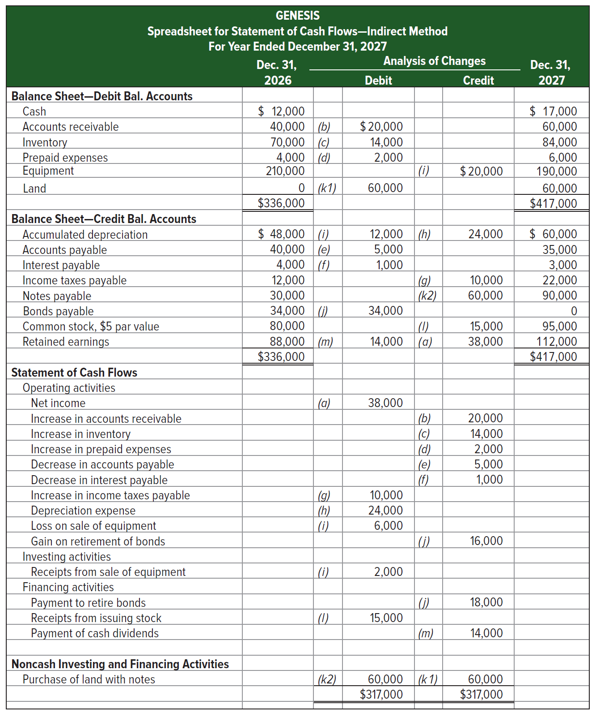
Spreadsheet Preparation
Exhibit 16A.1
A spreadsheet, also called work sheet or working paper, can help us organize the information needed to prepare a statement of cash flows.
Access the text alternative for slide images.
Notes:
This appendix explains how to use a spreadsheet (work sheet) to prepare the statement of cash flows under the indirect method.
Preparing the indirect method spreadsheet to analyze noncash accounts can be challenging when a company has a large number of accounts and many operating, investing, and financing transactions. A spreadsheet, also called work sheet or working paper, can help us organize the information needed to prepare a statement of cash flows. A spreadsheet also makes it easier to check the accuracy of our work.
The graphic on this slide shows the indirect method spreadsheet for Genesis. We enter both beginning and ending balance sheet amounts on the spreadsheet. We also enter information in the Analysis of Changes columns (keyed to the additional information items a through m) to explain changes in the accounts and determine the cash flows for operating, investing, and financing activities. Information about noncash investing and financing activities is reported near the bottom.

Slide 44
Learning Objective P5
Appendix 16B Compute cash flows from operating activities using the direct method.

Slide 45


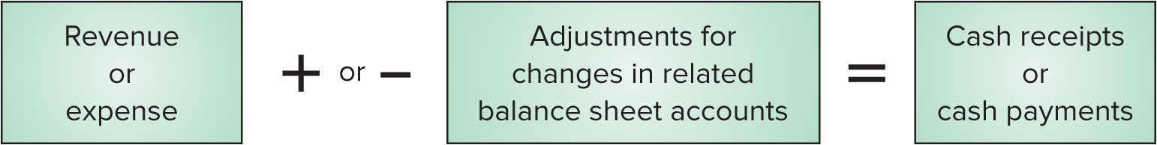

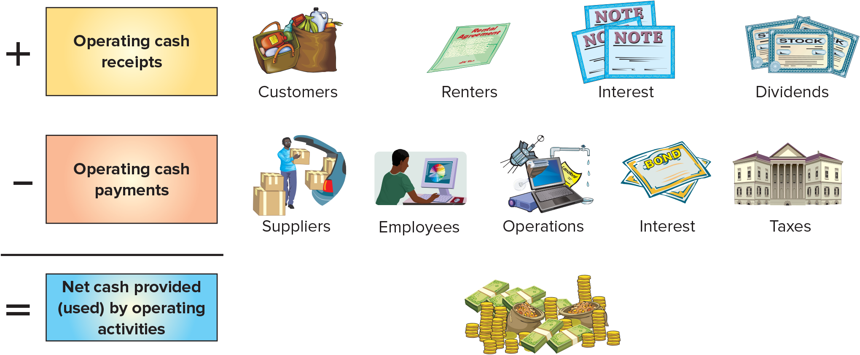
Direct Method of Reporting Operating Cash Flows: Operating Activities
Adjust income statement accounts related to operating activities for changes in their related balance sheet accounts:
Exhibit 16B.1
Framework for reporting cash receipts and cash payments
Access the text alternative for slide images.
Notes:
We compute cash flows from operating activities under the direct method by adjusting accrual-based income statement items to the cash basis. The usual approach is to adjust income statement accounts related to operating activities for changes in their related balance sheet accounts as illustrated in the first graphic on this slide. The framework for reporting cash receipts and cash payments for the operating section of the cash flow statement under the direct method is shown in the second graphic on this slide.

Slide 46
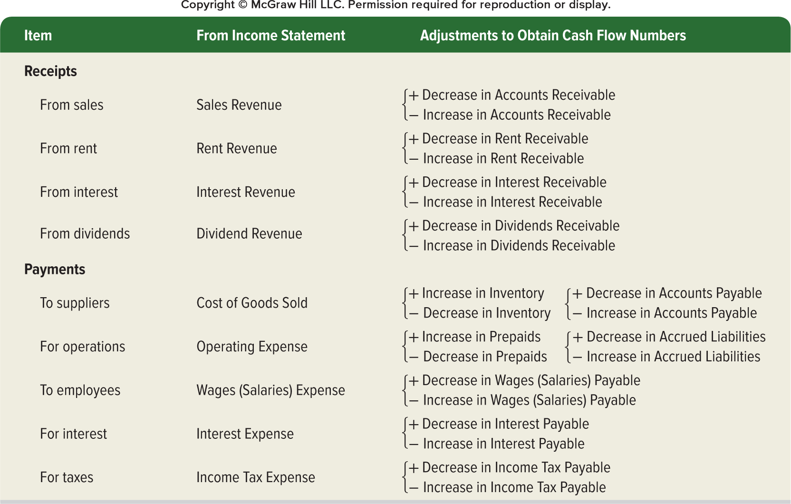
Direct Method of Reporting Operating Cash Flows
Exhibit 16B.6
Access the text alternative for slide images.
Notes:
This slide summarizes common adjustments for net income to yield net cash provided (used) by operating activities under the direct method.

Slide 47
End of Main Content

Slide 48
Accessibility Content: Text Alternatives for Images

Slide 49
Operating Activities - Text Alternative
Return to parent-slide containing images.
The following are shown as Cash Inflows into Operating Activities:
• cash sales to customers
• collections on credit sales
• receipt of dividend revenue
• receipt of interest revenue
The following are shown as Cash Outflows coming from Operating Activities:
• pay operating expenses
• pay taxes
• pay interest owed
• pay salaries and wages
• pay suppliers for goods and services
Return to parent-slide containing images.

Slide 50
Investing Activities - Text Alternative
Return to parent-slide containing images.
The following are shown as Cash Inflows into Investing Activities:
• selling plant assets
• selling investments
• collecting principal on notes receivable
• selling intangible assets
The following are shown as Cash Outflows coming from Investing Activities:
• buy intangible assets
• buy plant assets
• buy investments
• loan money in return for notes receivable.
Return to parent-slide containing images.

Slide 51
Financing Activities - Text Alternative
Return to parent-slide containing images.
The following are shown as Cash Inflows into Financing Activities:
• issuing its common and preferred stock
• issuing long-term debt (notes payable and bonds payable)
• reissuing its treasury stock
• contributions by owners
The following are shown as Cash Outflows coming from Financing Activities:
• pay dividends to shareholders
• purchase treasury stock
• withdrawals by owners
• pay off long-term debt (notes payable and bonds payable).
Return to parent-slide containing images.

Slide 52
Link between Classification of Cash Flows and the Balance Sheet - Text Alternative
Return to parent-slide containing images.
Current assets and current liabilities affect operating cash flows.
Long-term assets affect investing cash flows. Long-term liabilities and equity affect financing cash flows.
Return to parent-slide containing images.

Slide 53
Preparing the Statement of Cash Flows - Text Alternative
Return to parent-slide containing images.
Step 1. Compute net increase or decrease in cash. An illustration shows a person displaying charts on a board to a group of people.
Step 2. Compute net cash from or for operating activities. An illustration shows a person talking to a salesperson in a shoe store.
Step 3. Compute net cash from or for investing activities. An illustration shows a truck parked near a factory.
Step 4. Compute net cash from or for financing activities. An illustration shows several bonds and stock certificates.
Step 5. Compute net cash from all sources; then prove it by adding it to beginning cash to get ending cash. An illustration shows two people working on desktop screens.
Return to parent-slide containing images.

Slide 54
Applying the Indirect Method - Text Alternative
Return to parent-slide containing images.
The table has the following data:
Cash flows from operating activities
Net Income, 38,000 dollars
Adjustments to reconcile net income to net cash provided by operating activities.
Section 1. Income statement items not affecting cash.
Depreciation expense, 24,000.
Loss on sale of equipment, 6,000.
Gain on retirement of bonds, (16,000).
Section 2. Changes in current assets and liabilities.
Increase in accounts receivable, (20,000).
Increase in inventory, (14,000).
Increase in prepaid expenses, (2,000).
Decrease in accounts payable, (5,000).
Decrease in interest payable, (1,000).
Increase in income taxes payable, 10,000.
Net cash provided by operating activities, 20,000.
Return to parent-slide containing images.

Slide 55
Cash Flows from Operating - Text Alternative
Return to parent-slide containing images.
The table has the following data:
Cash flows from operating activities
Net Income, 38,000 dollars
Adjustments to reconcile net income to net cash provided by operating activities.
Section 1. Income statement items not affecting cash.
Depreciation expense, 24,000.
Loss on sale of equipment, 6,000.
Gain on retirement of bonds, (16,000).
Section 2. Changes in current assets and liabilities.
Increase in accounts receivable, (20,000).
Increase in inventory, (14,000).
Increase in prepaid expenses, (2,000).
Decrease in accounts payable, (5,000).
Decrease in interest payable, (1,000).
Increase in income taxes payable, 10,000.
Net cash provided by operating activities, 20,000.
Return to parent-slide containing images.

Slide 56
Adjustments for Income Statement Items Not Affecting Cash - Text Alternative
Return to parent-slide containing images.
Cash flows from operating activities
Net Income, 38,000 dollars
Adjustments to reconcile net income to net cash provided by operating activities.
Section 1. Income statement items not affecting cash.
Depreciation expense, 24,000.
Loss on sale of equipment, 6,000.
Gain on retirement of bonds, (16,000).
Return to parent-slide containing images.

Slide 57
Adjustments for Changes in Current Assets and Current Liabilities 2 - Text Alternative
Return to parent-slide containing images.
Section 2. Changes in current assets and liabilities.
Increase in accounts receivable, (20,000).
Increase in inventory, (14,000).
Increase in prepaid expenses, (2,000).
Decrease in accounts payable, (5,000).
Decrease in interest payable, (1,000).
Increase in income taxes payable, 10,000.
Return to parent-slide containing images.

Slide 58
Spreadsheet Preparation - Text Alternative
Return to parent-slide containing images.
The table has seven columns and 32 account entries. The account entries are divided into four sections. The column headers are as follows: December 31, 2026; analysis of changes debit, analysis of changes credit, and December 31, 2027. The sections and the entries are as follows.
Section 1, Balance sheet—debit balance accounts.
Cash. December 31 2026, 12,000 dollars. December 31 2027, 17,000 dollars.
Accounts receivable. December 31 2026, 40,000 dollars. (b) debit 20,000 dollars. December 31 2027, 60,000 dollars.
Inventory. December 31 2026, 70,000 dollars. (c) debit 14,000 dollars. December 31 2027, 84,000 dollars.
Prepaid expenses. December 31 2026, 4,000 dollars. (d) debit 2,000 dollars. December 31 2027, 6,000 dollars.
Equipment. December 31 2026, 210,000 dollars. (i) credit 20,000 dollars. December 31 2027, 190,000 dollars.
Land. December 31 2026, 0 dollar. (k 1) debit 60,000 dollars. December 31 2027, 60,000 dollars.
Total values. December 31 2026, 336,000 dollars. December 31 2027, 417,000 dollars.
Section 2, Balance sheet—credit balance accounts.
Accumulated depreciation. December 31 2026, 48,000 dollars. (i) debit 12,000 dollars. (h) credit 24,000 dollars. December 31 2027, 60,000 dollars.
Accounts payable. December 31 2026, 40,000 dollars. (e) debit 5,000 dollars. December 31 2027, 35,000 dollars.
Interest payable. December 31 2026, 4,000 dollars. (f) debit 1,000 dollars. December 31 2027, 3,000 dollars.
Income taxes payable. December 31 2026, 12,000 dollars. (g) credit 10,000 dollars. December 31 2027, 22,000 dollars.
Notes payable. December 31 2026, 30,000 dollars. (k 2) credit 60,000 dollars. December 31 2027, 90,000 dollars.
Bonds payable. December 31 2026, 34,000 dollars. (i) debit 34,000 dollars. December 31 2027, 0 dollar.
Common stock, 5 dollars par value. December 31 2026, 80,000 dollars. (I) credit 15,000 dollars. December 31 2027, 95,000 dollars.
Retained earnings. December 31 2026, 88,000 dollars. (m) debit 14,000 dollars. (a) credit 38,000. December 31 2027, 112,000 dollars.
Total values. December 31 2026, 336,000 dollars. December 31 2027, 417,000 dollars.
Section 3, statement of cash flows.
Operating activities.
Net income. Debit, (a) 38,000.
Increase in accounts receivable. Credit, (b) 20,000.
Increase in inventory. Credit, (c) 14,000.
Increase in prepaid expenses. Credit, (d) 2,000.
Decrease in accounts payable. Credit, (e) 5,000.
Decrease in interest payable. Credit, (f) 1,000.
Increase in income taxes payable. Debit, (g) 10,000.
Depreciation expense. Debit, (h) 24,000.
Loss on sale of equipment. Debit, (i) 6,000.
Gain on retirement of bonds. Credit, (j) 1,000.
Investing activities.
Receipts from sale of equipment. Debit, (i) 2,000.
Financing activities.
Payment to retire bonds. Credit, (j) 18,000.
Receipts from issuing stock. Debit, (i) 15,000.
Payment of cash dividends. Credit, (m) 14,000.
Section 4, Noncash investing and financing activities.
Purchase of land with notes. (k2) debit 60,000. (k1) credit 60,000.
Total debit, 317,000 dollars. Total credit, 317,000.
Return to parent-slide containing images.

Slide 59
Direct Method of Reporting Operating Cash Flows: Operating Activities - Text Alternative
Return to parent-slide containing images.
Bottom image: Plus operating cash receipts (from customers, renters, interest, and dividends) minus operating cash payments (to suppliers, employees, operations, interest, taxes) equals net cash provided (used) by operating activities.
The following illustrations depict the different elements of the cash flow. Customers; two bags of groceries. Renters; a rental agreement. Interest; three notes. Dividends; three stock certificates. Suppliers; a person loads boxes into the trunk of a car. Employees; a person works on a computer. Operations; an illustration combining satellite, computer, projector, and water pipe. Interest; two bond certificates. Taxes; a large building. Net cash; stacks of coins and cash.
Return to parent-slide containing images.

Slide 60
Direct Method of Reporting Operating Cash Flows - Text Alternative
Return to parent-slide containing images.
The table has three columns and 9 rows. The column headers are as follows: item, from income statement, and adjustments to obtain cash flow numbers. The row entries are as follows.
Row 1. Receipts from sales; sales revenue on income statement; adjustments: positive decrease in accounts receivable or negative increase in accounts receivable.
Row 2. Receipts from rent; rent revenue on income statement; adjustments: positive decrease in rent receivable or negative increase in rent receivable.
Row 3. Receipts from interest; interest revenue on income statement; adjustments: positive decrease in interest receivable or negative increase in interest receivable.
Row 4. Receipts from dividends; dividend revenue on income statement; adjustments: positive decrease in dividends receivable or negative increase in dividends receivable.
Row 5. Payments to suppliers; cost of goods sold on income statement; adjustments: positive increase in inventory or negative decrease in inventory; positive decrease in accounts payable or negative increase in accounts payable.
Row 6. Payments for operations; operating expense on income statement; adjustments: positive increase in prepaids or negative decrease in prepaids; positive decrease in accrued liabilities or negative increase in accrued liabilities.
Row 7. Payments to employees; wages (salaries) expense on income statement; adjustments: positive decrease in wages (salaries) payable or negative increase in wages (salaries) payable.
Row 8. Payments for interest; interest expense on income statement; adjustments: positive decrease in interest payable or negative increase in interest payable.
Row 9. Payments for taxes; income tax expense on income statement; adjustments: positive decrease in income tax payable or negative increase in income tax payable.
Return to parent-slide containing images.

