Slide 1
Chapter 17
Analysis of Financial Statements
Wild and Shaw
Fundamental Accounting Principles
2025 Release

Slide 2
Chapter 17 Learning Objectives
CONCEPTUAL
C1 Define the building blocks of analysis and the standards for comparisons.
ANALYTICAL
A1 Apply DuPont analysis to return on equity.
A2 Appendix 17A—Explain the form and assess the content of a complete income statement.
PROCEDURAL
P1 Explain and apply methods of horizontal analysis.
P2 Describe and apply methods of vertical analysis.
P3 Define and apply ratio analysis.

Slide 3
Learning Objective C1
Define the building blocks of analysis and the standards for comparisons.

Slide 4
Purpose of Analysis
Common goal of financial statement analysis for both external and internal users is to evaluate company performance and financial condition and to assist in evaluating:
Past and current performance
Current financial position
Future performance and risk
Internal Users Managers Officers Internal Auditors
External Users Shareholders Lenders Suppliers
Notes:
Financial statement analysis applies analytical tools to financial statements and related data for making business decisions.
Internal users of accounting information manage and operate the company. They include managers, officers, and internal auditors. The purpose of financial statement analysis for internal users is to provide information to improve efficiency and effectiveness in providing products and services.
External users of accounting information are not directly involved in running the company. They include shareholders, lenders, and suppliers. External users use financial statement analysis to make more informed decisions to pursue their own goals.
The common goal of these users is to evaluate company performance and financial condition. This includes evaluating (1) past and current performance, (2) current financial position, and (3) future performance and risk.

Slide 5

Building Blocks of Analysis
Liquidity and efficiency
Solvency
Profitability
Market prospects
Notes:
Financial statement analysis focuses on one or more elements of the four areas that are the building blocks of financial statement analysis:
Liquidity and efficiency—ability to meet short-term obligations and to efficiently generate revenues.
Solvency—ability to generate future revenues and meet long-term obligations.
Profitability—ability to provide financial rewards sufficient to attract and retain financing.
Market prospects—ability to generate positive market expectations.

Slide 6
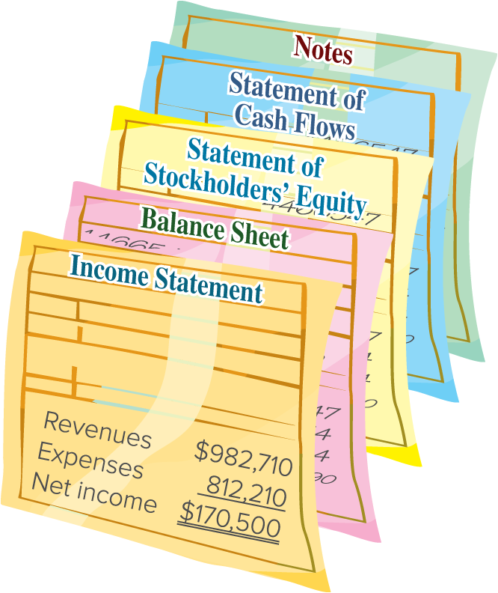
Information for Analysis
General-purpose financial statements:
Income Statement
Balance Sheet
Statement of Stockholders’ Equity
Statement of Cash Flows
Notes to the Financial Statements
Access the text alternative for slide images.
Notes:
Most users conduct analysis using general-purpose financial statements that include the (1) income statement, (2) balance sheet, (3) statement of stockholders’ equity (or statement of retained earnings), (4) statement of cash flows, and (5) notes to these statements.
Financial reporting refers to the communication of financial information useful for making investment, credit, and other business decisions. Financial reporting includes not only general-purpose financial statements but also information from SEC 10-K or other filings, press releases, shareholders’ meetings, forecasts, management letters, auditors’ reports, and webcasts.

Slide 7
Standards for Comparison
When we interpret our analysis, it is essential to compare the results we obtained to other standards or benchmarks.
Intracompany
Competitors
Industry
Guidelines (rules of thumb)
Notes:
When analyzing financial statements, we use the following standards (benchmarks) for comparison:
Intracompany—The company’s current performance is compared to its prior performance and its relations between financial items. Apple’s current net income, for instance, can be compared with its prior years’ net income and in relation to its revenues or total assets.
Competitor—Competitors provide standards for comparisons. Coca-Cola’s profit margin can be compared with PepsiCo’s profit margin.
Industry—Industry statistics provide standards of comparisons. Intel’s profit margin can be compared with its industry’s profit margin.
Guidelines (rules of thumb)—Standards of comparisons can develop from experience. Examples are the 2:1 level for the current ratio or 1:1 level for the acid-test ratio.
Benchmarks from a competitor or group of competitors are often best. Intracompany and industry measures are also important. Guidelines or rules of thumb should be applied with care, and then only if they seem reasonable given past experience and industry norms.

Slide 8
Tools of Analysis
Horizontal Analysis
Comparing the financial condition and performance across time.
Vertical Analysis
Comparing the financial condition and performance to a base amount.
Ratio Analysis
Measurement of key relations between financial statement items.
Notes:
Common tools of financial statement analysis are:
Horizontal analysis—comparison of financial condition and performance across time.
Vertical analysis—comparison of financial condition and performance to a base amount.
Ratio analysis—measurement of key relations between financial statement items.

Slide 9
Learning Objective P1
Explain and apply methods of horizontal analysis.

Slide 10
Horizontal Analysis
Horizontal analysis is the review of financial statement data
across time.
Notes:
Horizontal analysis is the review of financial statement data across time. Horizontal comes from the left-to-right [or right-to-left] movement of our eyes as we review comparative financial statements across time.

Slide 11
Comparative Statements: Dollar Change
Dollar change
=
Analysis period amount
−
Base period amount
When measuring the amount of the change in dollar amounts, compare the analysis period to the base period.
The analysis period refers to the financial statements under analysis.
The base period refers to the financial statements used for comparison.
Notes:
Comparing financial statements is done by analyzing dollar amount changes and percent changes in line items. Both analyses are relevant because dollar changes can yield large percent changes inconsistent with their importance.
A 50% change from a base figure of $100 is less important than the same percent change from a base amount of $100,000 in the same statement. We compute the dollar change for a financial statement item as shown in this slide.
Analysis period refers to the financial statements under analysis, and base period refers to the financial statements used for comparison. The prior year is commonly used as a base period.

Slide 12

Comparative Statements: Percent Change
% change
=
×
100
When calculating the change as a percentage, divide the amount of the dollar change by the base period amount, and then multiply by 100 to convert to a percentage.
Four cases require additional analysis.
The following content is arranged like a table. Table divided into 4 columns summarizes the analysis period, base period, dollar value, and percent of 4 cases listed in column 1. The columns for dollar and percent have a common header, change analysis. The first 3 data cells in column 5 are left blank.
Case | Analysis Period | Base Period | Change Analysis Dollar | Change Analysis Percent
A | $ 1,500 | $ (4,500) | $ 6,000 | –
B | (1,000) | 2,000 | (3,000) | –
C | 8,000 | – | 8,000 | –
D | 0 | 10,000 | (10,000) | (100%)
Notes:
We compute the percent change by dividing the analysis period amount minus the base period amount by the base period amount and then multiplying by 100.
There are a few rules in working with percent changes. Let’s look at four separate cases.
Cases A and B: When a negative amount is in one period and a positive amount is in the other, we cannot compute a meaningful percent change.
Case C: When no amount is in the base period, no percent change is computable.
Case D: When a positive amount is in the base period and zero is in the analysis period, the decrease is 100%.

Slide 13

Comparative Balance Sheets
APPLE INC.
Comparative Year-End Balance Sheets
Exhibit 17.1
The following content is arranged like a table. A table, titled Apple Incorporated comparative year-end balance sheets, summarizes current year, prior year, dollar change, and percent change values for the 25 accounts listed in column 1. The accounts are categorized into 3: assets, liabilities, and stockholders’ equity.
$ millions | Current Year | Prior Year | Dollar Change | Percent Change
Assets
Cash and cash equivalents | $ 29,965 | $ 23,646 | $ 6,319 | 26.7%
Short-term marketable securities | 31,590 | 24,658 | 6,932 | 28.1%
Accounts receivable, net | 29,508 | 28,184 | 1,324 | 4.7%
Vendor non-trade receivables | 31,477 | 32,748 | (1,271) | (3.9)%
Inventories | 6,331 | 4,946 | 1,385 | 28.0%
Other current assets | 14,695 | 21,223 | (6,528) | (30.8)%
Total current assets | 143,566 | 135,405 | 8,161 | 6.0%
Long-term marketable securities | 100,544 | 120,805 | (20,261) | (16.8)%
Property, plant and equipment, net | 43,715 | 42,117 | 1,598 | 3.8%
Other non-current assets | 64,758 | 54,428 | 10,330 | 19.0%
Total assets | $352,583 | $352,755 | $ (172) | 0.0%
Liabilities
Accounts payable | $ 62,611 | $ 64,115 | $ (1,504) | (2.3)%
Other current liabilities | 58,829 | 60,845 | (2,016) | (3.3)%
Deferred revenue | 8,061 | 7,912 | 149 | 1.9%
Commercial paper | 5,985 | 9,982 | (3,997) | (40.0)%
Current portion of long-term debt | 9,822 | 11,128 | (1,306) | (11.7)%
Total current liabilities | 145,308 | 153,982 | (8,674) | (5.6)%
Long-term debt | 95,281 | 98,959 | (3,678) | (3.7)%
Other non-current liabilities | 49,848 | 49,142 | 706 | 1.4%
Total Liabilities | 290,437 | 302,083 | (11,646) | (3.9)%
Stockholders’ Equity
Common stock | 73,812 | 64,849 | 8,963 | 13.8%
Retained earnings (Accumulated deficit) | (214) | (3,068) | 2,854 | 93.0%
Accumulated other comprehensive income (loss) | (11,452) | (11,109) | (343) | (3.1)%
Total stockholders’ equity | 62,146 | 50,672 | 11,474 | 22.6%
Total liabilities and stockholders’ equity | $352,583 | $352,755 | $ (172) | 0.0%
Notes:
Analysis of comparative financial statements begins by focusing on large dollar and percent changes. We then identify the reasons and implications for these changes. We also review small changes when we expected the changes to be large.
Exhibit 17.1 shows comparative balance sheets for Apple Inc (ticker: AAPL). Looking first at assets, a few items stand out. Cash and cash equivalents increase 26.7% and Short-term marketable securities increase 28.1% in the current year. The combined dollar increase of these two items is $13,251 million. Some of this increase is explained by Apple’s $20,261 million decrease in its Long-term marketable securities. Turning to the other asset items, there are no large differences. Apple’s total assets are approximately the same for both these years.
Looking at Apple’s financing side, we see that total liabilities decreased $11,646 million, or 3.9%, largely driven by decreases in Commercial paper (short-term debt) of $3,997 million, in Long-term debt of $3,678 million, and in the Current portion of long-term debt of $1,306 million. This shows that Apple is paying off some debt. It also is not taking on new debt, which makes economic sense when interest rates are high. The $11,474 million, or 22.6%, increase in equity is driven by the $8,963 million increase in common stock, which results from Apple’s share-based compensation plans. In reviewing Apple’s financial statements and notes in Appendix A (see retained earnings reconciliation in the statement of shareholders’ equity), we see that its income of $96,995 exceeded its dividends of $14,996 million and common stock repurchases of $77,046 million, which led to a $2,854 million increase in retained earnings.

Slide 14
Comparative Income Statements
Exhibit 17.2
APPLE INC.
Comparative Income Statements
The following content is arranged like a table. A table, titled Apple Incorporated comparative income statement, summarizes current year, prior year, dollar change, and percent change values for the 13 accounts listed in column 1. There is no percent change value for the account, other income (expense), net.
$ millions, except per share data | Current Year | Prior Year | Dollar Change | Percent Change
Net sales | $383,285 | $394,328 | $(11,043) | (2.8)%
Cost of sales | 214,137 | 223,546 | (9,409) | (4.2)%
Gross margin | 169,148 | 170,782 | (1,634) | (1.0)%
Research and development | 29,915 | 26,251 | 3,664 | 14.0%
Selling, general and administrative | 24,932 | 25,094 | (162) | (0.6)%
Total operating expenses | 54,847 | 51,345 | 3,502 | 6.8%
Operating income | 114,301 | 119,437 | (5,136) | (4.3)%
Other income (expense), net | (565) | (334) | (231) | (69.2)%
Income before provision for income taxes | 113,736 | 119,103 | (5,367) | (4.5)%
Provision for income taxes | 16,741 | 19,300 | (2,559) | (13.3)%
Net income | $ 96,995 | $ 99,803 | (2,808) | (2.8)%
Basic earnings per share | $ 6.16 | $ 6.15 | $ 0.01 | 0.2%
Diluted earnings per share | $ 6.13 | $ 6.11 | $ 0.02 | 0.3%
Notes:
Comparative income statements are prepared similarly to comparative balance sheets.
Exhibit 17.2 shows Apple’s comparative income statements. Apple shows decreases in net sales of 2.8% and in cost of sales of 4.2%. There is a slight decrease in gross margin of 1.0%. One concern is the 6.8% increase in total operating expenses. That increase is attributed to a 14.0% rise in research and development (R&D) expenses. While R&D might be key to future success, it is important for management to keep the remaining expenses under control in a period when sales decline by 2.8%. Overall, net income saw a decrease of $2,808 million, or 2.8%. Basic earnings per share increased by 0.2%, which is mainly due to fewer shares outstanding because of Apple’s share-repurchase strategy.

Slide 15
Trend Analysis: Equation
Trend analysis is used to reveal patterns in data across periods.
Notes:
Trend analysis involves computing trend percents that show patterns in data across periods.
Trend percent is computed as: (analysis period amount divided by base period amount) times 100.

Slide 16
Trend Analysis: Illustration
$ millions | Current Yr | 1 Yr Ago | 2 Yrs Ago | 3 Yrs Ago | 4 Yrs Ago
Net sales | $383,285 | $394,328 | $365,817 | $274,515 | $260,174
Cost of sales | 214,137 | 223,546 | 212,981 | 169,559 | 161,782
Operating expenses | 54,847 | 51,345 | 43,887 | 38,668 | 34,462
Exhibit 17.3
The following content is arranged like a table. Table divided into 6 columns. The column headers are marked from left to right as: $ millions, Current Yr, 1 Yr Ago, 2 Yrs Ago, 3 Yrs Ago, and 4 Yrs Ago.
Using the number reported 4 years ago as the base period, we get the following trend percents for each year by dividing that year’s amount by the base period amount:
In trend percent | Current Yr | 1 Yr Ago | 2 Yrs Ago | 3 Yrs Ago | 4 Yrs Ago
Net sales | 147.3% | 151.6% | 140.6% | 105.5% | 100.0%
Cost of sales | 132.4% | 138.2% | 131.6% | 104.8% | 100.0%
Operating expenses | 159.2% | 149.0% | 127.3% | 112.2% | 100.0%
Exhibit 17.4
The following content is arranged like a table. Table divided into 6 columns. The column headers are marked from left to right as: In trend percent, Current Yr, 1 Yr Ago, 2 Yrs Ago, 3 Yrs Ago, and 4 Yrs Ago.
Notes:
The trend percents—using data from Exhibit 17.3—are shown in Exhibit 17.4. The base period is the number reported four years ago, and the trend percent is computed for each year by dividing that year’s amount by the base period amount. For example, the net sales trend percent for the current year is 147.3%, computed as $383,285/$260,174.

Slide 17
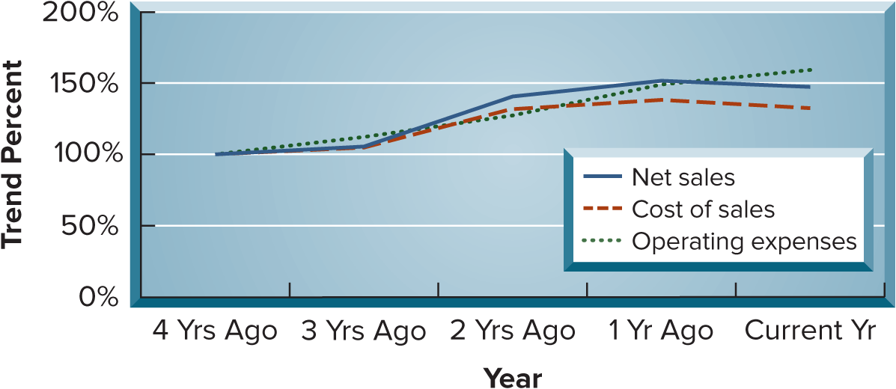
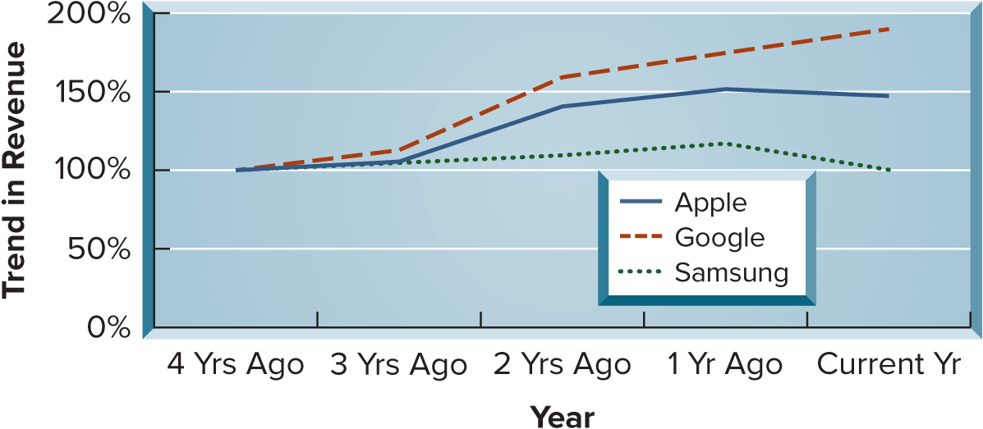
Line Graph of Trend Percents
Exhibit 17.5
Exhibit 17.6
We can use the trend percentages to construct a graph so we can see the trend over time.
Access the text alternative for slide images.
Notes:
This slide shows the trend percents from the prior slide in a line graph, which can help us identify trends and detect changes in direction or magnitude.
The graph shows that the trend line for operating expenses exceeds net sales in each of the recent three years shown. This is not positive for Apple. Apple’s net income will suffer if expenses rise faster than sales.

Slide 18
Learning Objective P2
Describe and apply methods of vertical analysis.

Slide 19



Vertical Analysis
Common-Size Statements
Common-size percent (%)
=
×
100
Financial Statement
Balance Sheet
Income Statement
Base Amount
Total Assets
Revenues
Notes:
Vertical analysis, also called common-size analysis, is used to evaluate individual financial statement items or a group of items as a percent of a common base amount.
The term vertical analysis arises from the up-down [or down-up] movement of our eyes as we review common-size financial statements.
We use common-size financial statements to show the relative importance of each financial statement item as a percent of a common base amount. All individual amounts in common-size statements are redefined in terms of common-size percents. A common-size percent is calculated as: (analysis amount divided by base amount) times 100.

Slide 20
Common-Size Balance Sheet
APPLE INC.
Common-Size Comparative Balance Sheets
Exhibit 17.8
$ millions | Current Year | Prior Year | Common-Size Percents* Current Year | Common-Size Percents* Prior Year
Assets
Cash and cash equivalents | $ 29,965 | $ 23,646 | 8.5% | 6.7%
Short-term marketable securities | 31,590 | 24,658 | 9.0% | 7.0%
Accounts receivable, net | 29,508 | 28,184 | 8.4% | 8.0%
Vendor non-trade receivables | 31,477 | 32,748 | 8.9% | 9.3%
Inventories | 6,331 | 4,946 | 1.8% | 1.4%
Other current assets | 14,695 | 21,223 | 4.2% | 6.0%
Total current assets | 143,566 | 135,405 | 40.7% | 38.4%
Long-term marketable securities | 100,544 | 120,805 | 28.5% | 34.2%
Property, plant and equipment, net | 43,715 | 42,117 | 12.4% | 11.9%
Other non-current assets | 64,758 | 54,428 | 18.4% | 15.4%
Total assets | $352,583 | $352,755 | 100.0% | 100.0%
Liabilities
Accounts payable | $ 62,611 | $ 64,115 | 17.8% | 18.2%
Other current liabilities | 58,829 | 60,845 | 16.7% | 17.2%
Deferred revenue | 8,061 | 7,912 | 2.3% | 2.2%
Commercial Paper | 5,985 | 9,982 | 1.7% | 2.8%
Current portion of long-term debt | 9,822 | 11,128 | 2.8% | 3.2%
Total current liabilities | 145,308 | 153,982 | 41.2% | 43.7%
Long-term debt | 95,281 | 98,959 | 27.0% | 28.1%
Other non-current liabilities | 49,848 | 49,142 | 14.1% | 13.9%
Total Liabilities | 290,437 | 302,083 | 82.4% | 85.6%
Stockholders’ Equity
Common stock | 73,812 | 64,849 | 20.9% | 18.4%
Retained earnings (Accumulated deficit) | (214) | (3,068) | (0.1)% | (0.9)%
Accumulated other comprehensive income (loss) | (11,452) | (11,109) | (3.2)% | (3.1)%
Total stockholders’ equity | 62,146 | 50,672 | 17.6% | 14.4%
Total liabilities and stockholders’ equity | $352,583 | $352,755 | 100.0% | 100.0%
A table, titled Apple Incorporated common-size comparative balance sheets, summarizes current year, prior year, common-size percents values for current year, and prior year for the 25 accounts listed in column 1. The accounts are categorized into 3: assets, liabilities, and stockholders’ equity.
*Percents are rounded to tenths and thus may not exactly sum to totals and subtotals.
Notes:
Common-size statements express each item as a percent of a base amount, which for a common-size balance sheet is total assets. The base amount is assigned a value of 100%. (Total liabilities plus equity also equals 100% since this amount equals total assets.) We then compute a common-size percent for each asset, liability, and equity item using total assets as the base amount.
Exhibit 17.8 shows common-size comparative balance sheets for Apple. On the asset side, two results stand out on both a magnitude and percentage basis: (1) an increase in Cash and cash equivalents from 6.7% to 8.5% of assets and in Short-term marketable securities from 7.0% to 9.0% of assets, and (2) a decrease in long-term marketable securities from 34.2% to 28.5% of assets. These changes are consistent with a shift in liquid assets from long-term to short-term. Apple also continues to return such assets to shareholders through stock repurchases and dividends.
Turning to liabilities, analysis reveals relatively minor changes in common-size percents, with no change greater 1.1% for any liability item. Looking at equity, we see the increase in common stock from 18.4% to 20.9%. This reflects the additional stock outstanding from Apple’s share-based compensation plans. The negative retained earnings, also called accumulated deficit, is due to Apple’s multiyear stock repurchases plan along with increased dividends.

Slide 21
Common-Size Income Statement
Exhibit 17.9
APPLE INC.
Common-Size Comparative Income Statements
A table, titled Apple Incorporated common-size comparative income statements, summarizes current year, prior year, common-size percents values for current year, and prior year for the 11 accounts listed in column 1.
$ millions | Current Yr | Prior Yr | Common Size Percents* Current Yr | Common Size Percents* Prior Yr
Net sales | $383,285 | $394,328 | 100.0% | 100.0%
Cost of sales | 214,137 | 223,546 | 55.9% | 56.7%
Gross margin | 169,148 | 170,782 | 44.1% | 43.3%
Research and development | 29,915 | 26,251 | 7.8% | 6.7%
Selling, general and administrative | 24,932 | 25,094 | 6.5% | 6.4%
Total operating expenses | 54,847 | 51,345 | 14.3% | 13.0%
Operating income | 114,301 | 119,437 | 29.8% | 30.3%
Other income (expense), net | (565) | (334) | (0.1)% | (0.1)%
Income before provision for income taxes | 113,736 | 119,103 | 29.7% | 30.2%
Provision for income taxes | 16,741 | 19,300 | 4.4% | 4.9%
Net income | $ 96,995 | $ 99,803 | 25.3% | 25.3%
*Percents are rounded to tenths and thus may not exactly sum to totals and subtotals.
Notes:
Analysis also benefits from use of a common-size income statement. Revenue, or sales, is the base amount, which is assigned a value of 100%. Each common-size income statement item appears as a percent of revenue. If we think of the 100% revenue amount as representing one sales dollar, the remaining items show how each revenue dollar is distributed among costs, expenses, and income.
Exhibit 17.9 shows common-size comparative income statements for Apple. The past two years’ common-size numbers are similar with two exceptions. One is the 0.8% increase in Gross margin to 44.1%, which is a favorable change due largely to cost of sales being kept under control. An unfavorable change is the 1.3% increase in Total operating expenses from 13.0% to 14.3%. This increase is due to increased R&D costs, which could prove valuable in future innovations and profits.

Slide 22
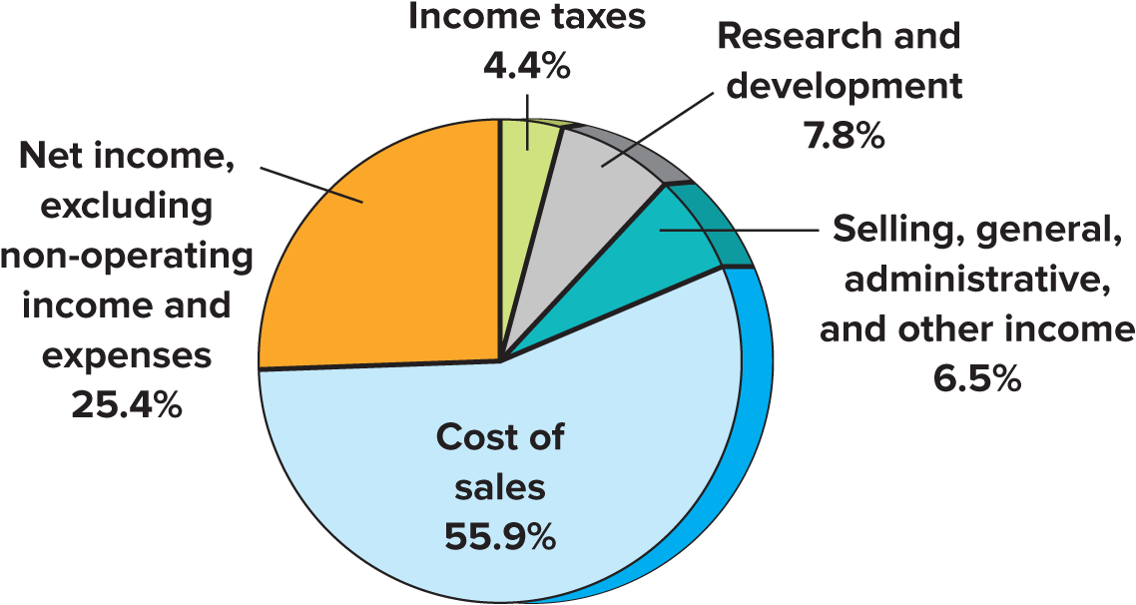
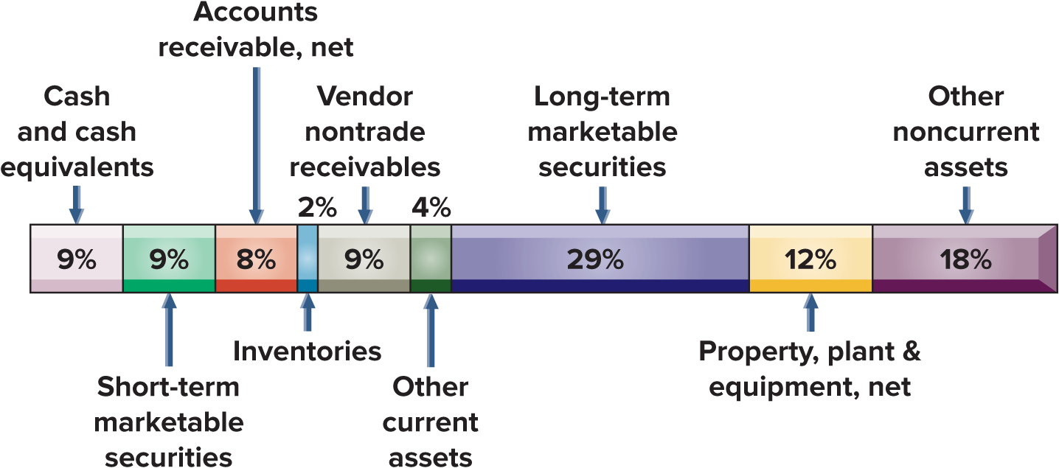
Data Visualizations – Part 1
Exhibit 17.10
Common-Size Graphic of Income Statement
Data visualization of Asset Components
Exhibit 17.12
Access the text alternative for slide images.
Notes:
Data visualizations reveal trends and insights not easily seen by looking at numbers.
Exhibit 17.10 is a graphic of Apple’s current year common-size income statement. This pie chart shows the contribution of each cost component of net sales for net income.
Exhibit 17.12 shows a visualization of Apple’s assets, a high percentage of which are in securities, followed by other non-current assets.

Slide 23
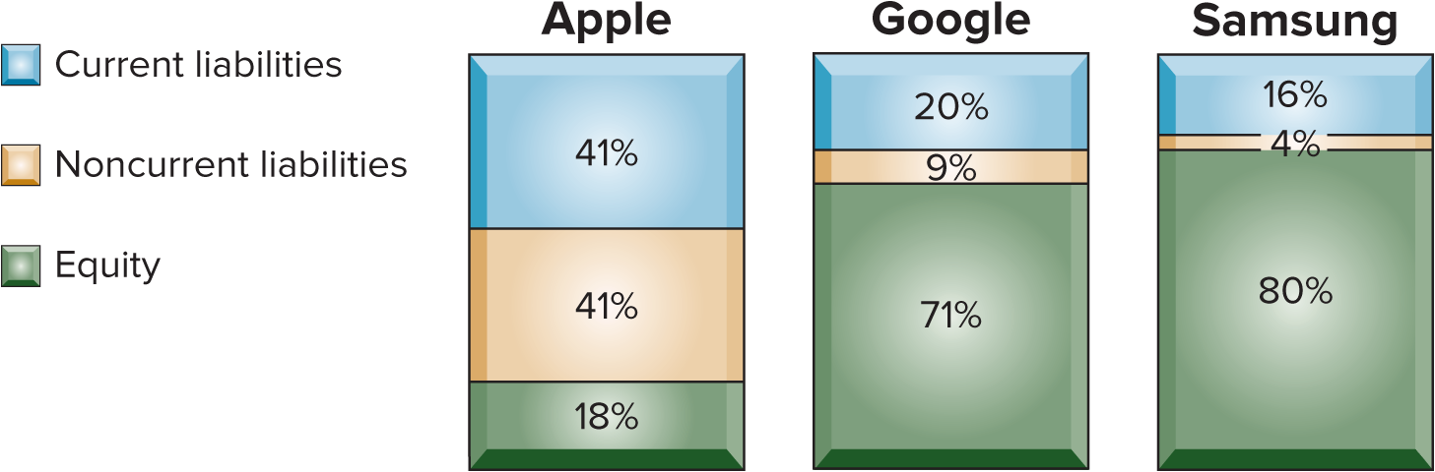
Data Visualizations – Part 2
Exhibit 17.13
Access the text alternative for slide images.
Notes:
Common-size financial statements are useful in comparing companies. Exhibit 17.13 shows visualizations of Apple, Google, and Samsung on financing
sources. This graphic shows the larger percent of equity financing for Google and Samsung versus Apple. It also shows the larger noncurrent debt
financing of Apple versus Google and Samsung. Comparison of a company’s common-size statements with competitors’ or industry common-size
statistics alerts us to differences in the structure of its financing.

Slide 24
Learning Objective P3
Define and apply ratio analysis.

Slide 25
Ratio Analysis
Liquidity and efficiency
Solvency
Profitability
Market prospects
Notes:
Ratios are used to uncover conditions and trends difficult to detect by inspecting individual amounts.
A ratio shows a relation between two quantities. It can be expressed as a percent, rate, or proportion. For instance, a change in an account balance from $100 to $250 can be expressed as (1) 150% increase, (2) 2.5 times, or (3) 2.5 to 1 (or 2.5:1).
This section describes important financial ratios. The ratios are organized into the four building blocks of financial statement analysis: (1) liquidity and efficiency, (2) solvency, (3) profitability, and (4) market prospects. We use four common standards for comparisons: intracompany, competitor, industry, and guidelines.

Slide 26
Liquidity and Efficiency
Current Ratio
Working Capital
Inventory Turnover
Acid-test Ratio
Days’ Sales Uncollected
Accounts Receivable Turnover
Days’ Sales in Inventory
Total Asset Turnover
Notes:
Liquidity is the availability of resources to pay short-term cash requirements. It is affected by the timing of cash inflows and outflows along with prospects for future performance.
Efficiency is how productive a company is in using its assets.

Slide 27
Working Capital
Working capital is the amount of current assets minus current liabilities.
$ millions | Current Yr | Prior Yr
Current assets | $143,566 | $135,405
Current liabilities | 145,308 | 153,982
Working capital | −$ 1,742 | −$ 18,577
Current ratio
$143,566 ∕ $145,308 = | 0.99 to 1
$135,405 ∕ $153,982 = |  | 0.88 to 1
Exhibit 17.14
A table summarizes the current year and prior year values of 3 accounts listed in column 1. The last 2 rows show the current ratio calculations for the current year and the prior year.
More working capital suggests a strong liquidity position and an ability to pay debts or continue operating.
Notes:
The amount of current assets minus current liabilities is called working capital, or net working capital. A company that runs low on working capital is less likely to pay debts or to continue operating.
When evaluating a company’s working capital, we look at the dollar amount of current assets minus current liabilities and at their ratio.

Slide 28

Current Ratio
A table summarizes the current year and prior year values of 3 accounts listed in column 1. The last 2 rows show the current ratio calculations for the current year and the prior year.
Exhibit 17.14
$ millions | Current Yr | Prior Yr
Current assets | $143,566 | $135,405
Current liabilities | 145,308 | 153,982
Working capital | −$ 1,742 | −$ 18,577
Current ratio
$143,566 ∕ $145,308 = | 0.99 to 1
$135,405 ∕ $153,982 = |  | 0.88 to 1
This ratio measures the short-term debt-paying ability of the company.
A higher current ratio suggests a strong ability to meet current obligations.
Notes:
The current ratio is defined as shown.
Apple’s working capital and current ratio are shown in Exhibit 17.14. Also, Google’s (2.10),Samsung’s (2.59), and the industry’s (1.35) current ratios are shown in the margin. Although its ratio (0.99) is lower than competitors’ ratios, Apple is not in danger of defaulting on loan payments. A high current ratio suggests a strong ability to meet current obligations. An excessively high current ratio can mean that the company has invested too much in current assets compared to current obligations. An excessive investment in current assets is not an efficient use of funds be-cause current assets normally earn a low return on investment (compared with long-term assets).
Many analysts use a guideline of 2:1 (or 1.5:1) for the current ratio. A 2:1 or higher ratio is considered low risk in the short run. Analysis of the current ratio, and many other ratios, must consider type of business, composition of current assets, and turnover rate of current asset components.

Slide 29


Acid-Test Ratio
Referred to as Quick Assets
$ millions | Current Yr | Prior Yr
Cash and equivalents | $ 29,965 | $ 23,646
Short-term securities | 31,590 | 24,658
Current receivables | 29,508 | 28,184
Total quick assets | $ 91,063 | $ 76,488
Current liabilities | $145,308 | $153,982
Acid-test ratio
$91,063 ∕ $145,308 = | 0.63 to 1
$76,488 ∕ $153,982 = |  | 0.50 to 1
Exhibit 17.15
A table summarizes the current year and prior year values of 5 accounts listed in column 1. The last 2 rows show the acid-test ratio calculations for the current year and the prior year.
This ratio is like the current ratio but excludes current assets such as inventories and prepaid expenses that may be difficult to quickly convert into cash.
Notes:
Quick assets are cash, short-term investments, and current receivables. These are the most liquid types of current assets. The acid-test ratio, also called quick ratio, and introduced in Chapter 4, reflects on a company’s short-term liquidity and is shown on this slide.
As with analysis of the current ratio, we must consider other factors. How frequently a company converts its current assets into cash also affects its ability to pay current obligations. This means analysis of short-term liquidity should consider receivables and inventories.
Apple’s acid-test ratio is computed in Exhibit 17.15. Apple’s acid-test ratio (0.63) is lower than those for Google (1.94) and Samsung (1.79), but it is higher than the 1:1 guideline for an acceptable acid-test ratio. As with analysis of the current ratio, we must consider other factors. How frequently a company converts its current assets into cash also affects its ability to pay current obligations. This means analysis of short-term liquidity should consider receivables and inventories.

Slide 30



Accounts Receivable Turnover
This ratio measures how many times a company converts its receivables into cash.
Notes:
Accounts receivable turnover measures how frequently a company converts its receivables into cash. Accounts receivable turnover is high when accounts receivable are quickly collected.
Apple’s turnover of 13.3 exceeds Google’s 7.0 and Samsung’s 7.2 turnover.
A high turnover is favorable because it means the company does not tie up assets in accounts receivable. However, accounts receivable turnover can be too high; this can occur when credit terms are so restrictive that they decrease sales.

Slide 31



Inventory Turnover
This ratio measures how long a company holds inventory before selling it.
Notes:
Inventory turnover measures how long a company holds inventory before selling it. Apple’s inventory turnover at 38.0. Apple’s inventory turnover is higher than Samsung’s 3.5 (Google did not report its inventory amount).
A company with a high turnover requires a smaller investment in inventory than one producing the same sales with a lower turnover. Inventory turnover can be too high, however, if the inventory is so low that stock-outs occur.

Slide 32

Days’ Sales Uncollected
This ratio measures how frequently a company collects its accounts receivable.
Notes:
Days’ sales uncollected measures how frequently a company collects accounts receivable.
Apple’s days’ sales uncollected of 28.1 days is shown next to the formula. Both Google’s days’ sales uncollected of 57.0 days and Samsung’s 51.7 days are more than the 28.1 days for Apple.
Days’ sales uncollected is more meaningful if we know company credit terms. A rough guideline states that days’ sales uncollected should not exceed 1 1⁄3 times the days in its (1) credit period, if discounts are not offered or (2) discount period, if favorable discounts are offered.

Slide 33
Days’ Sales in Inventory
This ratio is a useful measure in evaluating inventory liquidity.
Notes:
Days’ sales in inventory is used to evaluate inventory liquidity.
We compute days’ sales in inventory as follows. Apple’s days’ sales in inventory of 10.8 days is shown next to the formula. If the products in Apple’s inventory are in demand by customers, this formula estimates that its inventory will be converted into receivables (or cash) in 10.8 days. If all of Apple’s sales were credit sales, the conversion of inventory to receivables in 10.8 days plus the conversion of receivables to cash in 28.1 days implies that inventory will be converted to cash in about 38.9 days (10.8 + 28.1).

Slide 34


Total Asset Turnover
This ratio measures a company’s ability to use its assets to generate sales.
It is an important indication of operating efficiency.
Notes:
Total asset turnover measures a company’s ability to use its assets to generate sales and reflects on operating efficiency.
Apple’s total asset turnover of 1.09 is shown next to the formula. Apple’s turnover is greater than that for Google’s of (0.80), and Samsung (0.57).

Slide 35
Solvency
Debt Ratio
Equity Ratio
Debt-to-Equity Ratio
Times Interest Earned
Notes:
Solvency is a company’s long-run financial viability and its ability to cover long-term obligations. Analysis of solvency is long term and uses more encompassing measures than liquidity. An important part of solvency analysis is a company’s capital structure. Capital structure refers to a company’s makeup of equity and debt financing.

Slide 36

Debt Ratio and Equity Ratio
A table summarizes the current year and ratio values of 3 accounts listed in column 1. The ratio 82.4 percent is labeled debt ratio and the ratio 17.6 percent is labeled, equity ratio.
Apple, $ millions | Current Year | Ratios
Total liabilities | $290,437 | 82.4% | [Debt ratio]
Total equity | 62,146 | 17.6% | [Equity ratio]
Total liabilities and equity | $352,583 | 100.0%
$290,437 ÷ $352,583 = 82.4%
The debt ratio shows total liabilities as a percent of total assets.
The equity ratio shows total equity as a percent of total assets.
Notes:
One element of solvency analysis is to assess a company’s mix of debt and equity financing. The debt ratio shows total liabilities as a percent of total assets. The equity ratio shows total equity as a percent of total assets. Apple’s debt and equity ratios are shown on this slide.
Apple’s ratios reveal more debt than equity. A company is considered less risky if its capital structure (equity plus debt) has more equity. Debt is considered more risky because of its required payments for interest and principal. Stockholders cannot require payment from the company. However, debt can increase income for stockholders if the company earns a higher return than interest paid on the debt.

Slide 37


Debt-to-Equity Ratio
This ratio measures what portion of a company’s assets are contributed by creditors. A larger debt-to-equity ratio implies less opportunity to expand through use of debt financing.
Notes:
The debt-to-equity ratio measures solvency and is computed as total liabilities divided by total equity.
Apple’s debt-to-equity ratio is 4.67. Apple’s ratio is higher than those of Google (0.42) and Samsung (0.25), and greater than the industry ratio of 0.6. Apple’s capital structure has more debt than equity.
Debt must be repaid with interest, while equity does not. Debt payments can be burdensome when the industry and/or the economy experience a downturn.

Slide 38




Times Interest Earned
Net income
+ Interest expense
+ Income taxes
= Income before interest and taxes
This is the most common measure of a company’s ability to pay interest expense.
Notes:
Times interest earned is the amount of income before subtracting interest expense and income taxes and is the amount available to pay interest expense. The times interest earned ratio measures a company’s ability to pay interest.
Apple’s times interest earned ratio is 29.9 which suggests that creditors have little risk of nonrepayment.
The larger this ratio, the less risky is the company for creditors. One guideline says that creditors are reasonably safe if the company has a ratio of two or more.

Slide 39



Profitability
Profit Margin
Return on Total Assets
Return on Equity
Gross Margin Ratio
Notes:
Profitability refers to a company’s ability to generate an adequate return on invested capital. Return is judged by assessing earnings relative to the level and sources of financing.

Slide 40


Gross Margin Ratio
This ratio measures a company’s percent of gross margin in each dollar of net sales.
Notes:
Gross margin ratio is a company’s percent of gross margin in each dollar of net sales. Gross margin is net sales minus cost of goods sold. The gross margin ratio is the amount of each dollar left over to cover all other operating expenses and still yield a profit. Apple’s gross margin ratio is 44.1%; see its calculation next to the formula. Apple’s 44.1% profit margin is lower than Google’s 56.6% but higher than Samsung’s 30.3% and the industry’s 30% margin.

Slide 41


Profit Margin
This ratio measures a company’s ability to earn net income from each sales dollar.
Notes:
Profit margin measures a company’s ability to earn net income from sales.
Apple’s profit margin of 25.3% is shown next to the formula. To evaluate profit margin, we must consider the industry. For instance, an appliance company might require a profit margin of 15%, whereas a retail supermarket might require a profit margin of 2%.
Apple’s 25.3% profit margin is higher than Google’s 24.0%, but higher than Samsung’s 6.0% and the industry’s 11% margin.

Slide 42



Return on Total Assets
Return on total assets measures how well assets are utilized by the company.
The relation between profit margin, total asset turnover, and return on total assets is:
Notes:
Return on total assets is defined as net income divided by average total assets. We can determine the return a company earns on its total assets.
Apple’s return on total assets of 27.5% is shown next to the formula. Apple’s 27.5% return on total assets is higher than Google’s 19.2%, Samsung’s 3.4%, and the industry’s 8%. We also should evaluate any trend in the return.
Both profit margin and total asset turnover affect operating efficiency, as measured by return on total assets. This analysis shows that Apple’s superior return on assets versus that of Google is driven by its higher asset turnover.

Slide 43

Return on Equity
This measure indicates the company’s ability to earn income for common stockholders.
Notes:
Return on equity measures a company’s ability to earn income for its owners and is computed as net income divided by average total equity.
Apple’s 171.9% return on equity is superior to Google’s 27.4% and Samsung’s 4.3%.

Slide 44
Market Prospects
Price-Earnings Ratio
Dividend Yield
Notes:
Market measures are useful for analyzing corporations with publicly traded stock. These market measures use stock price, which reflects the market’s (public’s) expectations for the company. This includes expectations of both company return and risk—as the market perceives it.
Key measures of market prospects include the price-earnings ratio and dividend yield.

Slide 45


Price-Earnings Ratio
This ratio measures market expectations for future growth.
Notes:
Computation of the price-earnings ratio is computed as market price per common share divided by earnings per share.
The price-earnings ratio measures market expectations for future growth.
The market price of Apple’s common stock at the start of the current fiscal year was $171.21. Using Apple’s $6.16 basic earnings per share, we compute its price-earnings ratio as shown above. Apple’s price-earnings ratio of 27.8 is higher than that for Google (24.2) and the industry (12.0) for this period.

Slide 46
Dividend Yield
This ratio is used to compare the dividend-paying performance of different companies.
Notes:
Dividend yield is used to compare the dividend-paying performance of different companies. It is computed as annual cash dividends per share divided by market price per share.
Apple’s dividend yield of 0.5%, based on its fiscal year-end market price per share of $171.21 and its $0.94 cash dividends per share.
Some companies, such as Amazon, do not pay dividends because they reinvest the cash to grow their businesses in the hope of generating greater future earnings and dividends.

Slide 47
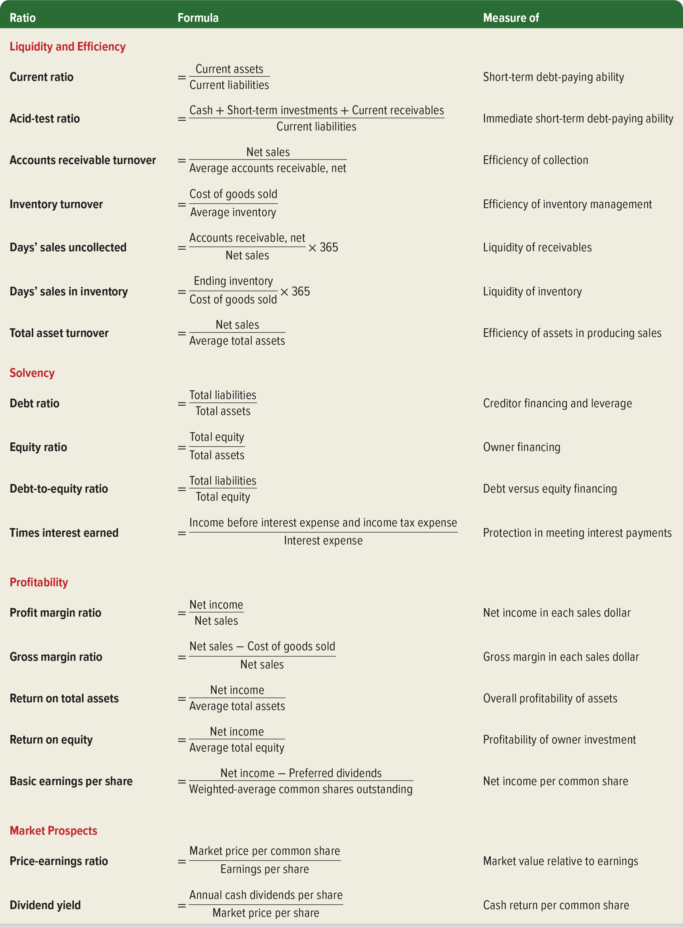
Summary of Ratios
Exhibit 17.16
Access the text alternative for slide images.
Notes:
This slide summarizes the major financial statement analysis ratios illustrated in this chapter and throughout the book. This summary includes each ratio’s title, its formula, and the purpose for which it is commonly used.

Slide 48
Learning Objective A1
Apply DuPont analysis to return on equity.

Slide 49

DuPont Analysis
DuPont Analysis is used to break down return on equity into three components:
Profit margin = net income earned on each dollar of sales.
Asset turnover = sales generated on each dollar of assets.
Leverage = financing of assets through liabilities.
Notes:
Return on equity (ROE) is one of the most frequently used financial ratios. We previously defined ROE as net income divided by average stockholders’ equity. This reflects the income
earned from each dollar of equity investment. For better insight into the factors that drive ROE, a DuPont analysis can be used to break down return on equity into three components:
• Profit margin Net income earned on each dollar of sales (a profitability measure)
• Asset turnover Sales generated on each dollar of assets (an efficiency measure)
• Leverage Financing of assets through liabilities (higher leverage means more liabilities)
DuPont definitions for return on equity are shown in this graphic.

Slide 50
DuPont Analysis: Examples
The following content is arranged like a table. Table divided into 9 columns. The column headers are marked from left to right as: $ millions, Net Income, Sales, Average Total Assets, Average Stockholders’ Equity, Profit Margin, Asset Turnover, Leverage, and Return on Equity.
$ millions | Net Income | Sales | Average Total Assets | Average Stockholders’ Equity | Profit Margin | Asset Turnover | Leverage | Return on Equity*
FedEx | $3,972 | $90,155 | $86,569 | $25,514 | 0.044 | 1.041 | 3.393 | 0.16
UPS | $6,708 | $90,958 | $70,991 | $18,559 | 0.074 | 1.281 | 3.825 | 0.36
Exhibit 17.17
*With rounding
R O E for FedEx is computed as shown here:
FedEx: 0.044 profit margin × 1.041 asset turnover × 3.393 leverage = 0.16 or 16% return on equity.
Notes:
Return on equity (ROE) and its components for FedEx and UPS is shown here.
Comparing FedEx to UPS we see that UPS performs better than Fedex on Profit margin and Asset turnover. A higher profit margin suggests a superior ability to earn net income from sales. A higher asset turnover indicates UPS generates more sales for the same amount of assets. However, higher Leverage, indicates that UPS relies more on liabilities to finance its operations than equity. Higher leverage is an effective strategy to boost return on equity if UPS can earn a higher return than the interest paid on the debt. However, greater leverage implies greater risk as liabilities require principal and interest payments in good times and in bad. Overall, UPS’s ability to earn a higher profit margin, maintain a greater asset turnover, and effectively use leverage, resulted in a better return on equity compared to FedEx.

Slide 51
Learning Objective A2
Appendix 17A Explain the form and assess the content of a complete income statement.

Slide 52
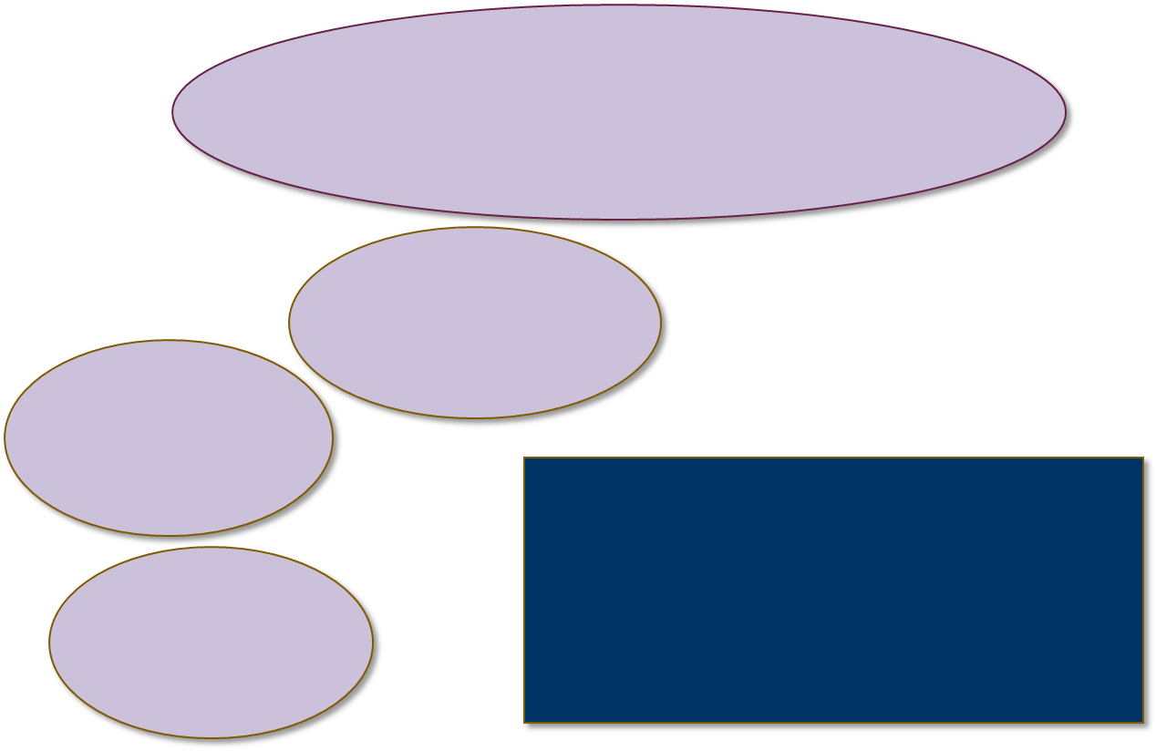




Sustainable Income
Changes in Accounting Principles: Retrospective application on prior financial statements.
Discontinued
Segments
Continuing Operations
Net Income
Earnings per share
Notes:
When a company’s activities include income-related events not part of its normal, continuing operations, it must disclose information about these events. To alert users to these activities, companies separate the income statement into continuing operations, discontinued segments, comprehensive income, and earnings per share.

Slide 53
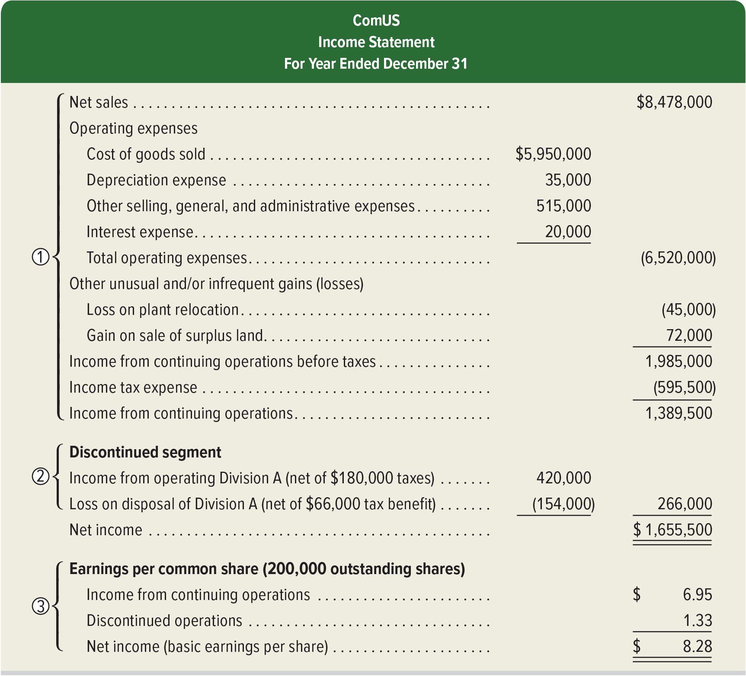
Income Statement All-inclusive
Exhibit 17A.1
Access the text alternative for slide images.
Notes:
Section 1: Continuing Operations shows revenues, expenses, and income from continuing operations. This information is used to predict future operations, and most view this section as the most important. Gains and losses that are normal and frequent are reported as part of continuing operations. Gains and losses that are either unusual and/or infrequent are reported as part of continuing operations but after the normal revenues and expenses. Items considered unusual and/or infrequent include (1) property taken away by a foreign government, (2) condemning of property, (3) prohibiting use of an asset from a new law, (4) losses and gains from an unusual and infrequent calamity (“act of God”), and (5) financial effects of labor strikes.
Section 2: Discontinued Segments. A business segment is a part of a company that is separated by its products/services or by geographic location. A segment has assets, liabilities, and financial results of operations that can be separated from those of other parts of the company. A gain or loss from selling or closing down a segment is separately reported. Section 2 of Exhibit 17A.1 reports both (a) income from operating the discontinued segment before its disposal and (b) the loss from disposing of the segment’s net assets. The income tax effects of each are reported separately from the income tax expense in section 1.
Section 3: Earnings per Share of Exhibit 17A.1 reports earnings per share for both continuing operations and discontinued segments (when they both exist). Earnings per share is covered in Chapter 13.
Changes in Accounting Principles. Changes in accounting principles require retrospective application to prior periods’ financial statements. Retrospective application means applying a different accounting principle to prior periods as if that principle had always been used. Retrospective application enhances the consistency of financial information between periods, which improves the usefulness of information, especially with comparative analyses.

Slide 54
End of Main Content

Slide 55
Accessibility Content: Text Alternatives for Images

Slide 56
Information for Analysis - Text Alternative
Return to parent-slide containing images.
The income statement shows the following details: revenue 982,710 dollars, expenses 812,210, net income 170,500 dollars.
Return to parent-slide containing images.

Slide 57
Line Graph of Trend Percents - Text Alternative
Return to parent-slide containing images.
EXHIBIT 17.5: The line graph shows the year on the horizontal axis (4 years ago, 3 years ago, 2 years ago, 1 year ago, and current year). Trend percent is depicted on the vertical axis. It ranges from 0 through 200 in increments of 50 percent. The graph plots three trend lines.
The line for Net sales passes through the following points: (4 years ago, 100 percent), (3 years ago, 105 percent), (2 years ago, 140 percent), (1 year ago, 151 percent), (current year, 147 percent).
The line for cost of sales passes through the following points: (4 years ago, 100 percent), (3 years ago, 104 percent), (2 years ago, 131 percent), (1 year ago, 138 percent), (current year, 132 percent).
The line for operating expenses passes through the following points: (4 years ago, 100 percent), (3 years ago, 112 percent), (2 years ago, 127 percent), (1 year ago, 149 percent), (current year, 159 percent). Please note the data are approximate.
EXHIBIT 17.6: The line graph shows the year on the horizontal axis (4 years ago, 3 years ago, 2 years ago, 1 year ago, and the current year). The trend in revenue is depicted on the vertical axis. It ranges from 0 through 200 percent in increments of 50 percent. The graph plots three trend lines.
The line for Apple passes through the following points: (4 years ago, 100 percent), (3 years ago, 100 percent), (2 years ago, 140 percent), (1 year ago, 150 percent), (current year, 148 percent).
The line for Google passes through the following points: (4 years ago, 100 percent), (3 years ago, 115 percent), (2 years ago, 160 percent), (1 year ago, 175 percent), (current year, 190 percent).
The line for Samsung passes through the following points: (4 years ago, 100 percent), (3 years ago, 105 percent), (2 years ago, 110 percent), (1 year ago, 115 percent), (current year, 100 percent). Please note the data are approximate.
Return to parent-slide containing images.

Slide 58
Data Visualizations – Part 1 - Text Alternative
Return to parent-slide containing images.
EXHIBIT 17.10: The data is as follows. Cost of sales: 55.9 percent. Net income, excluding non-operating income and expenses: 25.4 percent. Income taxes: 4.4 percent. Research and development: 7.8 percent. Selling, general, administrative, and other income: 6.5 percent.
EXHIBIT 17.12: The horizontal chart shows the following details.
Cash and cash equivalents: 9 percent.
Short-term marketable securities: 9 percent.
Accounts receivable, net: 8 percent.
Inventories: 2 percent.
Vendor non-trade receivables: 9 percent.
Other current assets: 4 percent.
Long-term marketable securities: 29 percent.
Property, plant and equipment, net: 12 percent.
Other noncurrent assets: 18 percent.
Return to parent-slide containing images.

Slide 59
Data Visualizations – Part 2 - Text Alternative
Return to parent-slide containing images.
The graph shows the following details.
Apple. Current liabilities, 41 percent; noncurrent liabilities, 41 percent; equity, 18 percent.
Google. Current liabilities, 20 percent; noncurrent liabilities, 9 percent; equity, 71 percent.
Samsung. Current liabilities, 16 percent; noncurrent liabilities, 4 percent; equity, 80 percent.
Return to parent-slide containing images.

Slide 60
Summary of Ratios - Text Alternative
Return to parent-slide containing images.
The table has 18 rows and three columns. The column headers are ratio formula, and measure of. The ratios are categorized into four. The row entries are as follows.
Category 1: liquidity and efficiency.
Row 1. Current ratio. Current assets over current liabilities. Short-term debt-paying ability.
Row 2. Acid-test ratio. Cash plus short-term investments plus current receivables over current liabilities. Immediate short-term debt-paying ability.
Row 3. Accounts receivable turnover. Net sales over Average accounts receivable, net. Efficiency of collection.
Row 4. Inventory turnover. Cost of goods sold over average inventory. Efficiency of inventory management.
Row 5. Days' sales uncollected. Accounts receivable, net over Net sales times 365. Liquidity of receivables.
Row 6. Days' sales in inventory. Ending inventory over Cost of goods sold times 365. Liquidity of inventory.
Row 7. Total asset turnover. Net sales over average total assets. Efficiency of assets in producing sales.
Category 2: Solvency.
Row 8. Debt ratio. Total liabilities over total assets. Creditor financing and leverage.
Row 9. Equity ratio. Total equity over total assets. Owner financing.
Row 10. Debt-to-equity ratio. Total liabilities over total equity. Debt versus equity financing.
Row 11. Times interest earned. Income before interest expense and income tax expense over interest expense. Protection in meeting interest payments.
Category 3: profitability.
Row 12. Profit margin ratio. Net income over net sales. Net income in each sales dollar.
Row 13. Gross margin ratio. Net sales minus cost of goods sold over net sales. Gross margin in each sales dollar.
Row 14. Return on total assets. Net income over average total assets. Overall profitability of assets.
Row 15. Return on equity. Net income over average total equity. Profitability of owner investment.
Row 16. Basic earnings per share. Net income minus preferred dividends over weighted-average common shares outstanding. Net income per common share.
Category 4. Market Prospects.
Row 17. Price-earnings ratio. Market price per common share over earnings per share. Market value relative to earnings.
Row 18. Dividend yield. Annual cash dividends per share over market price per share. Cash return per common share.
Return to parent-slide containing images.

Slide 61
Income Statement All-inclusive - Text Alternative
Return to parent-slide containing images.
The table is titled: ComUS; Income Statement; For Year Ended December 31.
Section 1.
Net sales, 8,478,000 dollars.
Operating expenses.
Cost of goods sold, 5,950,000 dollars.
Depreciation expense, 35,000.
Other selling, general, and administrative expenses, 515,000.
Interest expense, 20,000.
Total operating expenses, (6,520,000).
Other unusual and or infrequent gains (losses).
Loss on plant relocation, (45,000).
Gain on sale of surplus land, 72,000.
Income from continuing operations before taxes, 1,985,000.
Income taxes expense, (595,500).
Income from continuing operations, 1,389,500.
Section 2.
Discontinued segment.
Income from operating Division A (net of 180,000 taxes), 420,000.
Loss on disposal of Division A (net of 66,000 tax benefit), (154,000).
Sum of income and loss, 266,000.
Net Income, 1,655,500.
Section 3.
Earnings per common share (200,000 outstanding shares).
Income from continuing operations, 6.95 dollars.
Discontinued operations, 1.33.
Net income (basic earnings per share), 8.28 dollars.
Return to parent-slide containing images.

