Slide 1
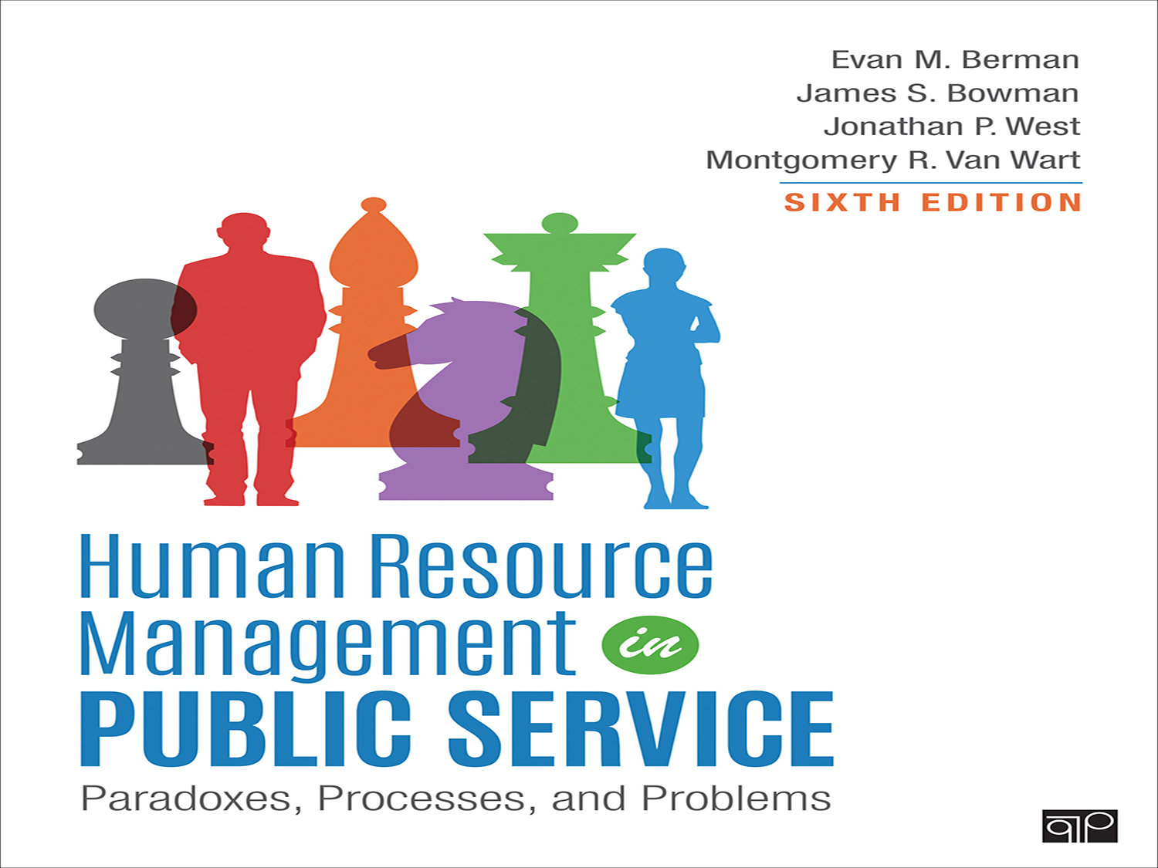
Welcome to MPA 643
Emily Veldkamp
Syllabus Overview

Slide 2
The Public Service Heritage:
People, Process, and Purpose
Chapter 1
If there are two courses of action, you should always pick the third.
- Proverb
2

Slide 3
Human Resources Management (HRM)
“Why is managing people so hard?”
“Why do people dislike management so much?”
Join the search to improve work life in organizations
Provide an efficient, effective employee experience
Notes:
All decisions affecting the relationship between the individual and the organization can be seen as dimensions of personnel management.
Human resources management in practice shapes the conditions in which people find themselves.
Paradoxes include the recognition of ambiguities, equivocations, unstated assumptions.
Paradox of needs individuals and organizations; need one another but human happiness and organizational rationality are as likely to conflict as they are to coincide.
Best-led organizations are those that achieve a balance between seemingly contradictory opposite.

Slide 4
Introductory Definitions
The term “civil service” refers to:
The government employees in permanent public service, excluding legislative, judicial, or uniformed military; positions typically are filled based on competitive examinations, and a professional career public service exists with protection against political influence and patronage.
Notes:
Understanding Civil Service
Definition: Government employees in permanent public service (excluding legislative, judicial, or military).
Key Features: Merit-based hiring, career protection from political influence, and competitive exams for entry.

Slide 5
Common HRM Functions
Human Resource Management deals with a wide range of areas:
Employment law
Policy development, implementation
Recruiting
Selection
Onboarding (managing the employee experience)
Offboarding
Position management / control
Compensation
Benefits administration
Training and professional development
Succession planning
Appraisal / Performance management
Coaching
Discipline
Labor relations
Notes:
HRM covers a broad range of responsibilities, including:
✅ Employment Law & Policies – Ensuring legal compliance
✅ Recruitment & Selection – Hiring the right talent
✅ Onboarding & Offboarding – Managing the employee journey
✅ Compensation & Benefits – Fair pay structures
✅ Training & Development – Growing employee skills
✅ Performance Management – Appraisals, coaching, and discipline
✅ Labor Relations – Negotiating with unions and resolving conflicts

Slide 6
Some Basic Definitions
Personnel Administration | Human Resources Management (HRM) | Strategic Human Resources Management (SHRM)
Narrow focus | Broad focus | Global focus
Focus on technical, internal processes, efficiency | Encompasses all decisions affecting the individual and the organization; focus on effectiveness | Strategic framework for how HRM can support long-term business goals and outcomes
Staffing, position management, pay systems, benefits management, training, appraisal and discipline, contract management | Accounts for talent management, job design, employee-friendly benefits and policies, professional development, proactive management of employee relations, health and safety, accountability | Longer-term people issues and macro-concerns about structure, quality, culture, values, commitment and resources management for future needs
Sharp divide between responsibilities of HR and line managers | Increased relevance for HR, line managers, and executives

Slide 7
Historical and Institutional Context
History of government reform efforts
Paul Light (book Tides of Reform (1997))
Four reform philosophies:
  Scientific management
  War on waste
  Watchful eye
  Liberation management
Notes:
Elements of scientific management are present in most public agencies
We know who reports to us and we report to
We do not skip levels (for the most part)
Policies are written from a uniform perspective assuming they work in all scenarios
We know what we expect of staff and we seek to increase compliance
Paul Light’s Tides of Reform (1997) identifies four major approaches to government HR reform:
Scientific Management – Efficiency-driven (e.g., structured hierarchy, clear policies)
War on Waste – Cost-cutting measures (e.g., capping federal employment)
Watchful Eye – Transparency and accountability (e.g., whistleblower protections)
Liberation Management – Flexibility and performance-based incentives

Slide 8
Tides of HRM Reform
Tide | 1- Scientific Management | 2- War on Waste | 3- Watchful Eye | 4- Liberation Management
Focus | Efficiency Hierarchy, micro division of labor, specialization, and well-defined chains of command | Economy How can the government be operated for less | Rights Transparency, fairness, openness, access; promote ethics on government | Standards Higher performance in government
Characteristics | Structure, rules, and “the one best way”; Emphasizes conformity and predictability of employees’ contributions to the organization | Rules, processes, procedures; in internal controls, oversight and regulation, and managerial directives | Strategies such as whistleblowers, interest groups, and the media | Evaluations, outcomes, and results
Notes:
Scientific Management- Trust and confidence in gov’t
Sees human relationships as subject to management control
Hallmarks of scientific management may impede achievement of quality performance in today’s organizations
Planning, organizing, staffing, directing, coordinating, reporting, and budgeting (POSDCORB)
Elements of scientific management are present in most public agencies
We know who reports to us and we report to
We do not skip levels (for the most part)
Policies are written from a uniform perspective assuming they work in all scenarios
We know what we expect of staff and we seek to increase compliance
War on Waste – Govt. mistrust and cynicism
Defining moment: congressional hearing on welfare fraud
Determine how the govt can be operated for less “wasteful, ridiculous, or ironic use of taxpayer’s money.”
Heightened rigor, City of Bell, defraud taxpayers with high salaries, litigation and new transparency laws
Strike a balance, do not overdo waste control by implementing policies and regulations that may end up being another hurdle
Characterized by use of implementation strategies such as generally accepted practices, audits, and investigations
Proliferation of detailed rules, processes, and procedures
Watchful Eye- Govt. mistrust and cynicism
Whistleblower, the news media, interest groups, and the public need access to information to ensure that the public’s right and the common interests are protected as well as individual rights.
Ethics Reform of 1989 established procedural standards for how government agencies pass rules with public notice, input, and statements of factual basis for decisions. This is very much present in today’s environment
Take all the necessary time to hire the right people, do not settle, one bad personnel decision can do a lot of damage and the affects may last for years
Firing employees without good cause may cost your organization much more and the employee may get restored.
Take the necessary time to document and ensure you are on solid ground.
E.g., greater scrutiny in the hiring process to ensure integrity and job-related competence of new recruits
Minimizes the use of illegitimate hiring criteria such as sex, race, age, and handicap status
Minimizes arbitrary decisions to fire employees
Liberation Management- Trust and confidence in gov’t
We evaluate our own work (or auditors or outside agencies) and we show results
Public agencies are continuously trying to evolve into a better version of themselves, we focus on customer service
Trends toward employee empowerment, reengineering, work teams, continuous improvement, customer service, flattened hierarchies, and self-directed employees
Breakdown of bureaucratic machine (at odds with War on Waste)
Harmony between labor and management – assume new responsibilities, forge new relationships, increase outputs, greater flexibility
Tailor incentives to motivations of individual employees

Slide 9
Federal HRM Reforms
Pendleton Act 1883
Introduced the merit system to the federal government (i.e. get rid of spoils system)
Created the Civil Service Commission (CSC)
Introduction of competitive practical exams
Entry into civil service permitted at any level in the hierarchy
Notes:
Civil service systems have at least three major constituents that they are trying to please. First among these are the political masters of the systems, whose primary interest is responsiveness. Political executives like governors and presidents would like to influence the selection of administrative leaders, and legislators would like to have a say through a confirmation process. Political masters would also like to select rank and file public employees, but this practice is highly limited in advanced democracies because it is so prone to corruption and inefficiency.
The second constituency that a civil service system must please consist of bureaucracy and civil servants themselves, whose primary interest is professionalism. They want to ensure that they are recruited fairly based on their technical merits, that their agencies actions are consistent with widely held professional standards, and that they will be able to use their professional judgment within the confines of legal parameters without political intrusiveness.
The third constituency to be pleased comprises those being served, taxpayers and customers whose primary interests are efficiency and service. Taxpayers want the lowest cost for the most service which is to say good value. Customers generally want the best service possible no matter the cost since they rarely pay directly or their fees are subsidized. Far away proficiency includes setting up competition like contracting services and improving service by implementing rigorous customer responsiveness measures.
Spoils system: appointments based on political favor and the evils (corruption, waste, graft, incompetence)
Key HRM Reforms in the U.S.
🔹 Pendleton Act (1883): Ended the spoils system, introduced merit-based hiring.
🔹 Civil Service Reform Act (1978): Created the Senior Executive Service (SES), whistleblower protections, and performance-based pay.
🔹 1990s Reform Movements:
Reinventing Government (Osborne & Gaebler, 1992) → Emphasized efficiency, competition, and customer focus.
National Performance Review (1993) → Decentralized hiring, performance-based organizations.

Slide 10
Civil Service Reform Act (CSRA) - 1978
Created a “Senior Executive Service (SES) to strengthen the presidential chain of command (scientific management), a cap on total federal employment to save money (war on waste), whistleblower protection to assure truth telling from the inside (watchful eye), and pay for performance to reward employees for doing something more than just show up for work (liberation management)”
Notes:
Civil service reform encompasses the efforts undertaken by group or individuals to alter the nature of govt service.

Slide 11
Federal HRM Reforms (con’t)
David Osborne and Ted Gaebler (1992 book, Reinventing Government)
Achieve government that “works better, costs less, and gets results Americans care about”
Focus on government that is catalytic, empowering, enterprising, competitive, mission and customer driven, anticipatory, results oriented, decentralized and market oriented.
Link between performance improvement and the personnel system

Slide 12
Civil Service Reform
Spurred reforms at the federal level in 1993 with National Performance Review (National Partnership for Reinventing Government)
An illustration of the liberation management tide of reform
Clinton’s three-pronged strategy:
  1. Authorizing personnel demonstration projects
  2. Creating “performance-based organizations”
  3. Constructing modified personnel systems for malfunctioning agencies
Notes:
Increased lateral opportunities, ore training, better compensation, more awards and recognition and fringe benefits,, better performance management and evaluation (appraisal), modern IT and office facilities
Modern Civil Service Trends
Deregulation: Less bureaucracy in hiring and firing.
Decentralization: More control at state and local levels.
Flexibility: Greater managerial discretion in promotions, incentives, and job classifications.

Slide 13
National Commission on the State and Local Public Service (NCSLPS)
In a 1993 report:
Outlines an agenda that targets civil service systems
Prescribes deregulation of government’s personnel system
Favors a more flexible and less rule-bound system
More decentralization of merit system
Less reliance on written tests

Slide 14
National Commission on the State and Local Public Service (NCSLPS) – con’t
Rejection of requirements that restrict managerial discretion in selecting from a pool of applicants
Less weight given to seniority and veteran’s preference
Fewer job classifications
Less cumbersome procedures for removing employees from positions
Greater portability of pensions
Greater flexibility to provide financial incentives for exemplary performance by work teams

Slide 15
HRM Principle #1
Understand the values inherent in the career public service.
  Managers need to provide need to provide leadership in reconciling competing demands and insulate public service from political manipulation and encourage disclosure of wrongdoing or gross mismanagement.
Notes:
Keep politics at arm’s length (e.g. recruitments of neutral competence)
1️⃣ Respect Civil Service Values: Protect public service from political influence and mismanagement.

Slide 16
HRM Principle #2
Foster legal compliance and integrate non–civil service systems as appropriate.
  Managers have to work with private sector and nonprofits, understanding and appreciating their vales and strengths, while ensuring that the interests of the public are maintained.
Notes:
2️⃣ Ensure Legal Compliance: Balance public sector needs with private sector collaboration.

Slide 17
HRM Principle #3
Understand that the public has rights beyond merit principles.
Public administrators must remember that they are accountable to the public, despite tension among organizational superiors or their own consciences.
They must be transparent in their actions and decision-making.
Notes:
Public agencies always consider the optics of their actions or inactions
Public agencies must consider the public’s point of view and that taxpayers fund public agencies
Transparent to the extent that restricting information would jeopardize the broader civic interest or compromise legitimate privacy rights.
3️⃣ Uphold Public Accountability: Transparency is essential—administrators serve the people.

Slide 18
HRM Principle #4
Provide leadership for public sector organizations
  Public administration should center on the efficient and effective use of human capital, such as investing in people, fostering innovation, taking appropriate risks, respecting due process, and maintaining professionalism and trust.
Notes:
4️⃣ Lead Effectively: Invest in human capital, embrace innovation, and uphold professionalism.

Slide 19
Ethics and Moral Management
  Public administrators must not only understand and balance conflicting values, but they must also be concerned with doing the right thing or acting on the right values.
  They must exercise discretion in addressing specific ethical issues, such as:
  A hiring manager instructing an interview panel to refuse to consider female job applicants age 30 or older
  Accidentally discovering information about impending layoffs
Notes:
Moral management: strategies for ensuring integrity at work.
Ethics in Public Administration
Public administrators face ethical dilemmas daily. They must:
✔️ Balance competing values (e.g., efficiency vs. equity).
✔️ Exercise discretion in hiring, promotions, and policy enforcement.
✔️ Address ethical issues (e.g., discrimination, transparency, conflicts of interest).

Slide 20
Approaches to Ethical Management
  Modeling exemplary moral leadership to top officials
  Adopting an organizational credo that promotes aspirational values
  Developing and enforcing a code of ethics
  Conducting an ethics audit
  Using ethics as a criterion in hiring and promotion
  Including ethics in employee and management training programs
  Factoring ethics into performance appraisal
  Anticipating and planning for ethical blind spots
  Serving with honor
Notes:
Approaches to Ethical Leadership:
🔹 Lead by example.
🔹 Implement a strong code of ethics.
🔹 Conduct ethics audits and training.
🔹 Integrate ethics into hiring and promotions.
🔹 Plan for ethical blind spots and dilemmas.
Final Thoughts
HRM is at the heart of effective public service. Understanding its reforms, principles, and ethical challenges equips us to be better leaders, decision-makers, and advocates for fair governance

