Slide 1
Introduction to public policy
Lecture 1

Slide 2
Public policy defined:
Public policy is what government chooses to do or not to do – Thomas Birkland
Public policy always refers to the actions of government and the intentions that determine those actions – Cochran et al.
Public policy is the sum of the government activities, whether pursued directly or through agents, which have an influence on the lives of citizens – Guy Peters
Public policy is a general plan of action adopted by a government to solve a social problem, counter a threat, or make use of an opportunity – Theodoulou & Kofinis
Public policy encourages, discourages, prohibits, or prescribes private action – Weimer & Vining

Slide 3
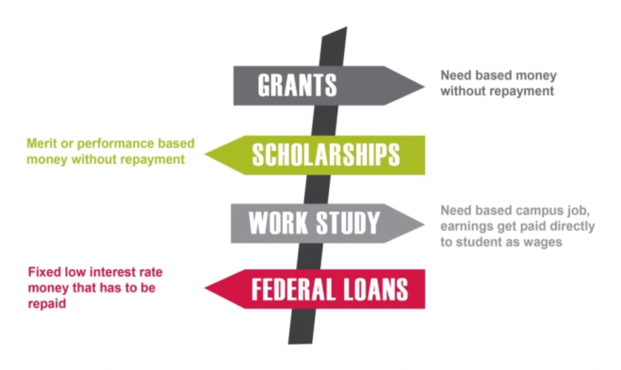
Public Policy Encouraging
Financial aid and scholarships encourage people to attend school who otherwise may not do so due cost

Slide 4
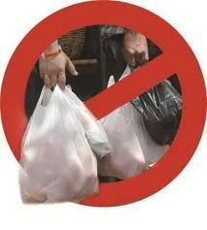
Public Policy Discouraging
High taxes on alcohol or cigarettes
Government forcing tobacco industry to advertise negative effects of smoking on packaging

Slide 5
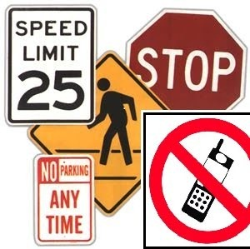
Public Policy Prohibiting
Banning smoking in public spaces such as restaurants
Fines for texting while driving or speeding

Slide 6

Public Policy Prescribing
A rule or order prescribed by an authority that controls or directs private behavior, often in relation to a standard or target.
Ex. Environmental standards for cars need to comply with California emission standards

Slide 7
What is government?
It is the only institution in society able to enforce its decisions on all others through the legitimate use or threat of force.

Slide 8
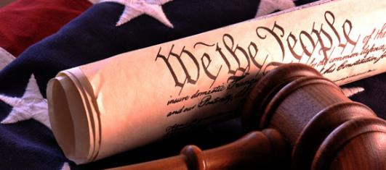
Why do we need government?
In a democratic society, why do we choose to have government tax us and make us do what we really don’t want to do?

Slide 9
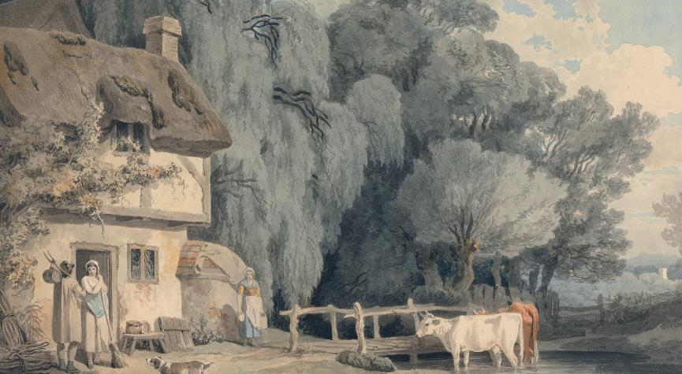
Tragedy of the Commons
Notes:
Garrett Hardin

Slide 10
Each farmer has a dairy herd that grazes on the village commons

Slide 11
Individual vs. collective interest – part 1
Individual is better off putting on as many cows as possible
Individual can benefit, while the cost is spread out over to everyone
Individual wants maximum benefit with minimum cost
Individual thinks adding one more cow will not kill off the village commons so there is no harm

Slide 12
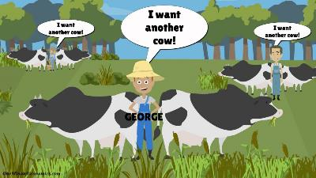
Why don’t individual farmers practice self-restraint?
Each farmer believes:
He cannot by his own efforts make or break the commons
He is not sure if other farmers will practice self-restraint so why should he

Slide 13
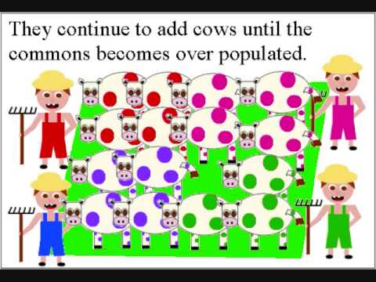
What is the solution to the tragedy of the commons?

Slide 14
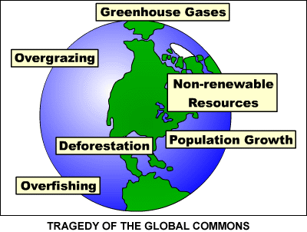
Individual vs. collective interest – part 2
It becomes rational to form a group that is able to coerce action to achieve a collective good, which would otherwise not be done voluntarily.
The group (our village govt.)
  can now levy taxes, hire guards
  to protect the commons, buy
  fertilizers, etc.

Slide 15
How does government achieve its goals?
    Directly
    Indirectly
    Voluntary Cooperation

Slide 16
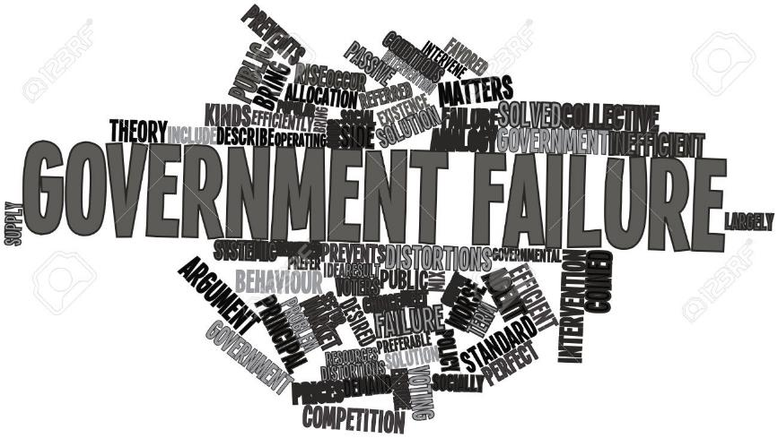
What happens when the government is unable to achieve the collective good?

Slide 17
Four Types of Government Failure
Problems inherent in direct democracy
Problems inherent in representative democracy
  Private self-interest
  Cost of monitoring
Problems inherent in bureaucratic supply
Problems inherent in decentralization

Slide 18
Four Types of Market Failure
Information asymmetry
Externalities
Natural monopolies
Collective/public goods

